Slide 1
Ohio College Tech Prep
West Regional Center
BAC Meeting
September 7, 2022

Slide 2
Agenda
9:00 a.m.
Introductions
Pam Hunt, West Region, Chief Administrator
9:15 a.m.
Business Advisory Councils Overview
Michelle Washington, ODE, Program Specialist – Office of Graduate Studies
9:45 a.m.
High-Impact Business Advisory Council Highlight
Bryan Stewart, MCESC Workforce Development Director
10:15 a.m.
Business Advisory Council Plan – Business-Education Leader Awards for Excellence – Overview and Development
Michelle Washington, ODE, Program Specialist – Office of Graduate Studies
10:45 a.m.
Feedback and Next Steps
Pam Hunt, West Region, Chief Administrator

Slide 3
Hello!
Pam Hunt
Ohio Tech Prep
Chief Administrator
West Regional Center
Sinclair College
pamela.hunt@sinclair.edu
C: 513.708.3726

Slide 4
Ohio Tech Prep West Regional Center - Coordinators
Tanisha Burns-Martin
Clark State College
burnst4442@clarkstate.edu
P: (937) 328-6451
Deb Holthaus
Edison State College
dholthaus@edisonohio.edu
P: (937) 778-7981

Slide 5
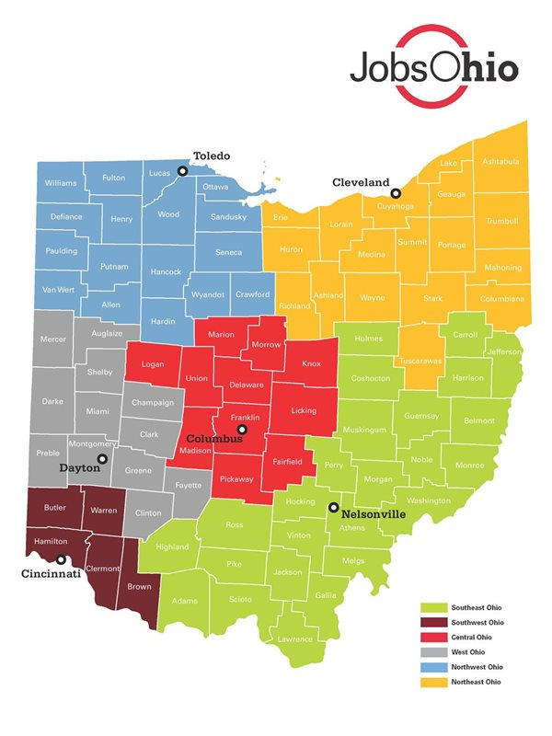
About Us
The six Ohio Tech Prep Regional Centers serve as the liaison to Ohio's 91 career-technical planning districts, 23 community colleges and 14 universities to ensure high-quality career-technical education programs for students.
New Grant Goals
Business Advisory Councils
Increase Business Partners
Assist BACs in achieving 3- or 4-star status
The Tech Prep Regional Centers are jointly managed by the Ohio Department of Higher Education and the Ohio Department of Education’s Office of Career-Technical Education

Slide 7
Montgomery County Educational Service Center
Bryan Stewart
Workforce Development Director
Bryan.Stewart@mcesc.org

Slide 9
Next Steps and Feedback

