Slide 1
Pre-Apprenticeship: Growing Local Talent

Slide 2
Introductions
Todd Schilling – Pre-Apprenticeship Coordinator: Sinclair

Slide 3
Overview
Pre-Apprenticeship Overview
Successes and Areas of Growth
Sinclair’s Role
Building a Successful Program
Establishing Business Partners

Slide 4
Pre-Apprenticeship
Pre-apprenticeship is an opportunity to provide high school students with the basic technical and job readiness skills in preparation to enter a Registered Apprenticeship program.
The best pre-apprenticeship programs are set up with close collaboration between the high schools, employers and Sinclair’s Office of Work-based Learning.
The purpose of this program is to provide the students with in-depth exposure to a career field that he/she may be interested in pursuing after high school.

Slide 5
Pre-Apprenticeship: Benefits
OSAC Recognized Pre-Apprentice completers earn a 12-point graduation credential and created more pathways to graduation.
Creates a career pathway to an in-demand occupation/career for students.
Earned OJT hours and Related Instruction may be credited towards the completion of a Registered Apprenticeship.
Secondary Schools build positive and lasting relationships with industry.
Employers participating in Registered Apprenticeship gain access to a pipeline of motivated, career oriented individuals.

Slide 6
Pre-Apprenticeship Successes
Students are getting real world experiences with industry partners
Business Partners are beginning to recognize the importance to working with high school students
Innovative Programs
Students obtaining graduation requirements
Provides students with opportunities outside the traditional pathways
Collaboration

Slide 7
Pre-Apprenticeship Areas of Growth
Building business partners
Establishing a program to fit your students
Student access to resources

Slide 8
Sinclair’s Role
Serve as Registered Apprenticeship Sponsor
Assist with Design and Implementation of Pre-Apprenticeship Program
Assist in Building Industry/Business Partners
Co-Tracking Students
Transitioning Students to Registered Apprenticeship or one of Sinclair’s Programs

Slide 9
Establishing the Pipeline

Slide 10
Transitioning to Next Steps
Pre-Apprentice
Continue with Current Employer
Exploring Career Options in Different Field
Continue in Career Field – Seeking New Employer

Slide 11
Sinclair’s Office of Work-based Learning
Steps to Getting Started

Slide 12
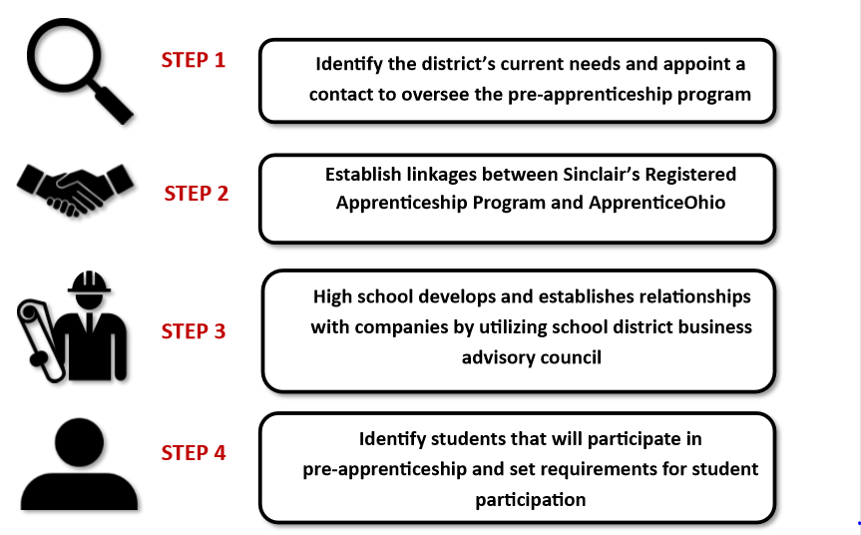
Pre-Apprenticeship

Slide 13
Operating Plan Overview
The Components of an OSAC Recognized Pre-Apprenticeship Operating Plan
Section A: Equal Opportunity Pledge
Section B: Enrollment
Section C: Instructional Content
Section D: Participant Status
Section E: Safety and Welfare
Section F: Program Administration
Section G: Linkage(s) to Registered Apprenticeship
Section H: Registered Apprenticeship Linkage Letter(s)

Slide 14
STEP 1: Identify POC
Identify the District’s current need(s) and area(s) of discipline and appoint a primary point of contact to oversee the pre-apprenticeship program.

Slide 15
STEP 2: Establish linkages
Establish linkages between Sinclair’s Registered Apprenticeship Program, other Registered Apprenticeship programs and Apprentice Ohio.

Slide 16
STEP 3: Build Relationships
The high schools begin to build relationships with local companies utilizing their own school district business advisory councils. Can also use companies that are currently partnering with Sinclair.

Slide 17
STEP 4: Identify Students
Identify students that are interested and willing to participate in the pre-apprenticeship. Create requirements and setup expectations for student participation.

Slide 18
Working with Businesses
Establish partnerships with companies
BAC, Chamber of Commerce, Sponsors
Work with company to design unique opportunities
Understanding minor labor laws
SB 166
Sinclair is here to help!

Slide 19
What is the role of the Employers?
Companies must establish Signatory Employer relationship with Sinclair
Work with high school partners to provide work-based learning opportunities
Design learning experiences for students to learn the career field
Work with the high school contacts to report students progress
Provide students opportunities after graduation

Slide 20
Questions

Slide 21
Contact Information
Todd Schilling
Email: todd.schilling@Sinclair.edu
Phone: 937-512-3355

Slide 22
Thank you!

