Slide 1
North Point Educational
Service Center

Slide 2
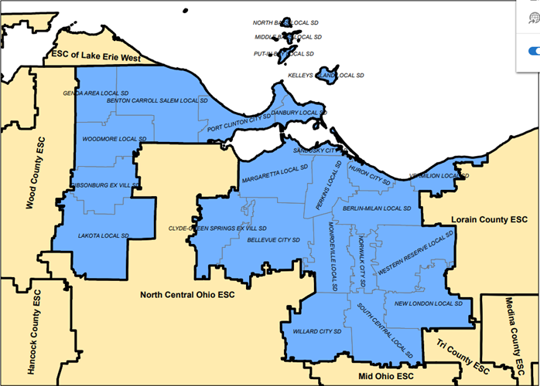
Regional Steering Committee : 23 leaders representing education, business and the economic sectors of each county in the NPESC footprint.
WHO WE ARE:
The mission of the North Point Educational Service Center Business Advisory Council is to engage the business and education communities to understand and support the educational and employment needs within the service region of Erie, Huron, Ottawa and Sandusky Counties.

Slide 3
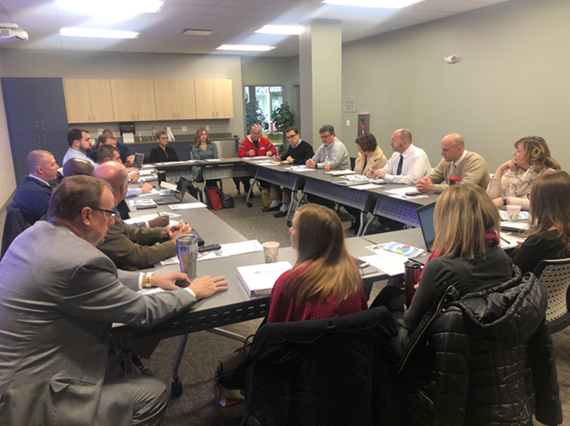
STRUCTURE:
Regional BAC Steering Committee meets quarterly.
County Committees meet 6 - 8 times per year:
Erie County
Huron County
Ottawa County
Sandusky County

Slide 4
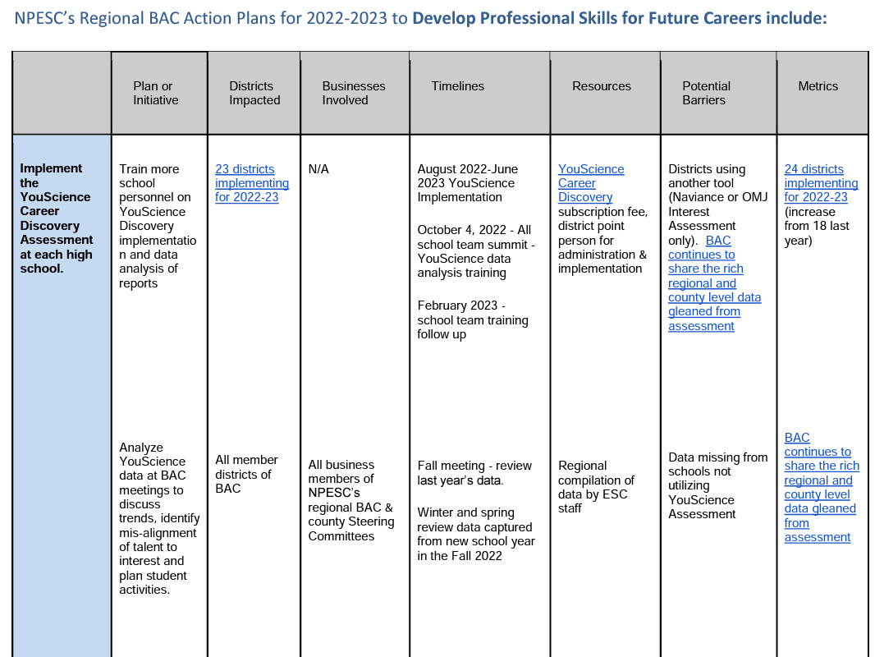
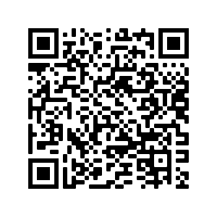
Tips for PLAN Development:
Align strategies to each of ODE’s three goals: Develop Professional Skills, Build Partnerships, & Coordinate Experiences
Use ODE’s suggested format
Include Metrics and indicate growth over previous years

Slide 5
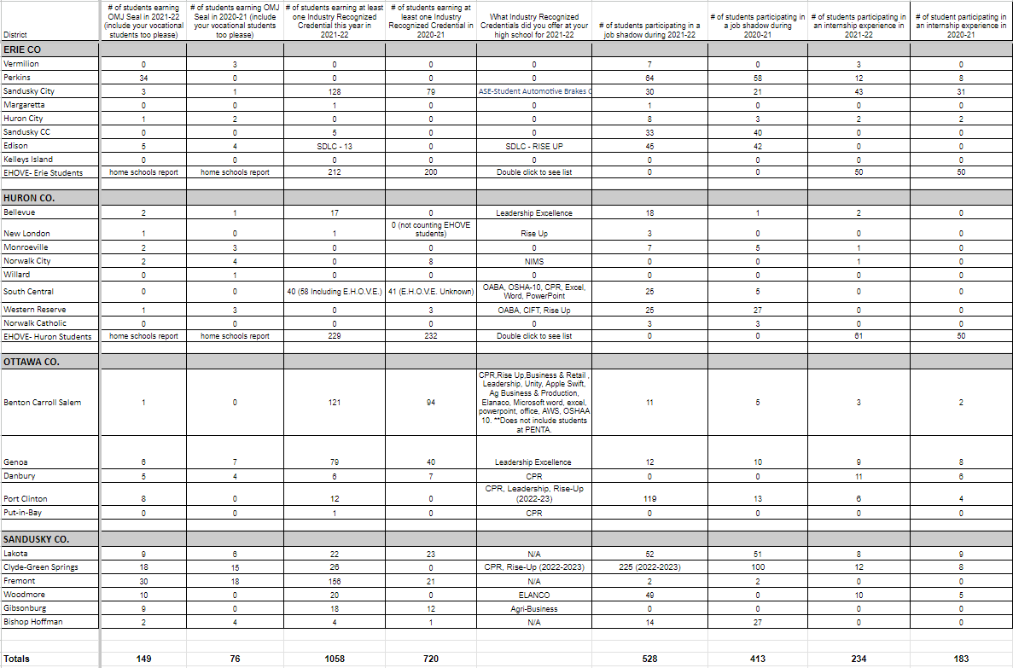
Collect Data and Celebrate Growth
Tip:
Use Google Sheets to help you

Slide 6
Keys to our Momentum:
Partnerships
Consistent Leadership
Early “wins”
Common Purpose
Branding
Data to drive work

Slide 7
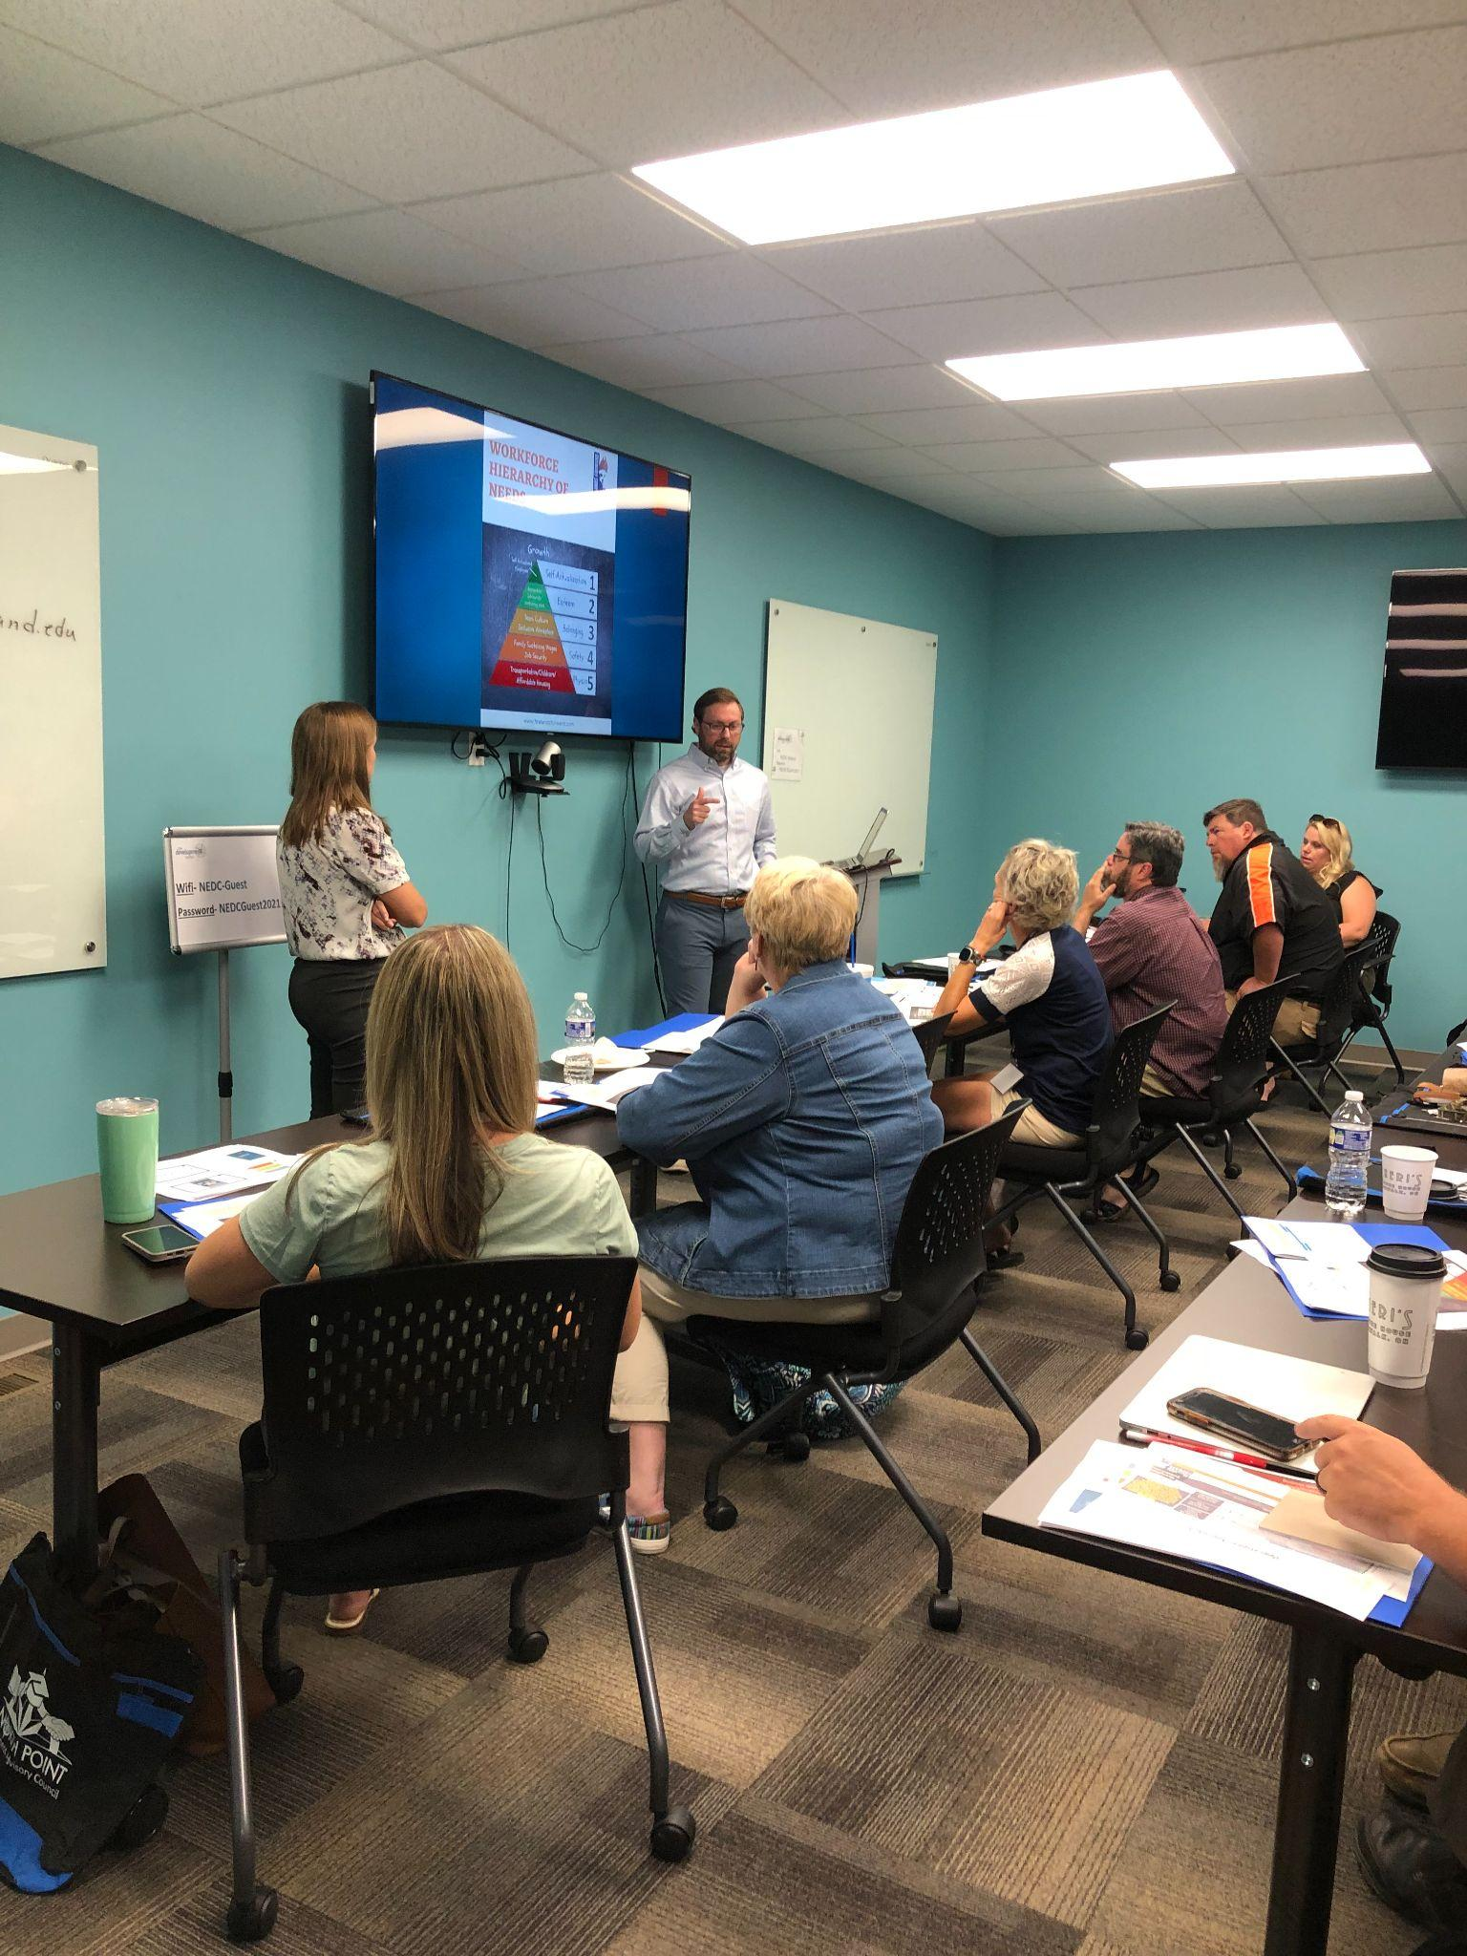
ECONOMIC DIRECTORS
OUR CRITICAL PARTNERS!!

Slide 8
YouScience Career Discovery
https://www.youscience.com/discovery/
Aptitude and Interest Career Discovery Tool
24 Districts Using (up from 18 in 2021-22)
9 Districts piloting the MS “Snapshot” tool this year (up from 1 in 2021-22)
Aggregated Reports -- County Analysis
Targeted student experiences
Employer Connections Portal/ “Opportunities”

Slide 9
Questions?
Contact:
Andrea Smith, Assistant Superintendent: asmith@npesc.org
Tim Myers:

