Slide 1
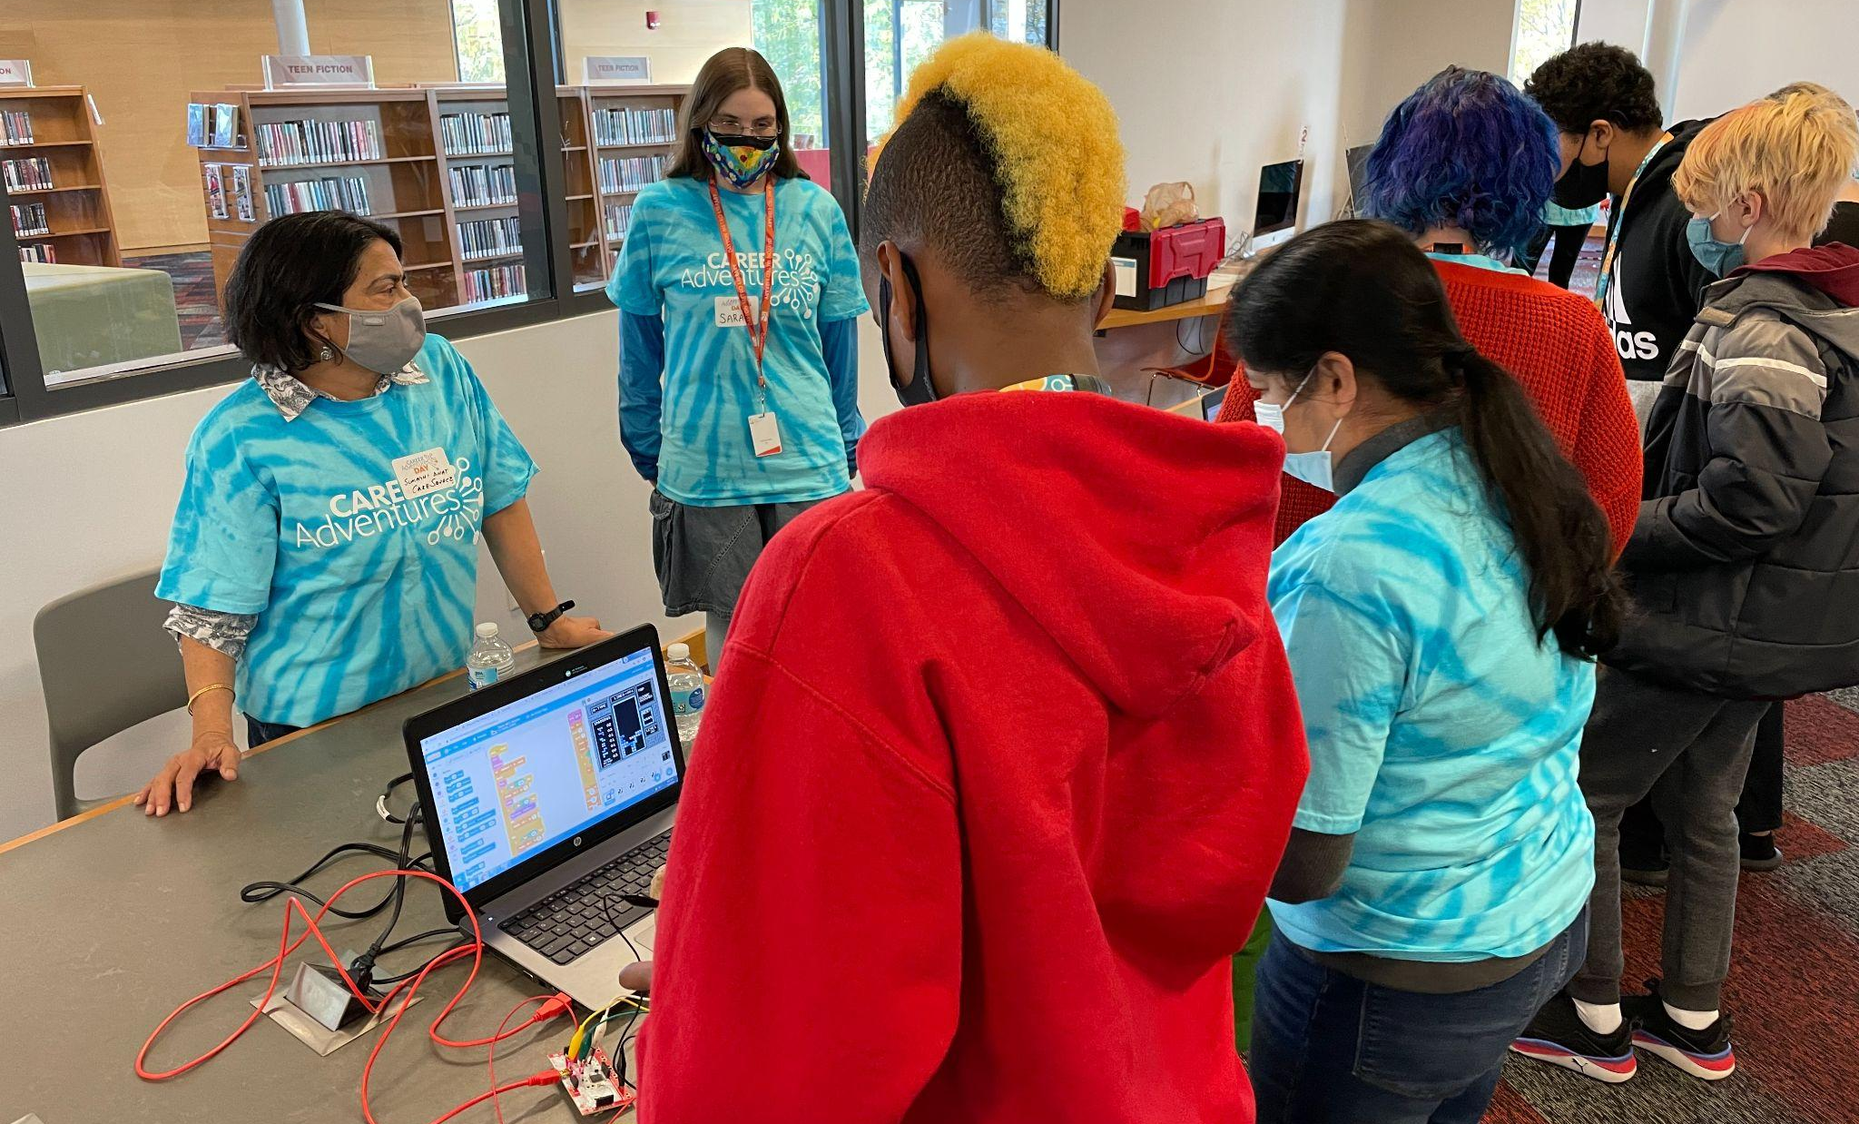
High Impact Business Advisory Council Highlight

Slide 2
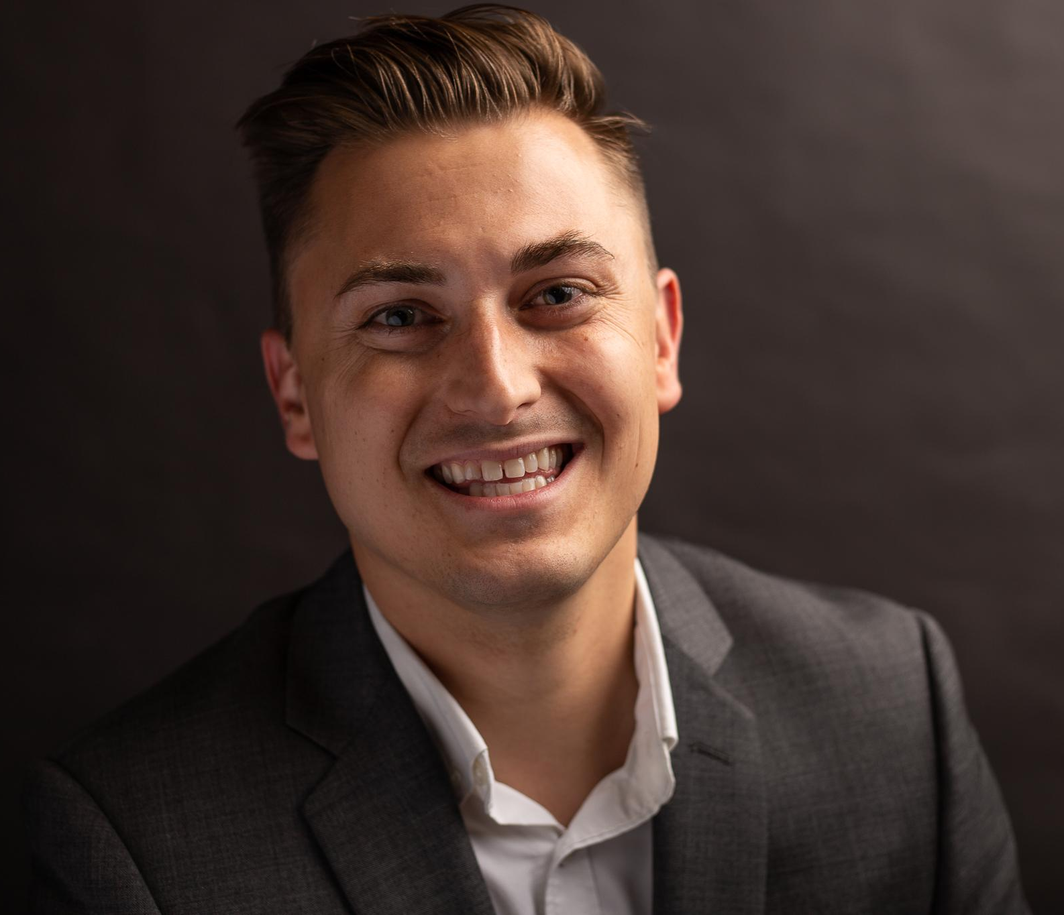
Presenter Info:
Bryan Stewart
Workforce Development Director
Bryan.Stewart@mcesc.org

Slide 3
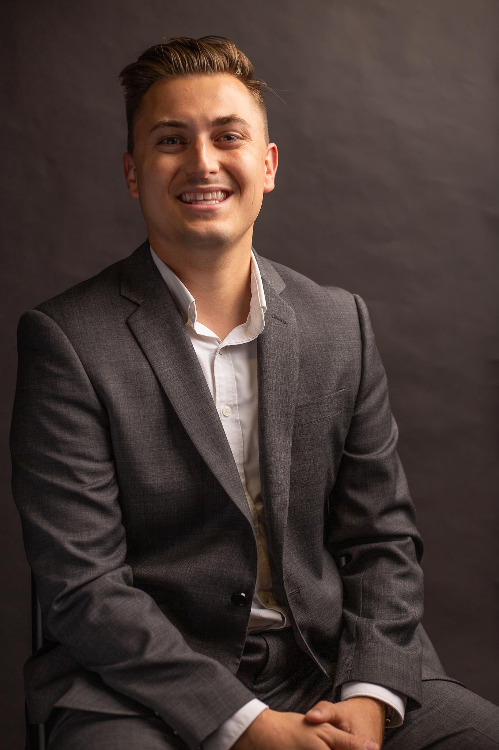
A little bit about me:
Degree in Diplomacy & Global Politics from Miami
Master of Public Administration from UD
Die hard Cincinnati Bengals fan
Science fiction lover
I have an ecommerce retail business and love exploring our state’s entrepreneur scene.

Slide 4
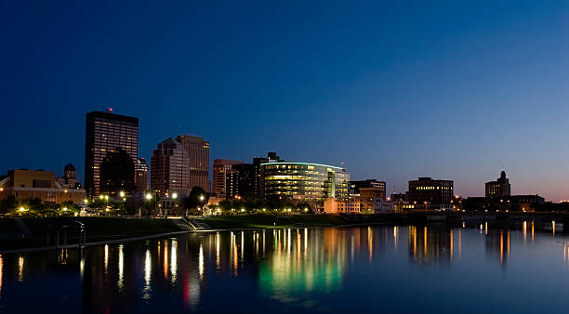
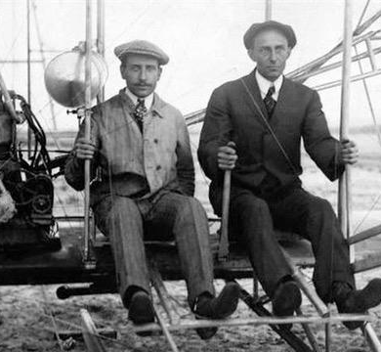

Slide 5
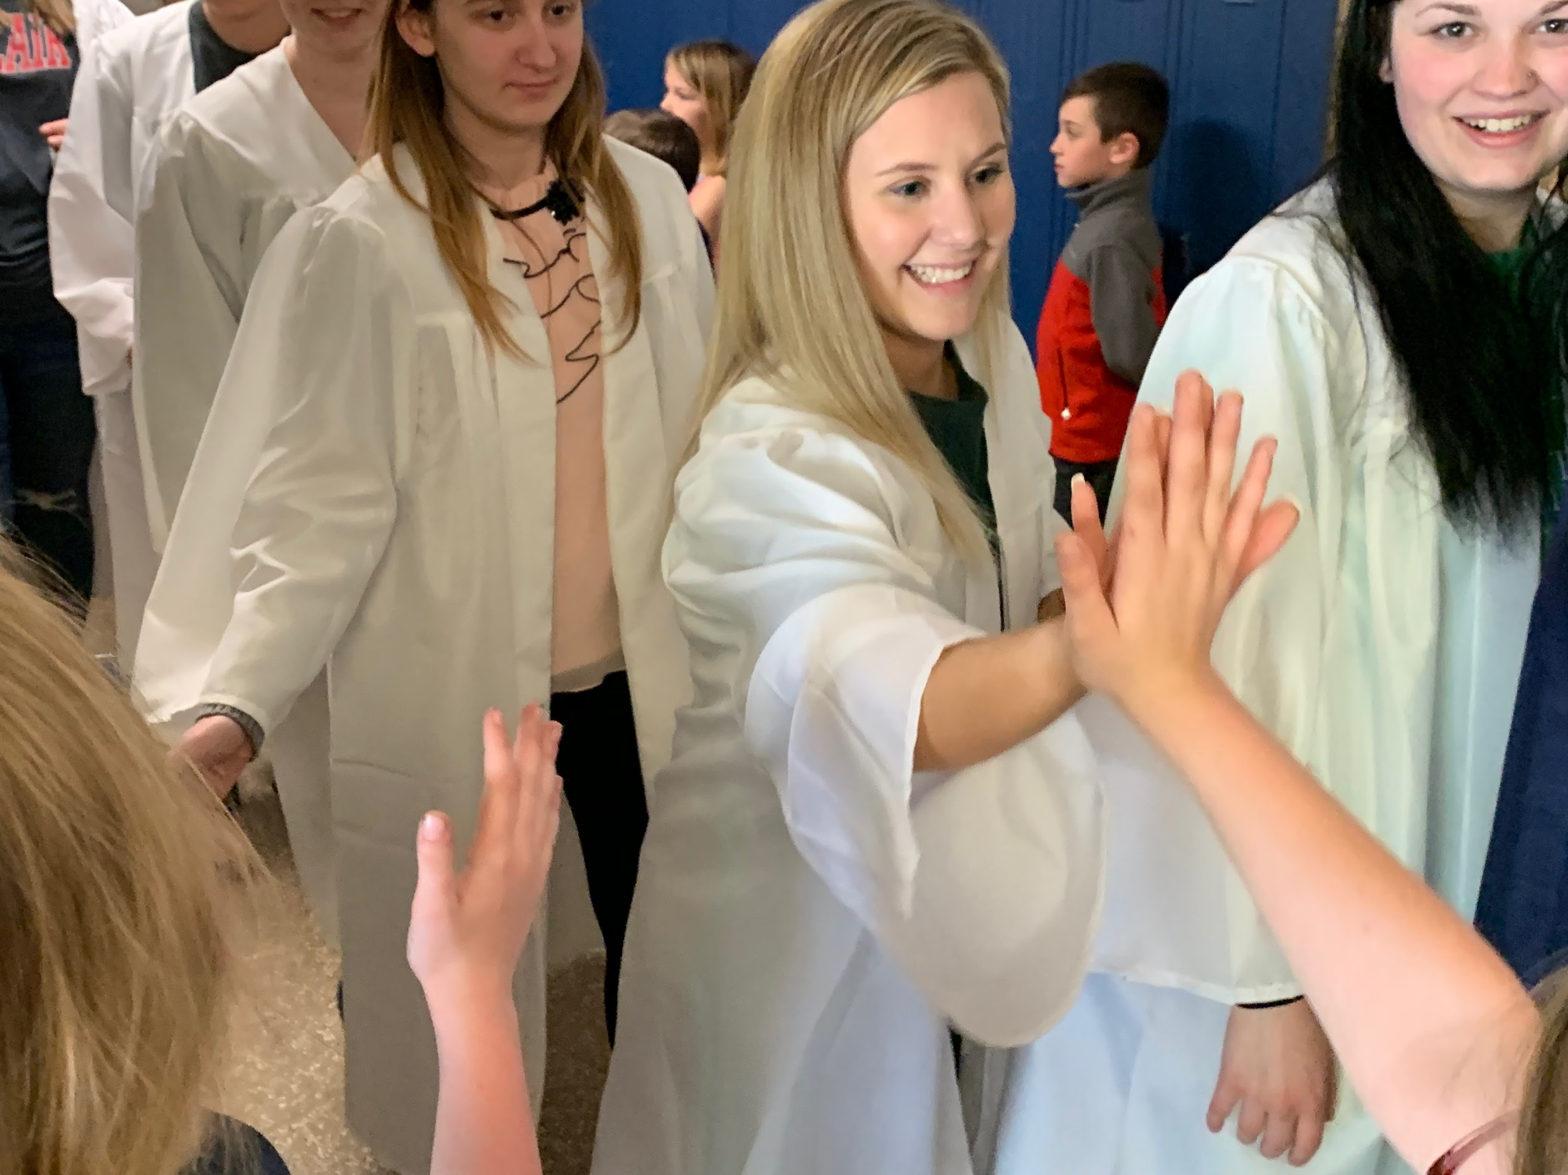
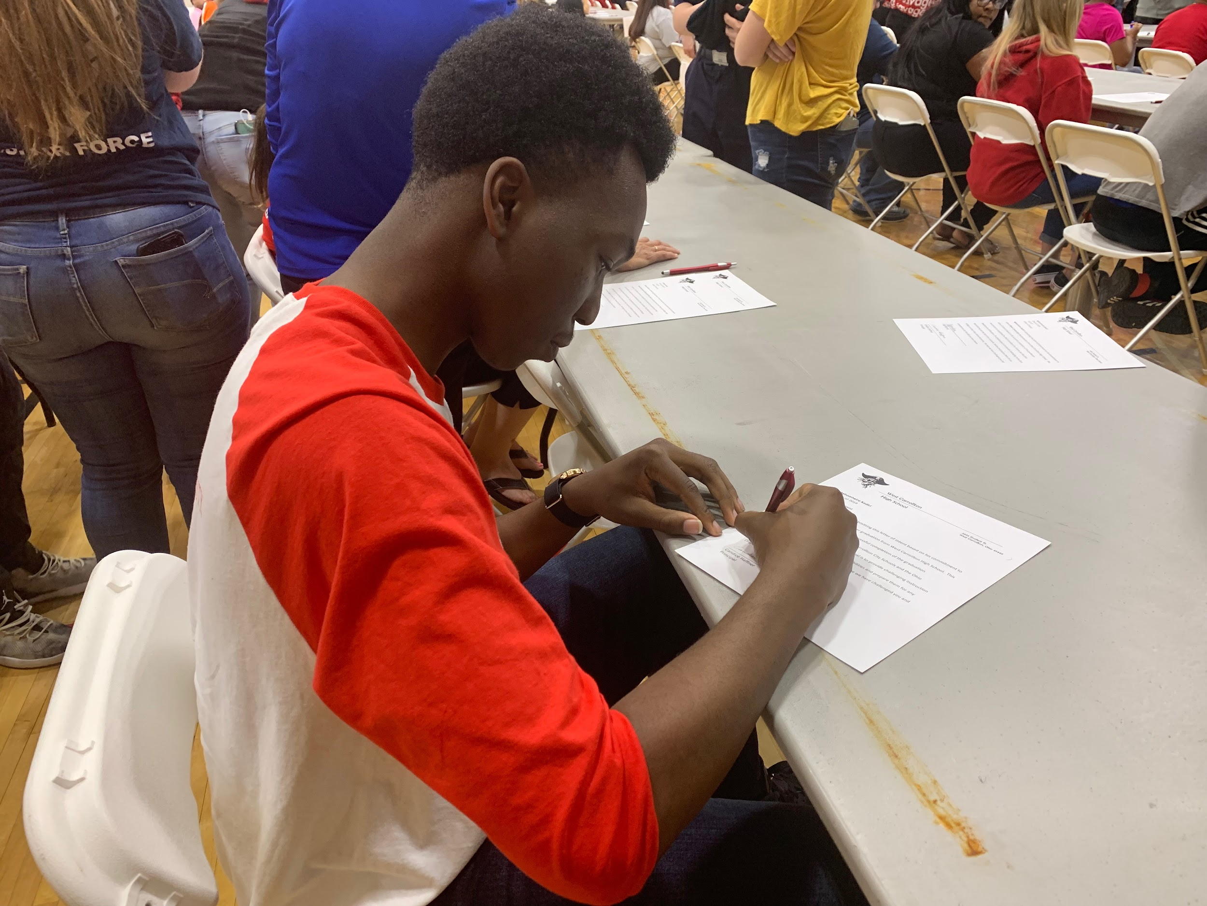
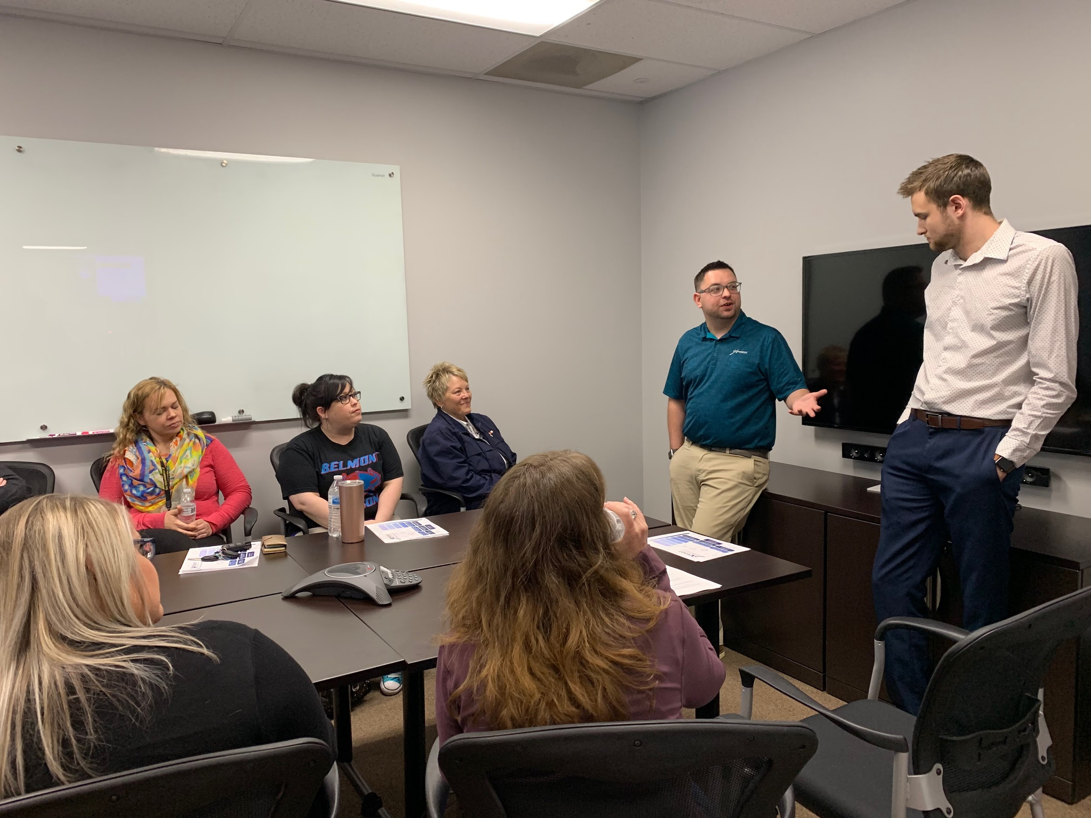
Montgomery County ESC Business Advisory Council
Ensuring our workforce can compete by enhancing partnerships between schools, higher education and employers
Ensuring student success and career-readiness
Helping existing and new businesses thrive
Keeping talent in our region
Making Montgomery County & Warren County great places to live and work

Slide 6
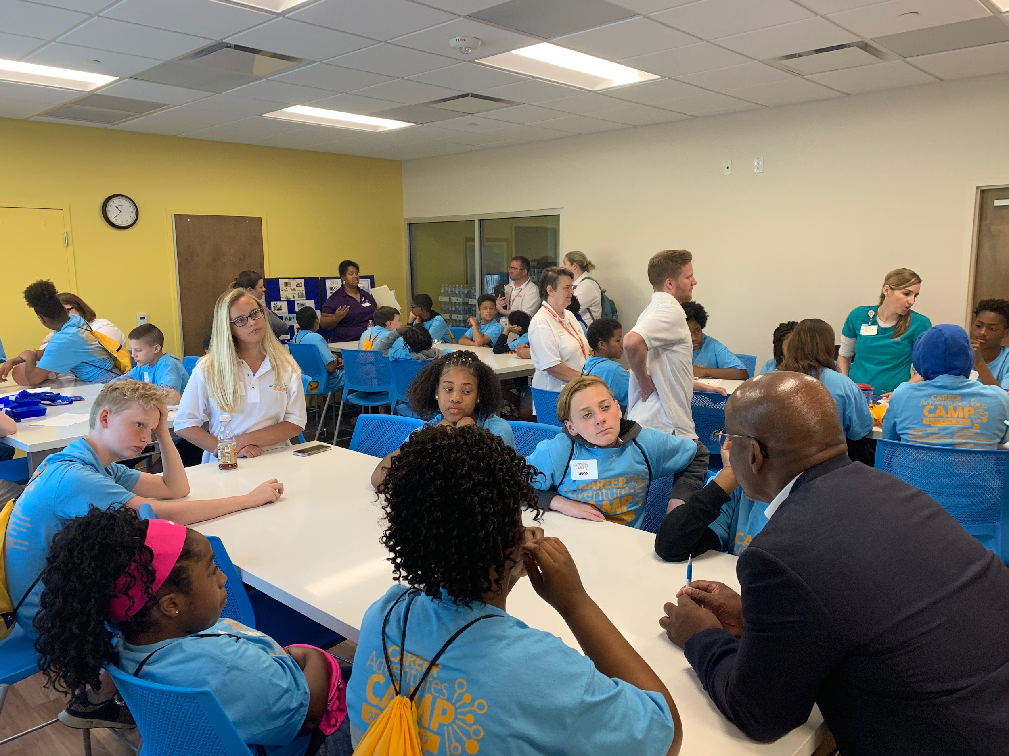
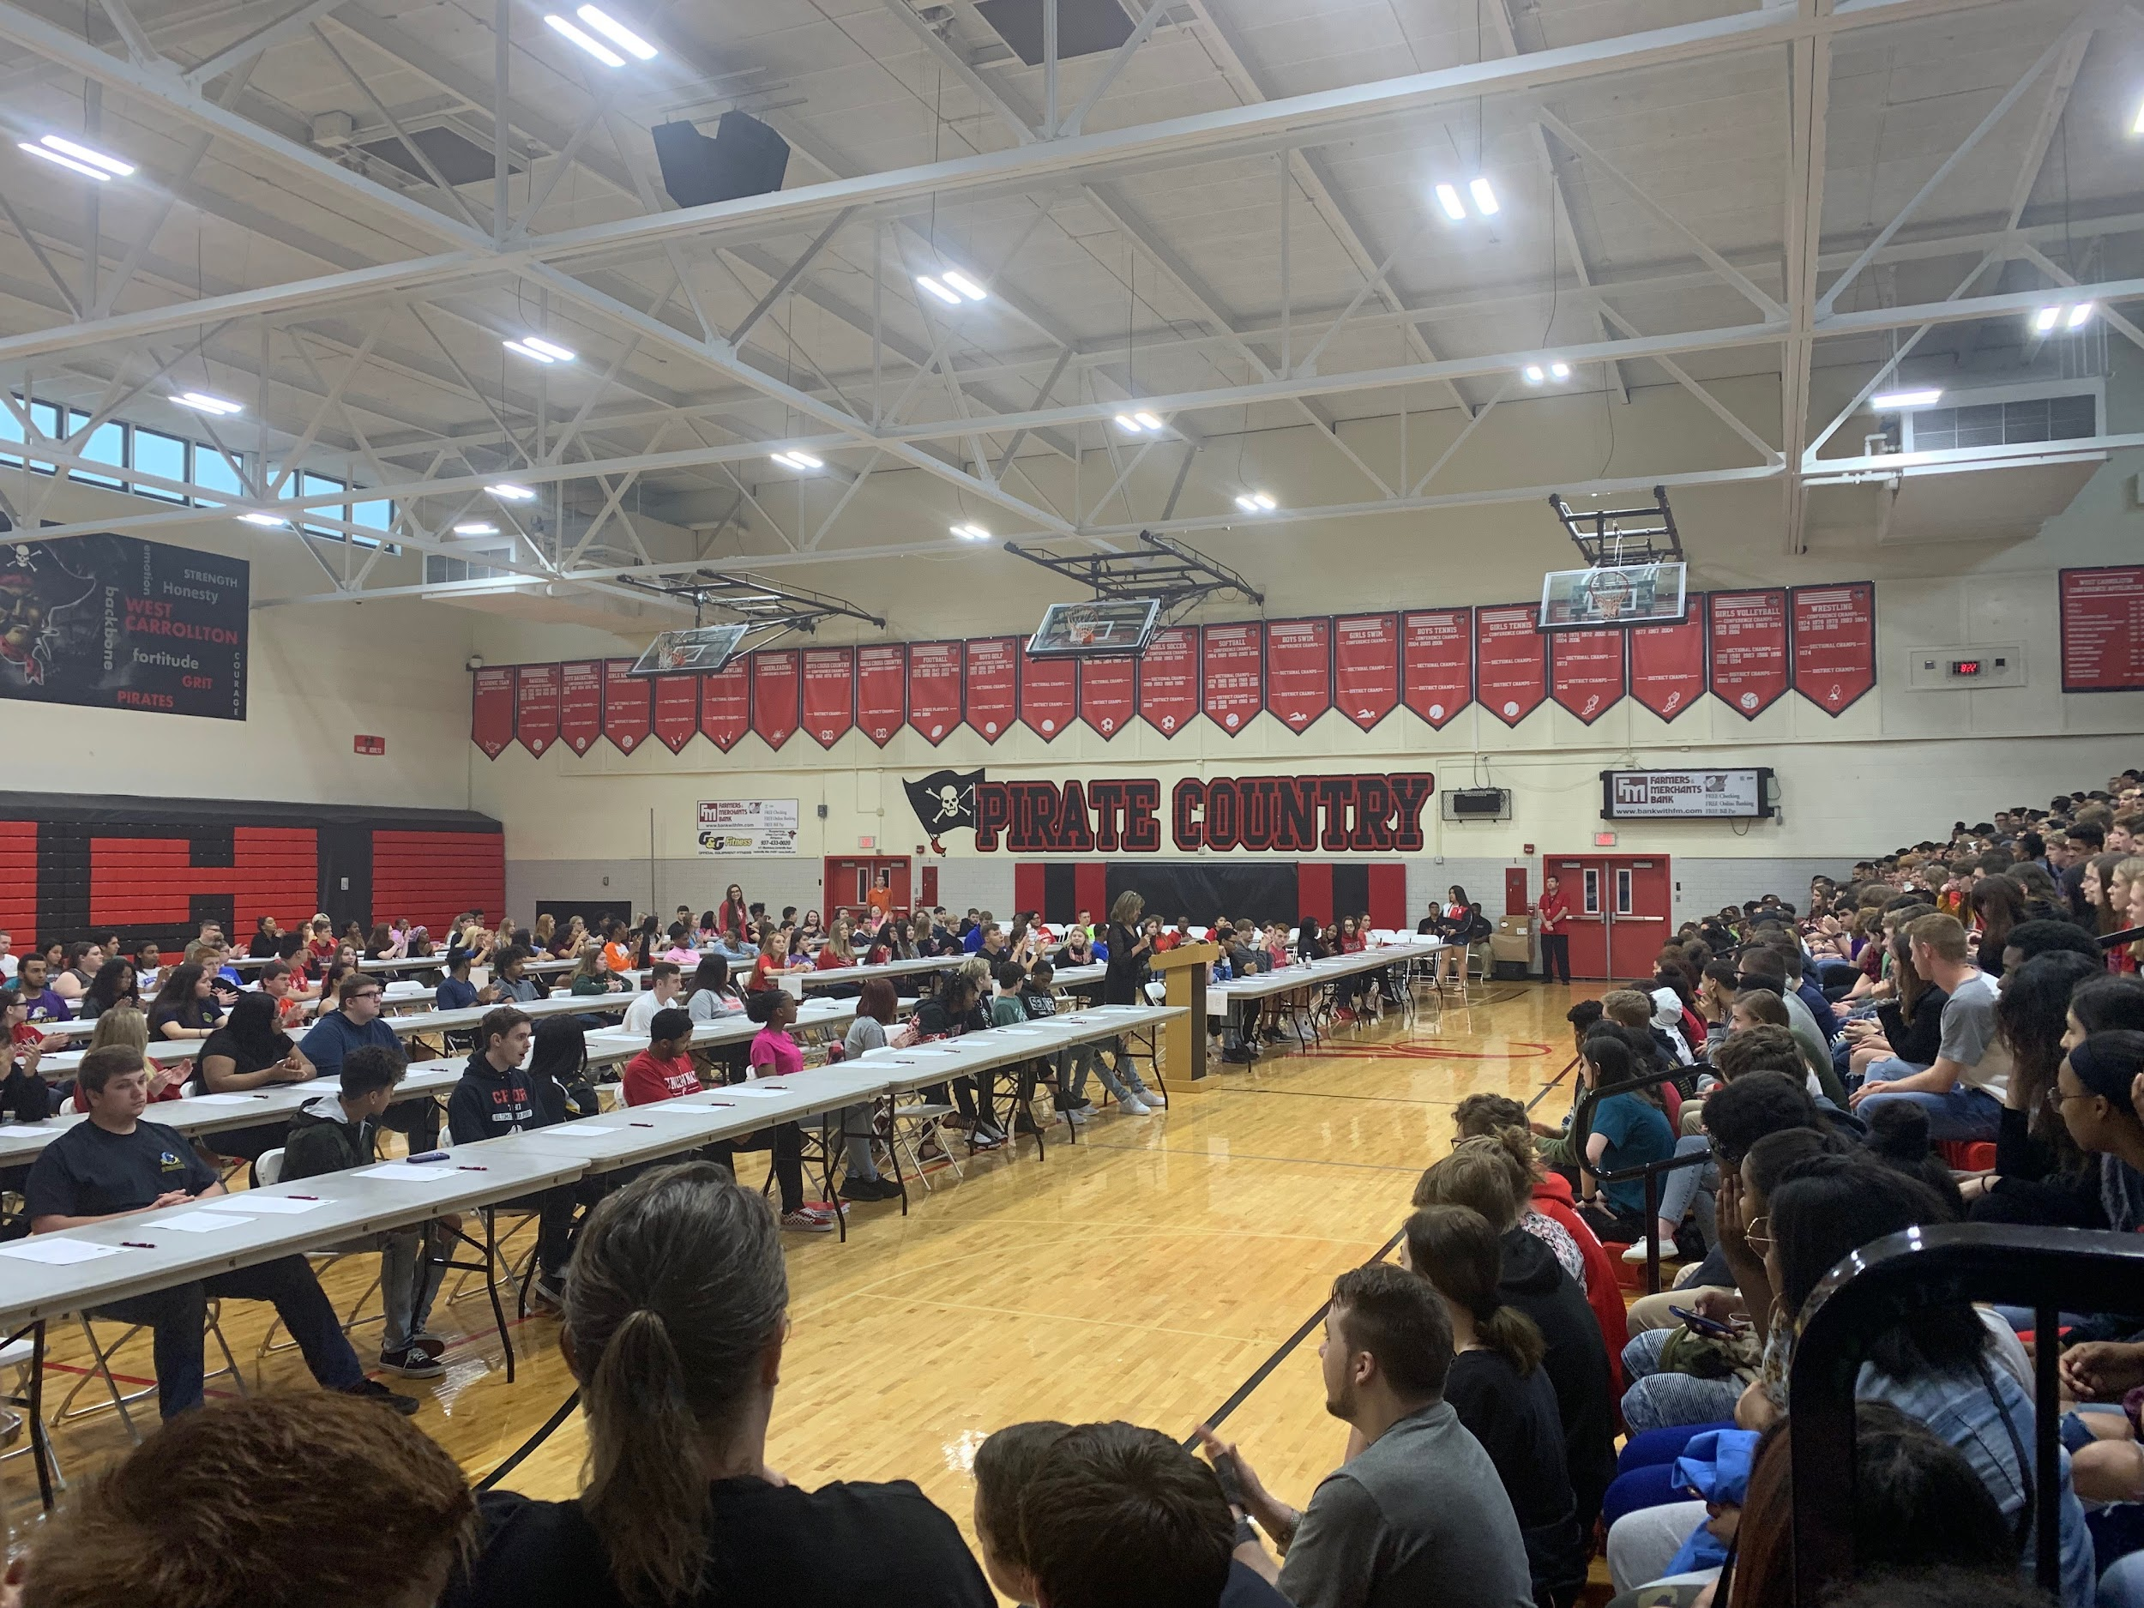

Slide 7
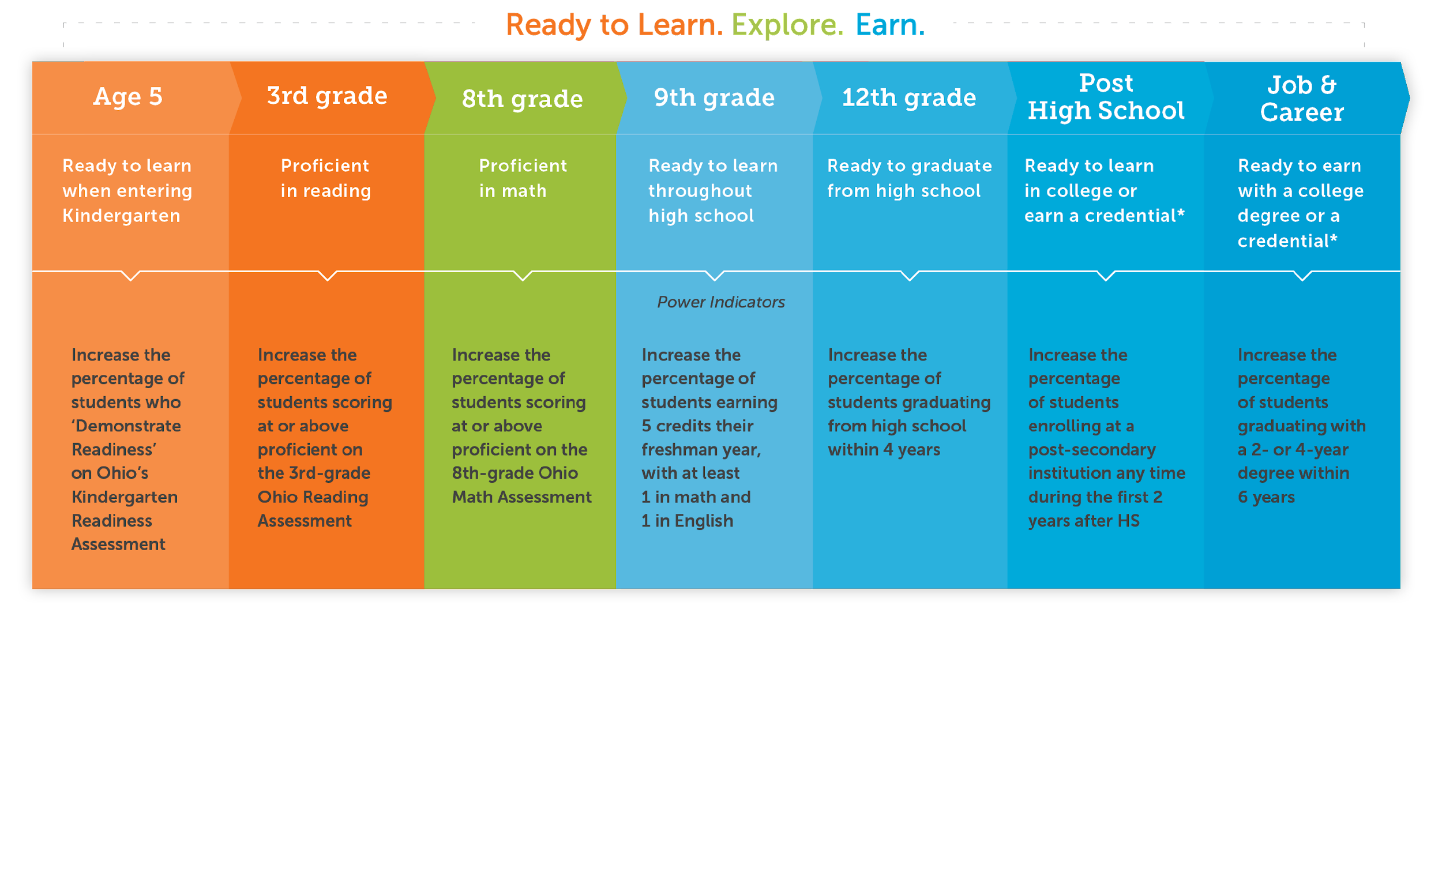
Ensuring Students Success
From Cradle to Career

Slide 9
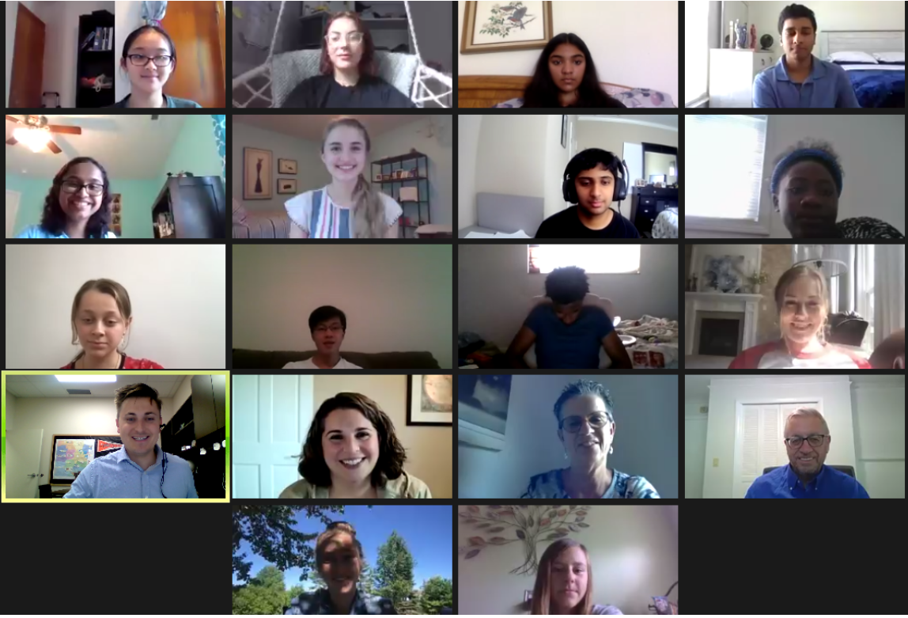
Our BAC represents 77,000+ Students

Slide 10
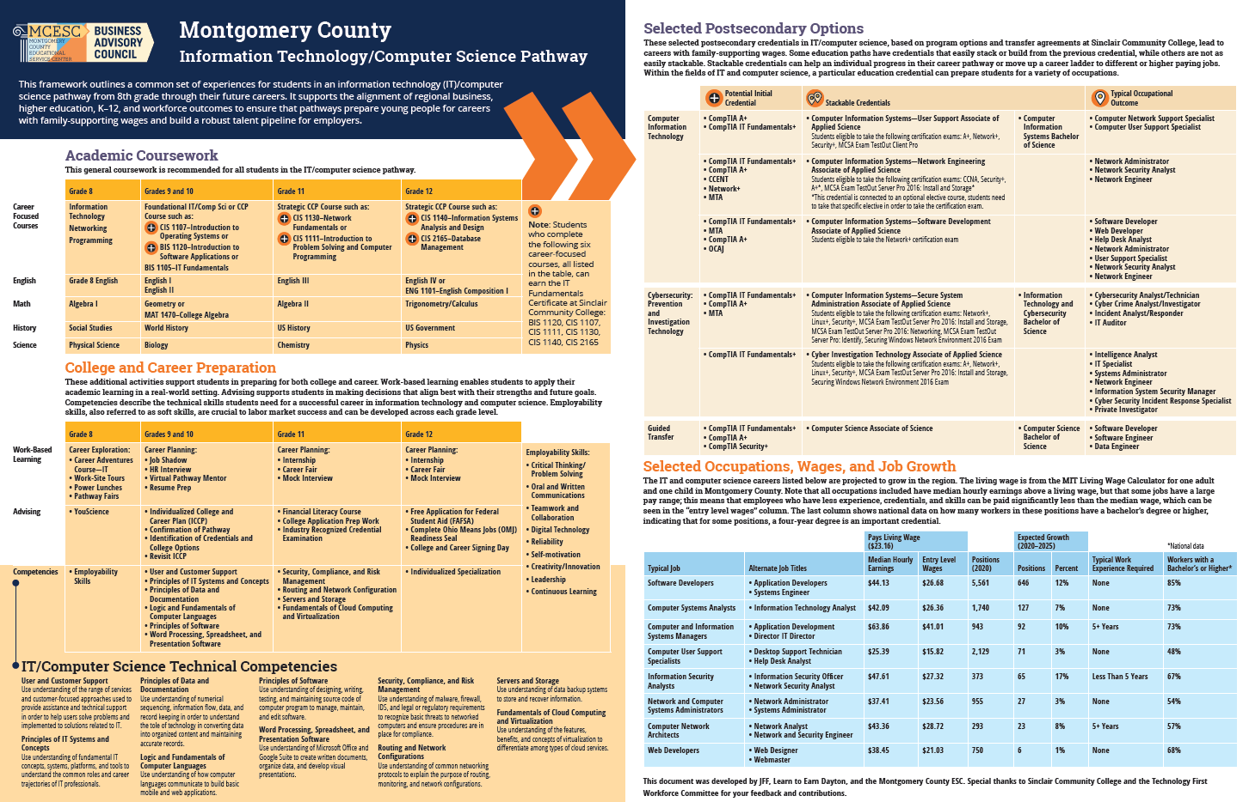

Slide 11
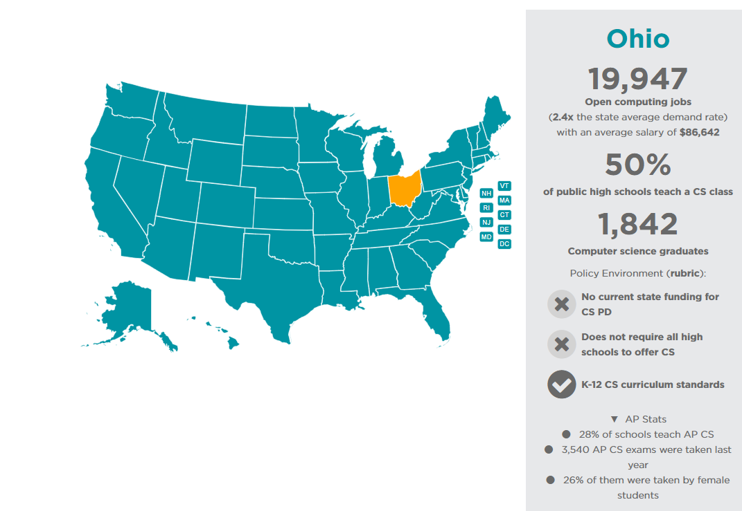
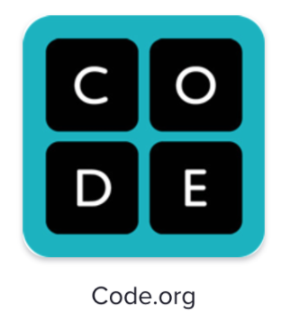

Slide 12
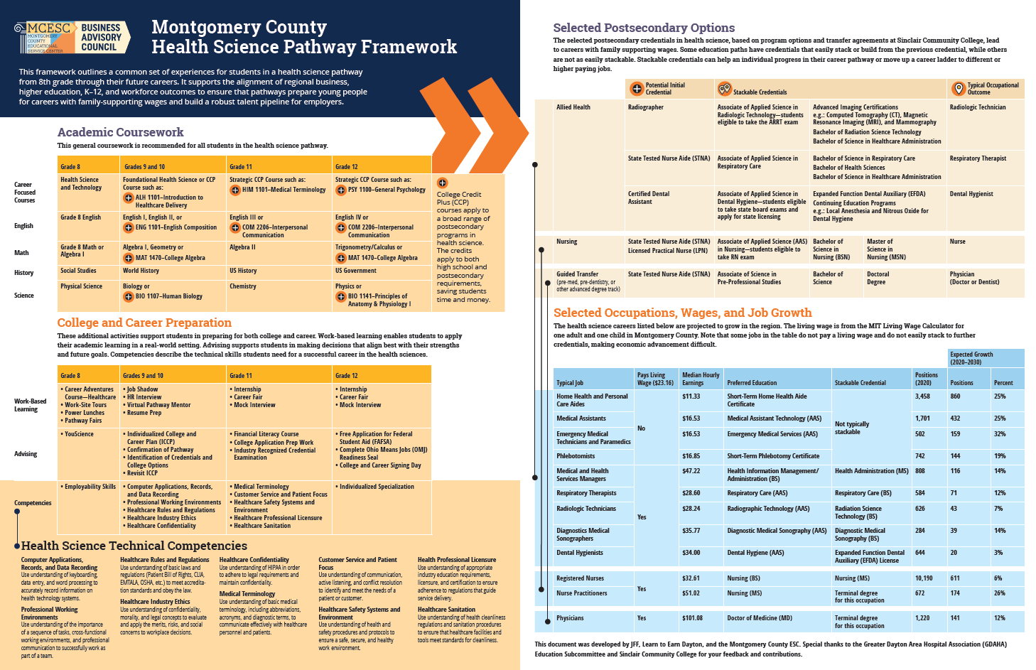

Slide 13
Education
Entrepreneurship
EMS/Fire/Police

Slide 14
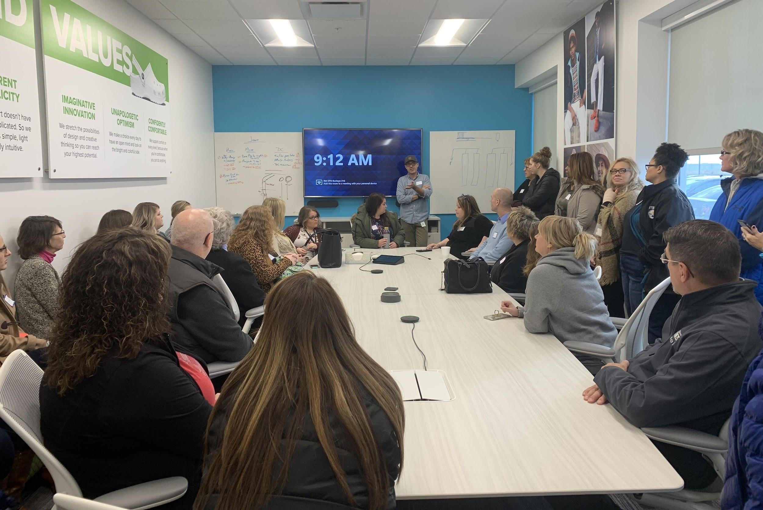
Career Champions and Counselors Academy
Crocs Distribution Center Tour on Nov. 19th 2019
Notes:
The work we do on the Business Advisory Council is done in concert with partners in K-12 Education and the larger community and major industries in our region.

Slide 15
Our Career Connections Weeks of Action
Notes:
The work we do on the Business Advisory Council is done in concert with partners in K-12 Education and the larger community and major industries in our region.

Slide 16
Construction Appreciation Week - Sept. 19th - 23rd
Please contact your partners in construction to
ensure your districts participate this year.

Slide 17
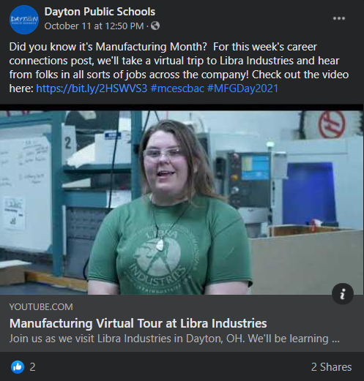
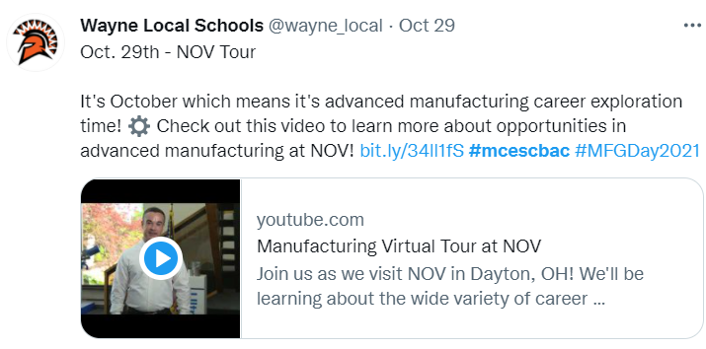
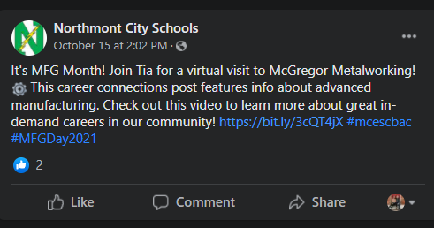
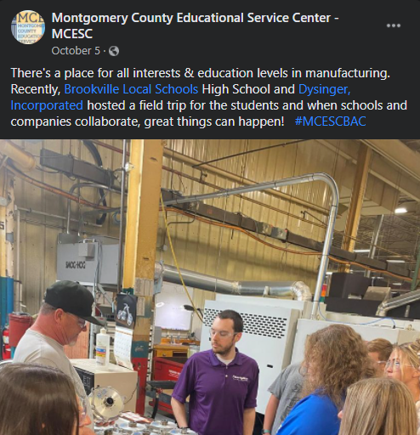
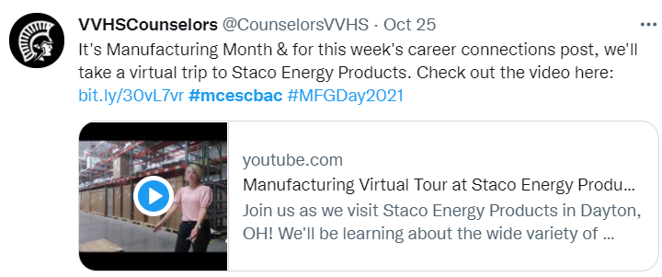
MFG Month - October

Slide 18
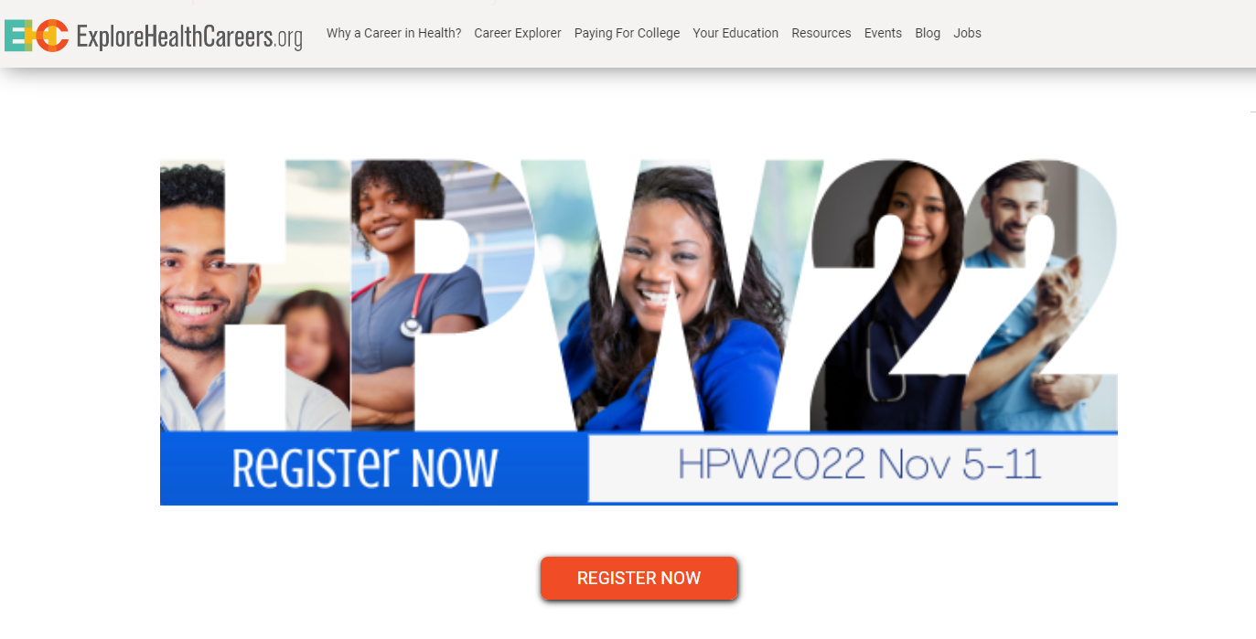

Slide 19
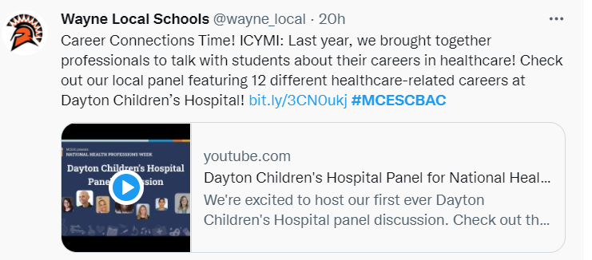
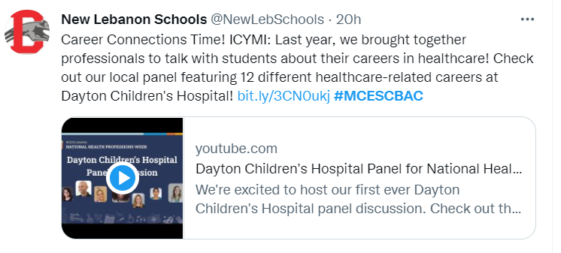

Slide 20
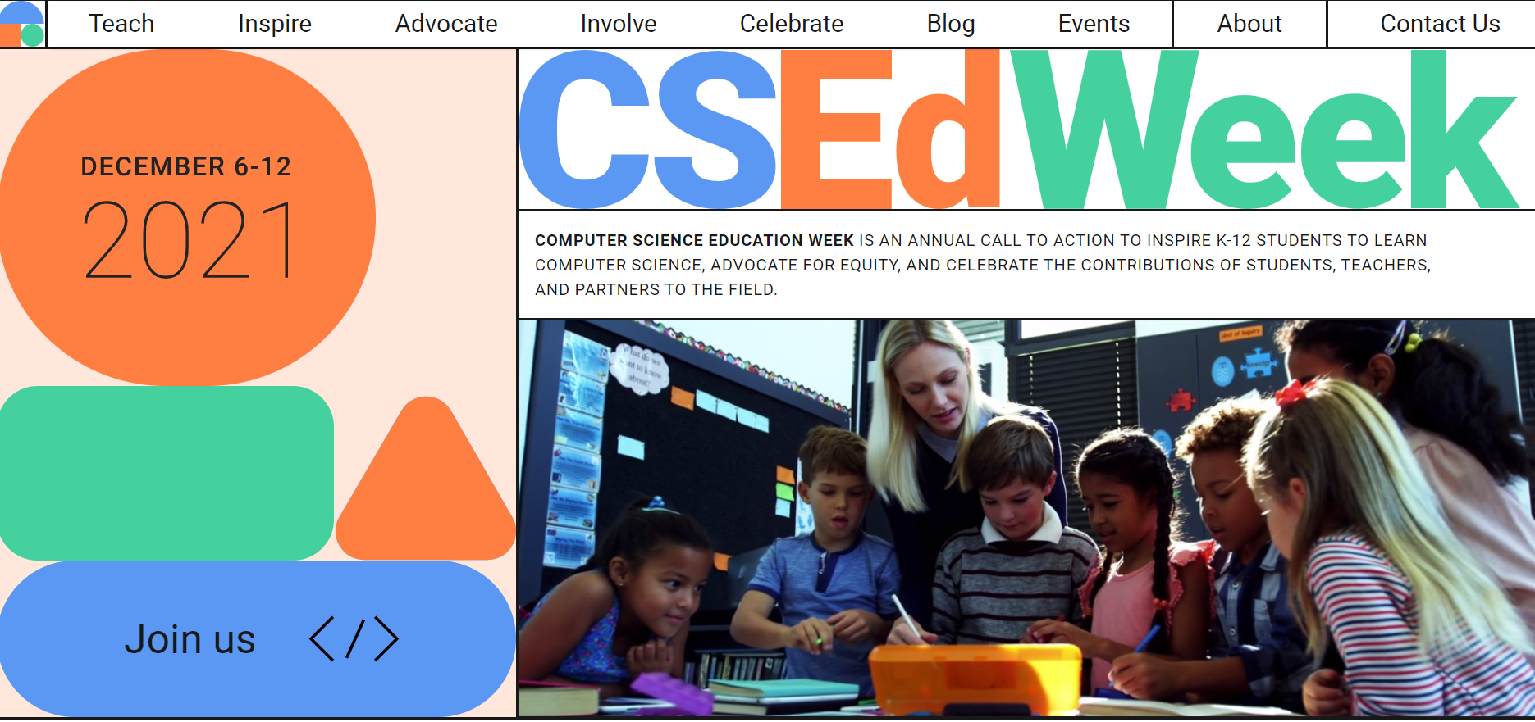
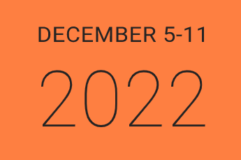

Slide 21
Our Six Working Groups
Educator Engagement
Parent & Community Engagement
Industry Engagement
Student Engagement
Policy & Advocacy
Warren County Specific Efforts

Slide 22
Expanding access to resources like:
So we can track and support you our BAC partner districts better!

Slide 23
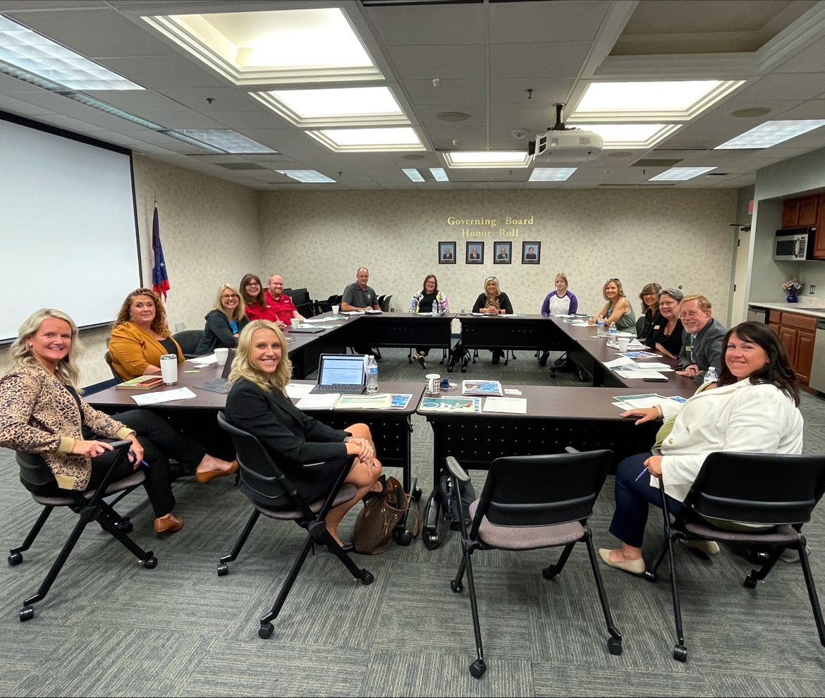
Lean into topics where there is a lot of energy and interested parties!
Financial literacy!

Slide 24
Submitting your plan!
Recognize this isn’t just a reporting document - it’s a guiding resource!
Allows your region to develop a coherent message!
Consider leveraging a graphic designer!
Meet with your major stakeholders to review your plan each fall!

Slide 25
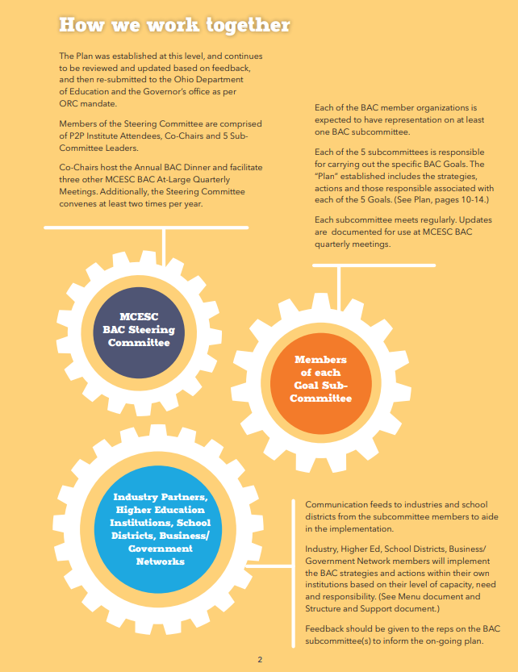
Leverage folks
from major institutions
We have 6 different working groups.
We invite folks from the private sector, higher-ed, the non-profit space, and neighborhood leaders!
Map out what you’re trying to do!

Slide 26
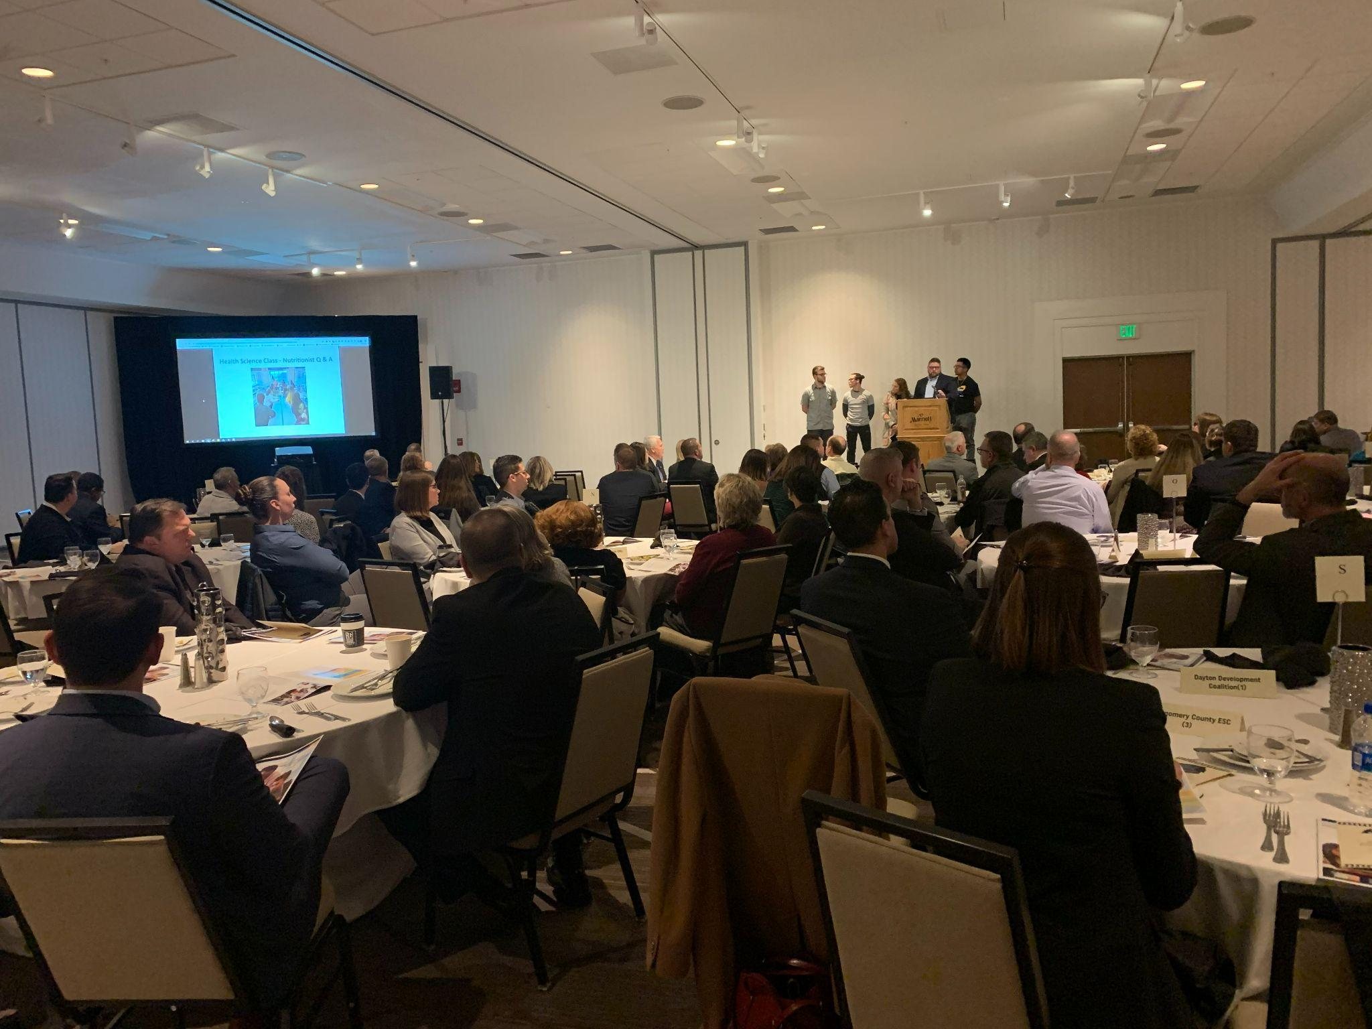
Leveraging an Annual Dinner with local leaders, highlight a district partner, and invite a keynote speaker!

Slide 27
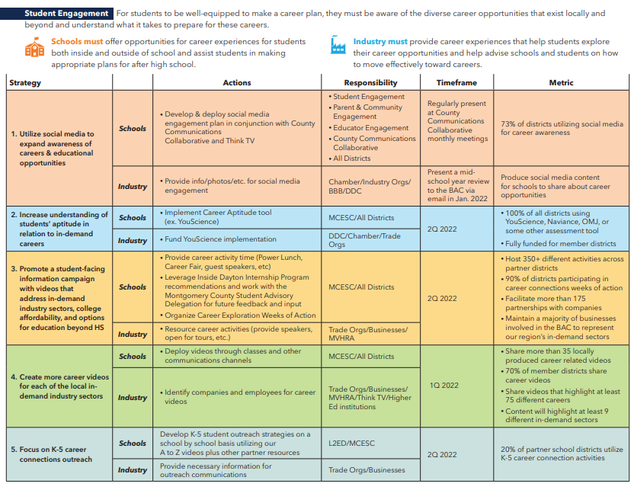
We recommend you include specifying: Strategy, Actions, Responsibilities, Timeframe, and Metric!

Slide 28
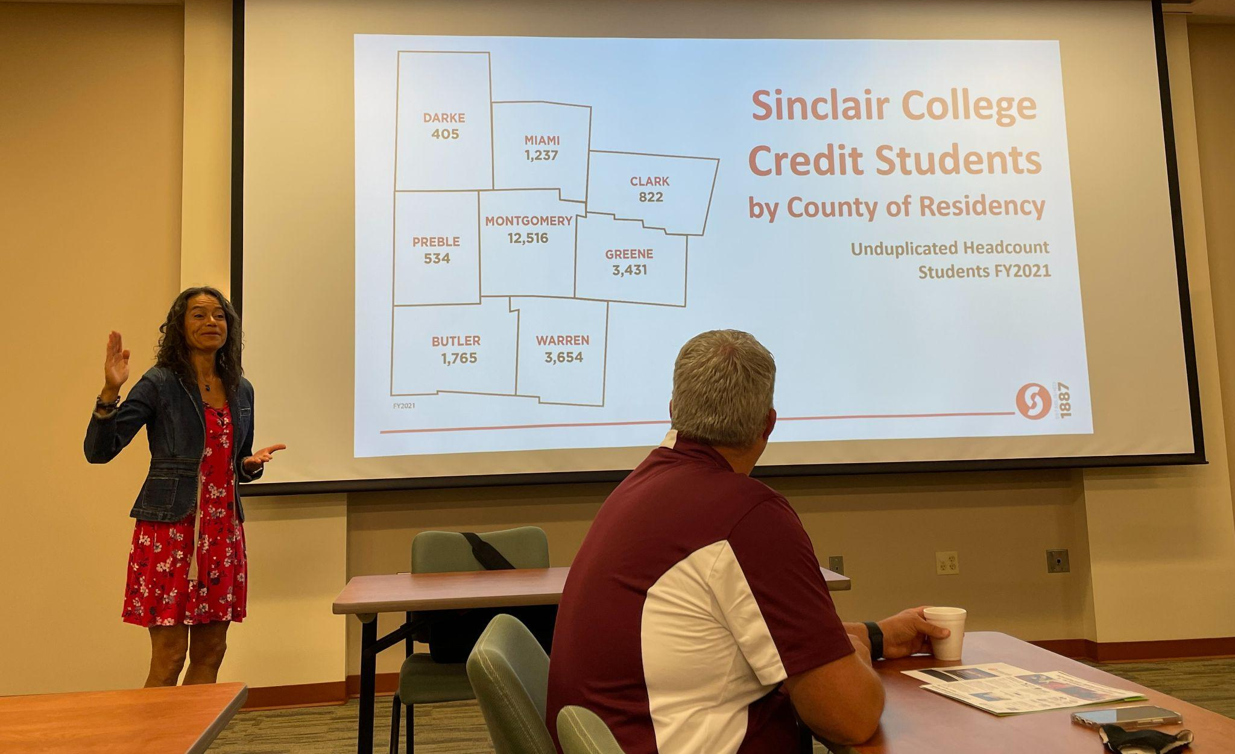
ACTION ITEM #1
Review your current plan.
Is it something you would share with an outside organization?
Should it be?
Notes:
The work we do on the Business Advisory Council is done in concert with partners in K-12 Education and the larger community and major industries in our region.

Slide 29
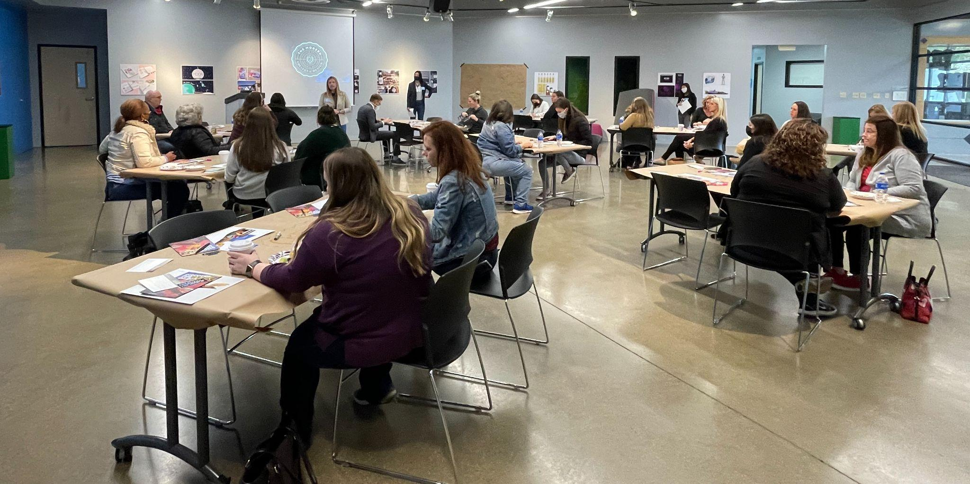
ACTION ITEM #2
Consider ways you can get your staff or district leaders out to meet with industry partners to solicit local feedback!
Notes:
Quick audit of who is in the room.

Slide 30
ACTION ITEM #3
Consider selecting a specific in-demand career path for this school year and design a formal (or informal) pathway with your BAC leadership.
Notes:
Quick audit of who is in the room.

Slide 31
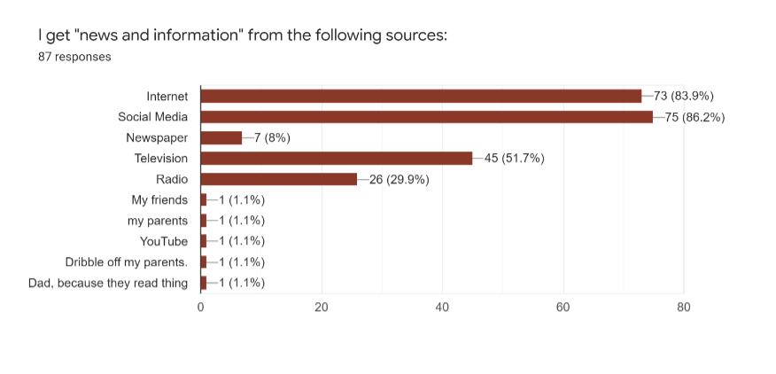
ACTION ITEM #4
Commit to incorporating student voice!

Slide 32
Begin designing system level tools like Career Fair Google Forms or implementing job shadow packets.
ACTION ITEM #5

Slide 33
ACTION ITEM #6
Help your region participate more deeply in weeks of career exploration like In-Demand Jobs Week in May!
Notes:
Quick audit of who is in the room.

Slide 34
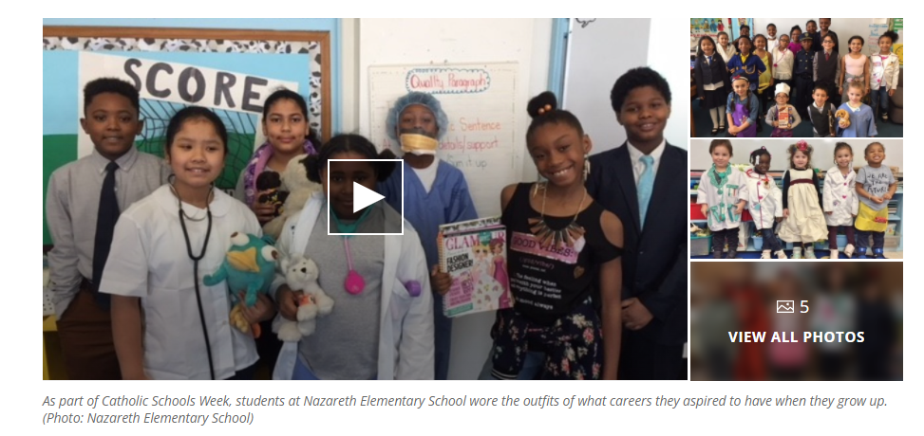
ACTION ITEM #7
Commit your district to host a Dress for Success or Touch a Truck event for your elementary school students this spring.

Slide 35
Questions? Comments?
Bryan Stewart
Workforce Development Director
Bryan.Stewart@mcesc.org

