Slide 1
Ohio College Tech Prep West Regional BAC Workshop
Michelle Washington
September 7, 2022

Slide 2
Agenda
Important Dates
Addressing Challenges and Opportunities
Planning and Collaborations
Business Advisory Council Plan Template
Plan Submission Process
Business-Education Leadership Award for Excellent Business Advisory Councils

Slide 3
Important Dates
Business Advisory Council Plans and Addendums are due September 30, 2022
Joint statements must be posted by March 1, 2023

Slide 4
Addressing Challenges and Opportunities
What challenges are you facing as a council?
What opportunities exist in within your councils?
What resources do you need?

Slide 5
Business Advisory Council Planning
Examples of council planning process
How do you determine which goals to focus on?
Setting Goals

Slide 6
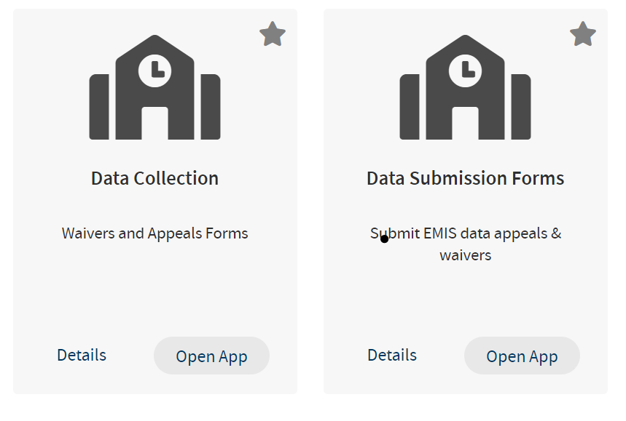
Business Advisory Council Plan
2022-2023 Plan Template
Plan Submission

Slide 7
Business-Education Leader Awards for Excellent Business Advisory Councils

Slide 8
Office Hours and Contact Information
Business Advisory Council Office Hours:
Monday, September 12, 2022 – 11:30-12:30 pm
Tuesday, September 20, 2022 – 2:30-3:30 pm
Thursday, September 29, 2022 – 10:30-11:30 am
Michelle.Washington@education.ohio.gov

Slide 9
@OHEducation

Slide 10
Share your learning community with us!
#MyOhioClassroom
Celebrate educators!
#OhioLovesTeachers

