Slide 1



Pre-Apprenticeship: Establishing a Pipeline

Slide 2



Introductions
Pam Hunt – Chief Administrator: Ohio College Tech Prep-West
Todd Schilling – Pre-Apprenticeship Coordinator: Sinclair
Eric Gearhart – Principal: Centerville School of Possibilities
Steve Verhoff – Assistant Superintendent: Tipp City Schools

Slide 3
Overview
Overview of OSAC Recognized Pre-Apprenticeships
Steps to Getting Started
Pre-Apprenticeship Operating Plan
High School Administrator Discussion
Questions

Slide 4
Pre-Apprenticeship
Pre-apprenticeship is an opportunity to provide high school students with the basic technical and job readiness skills in preparation to enter a Registered Apprenticeship program.
The best pre-apprenticeship programs are set up with close collaboration between the high schools, employers and Sinclair’s Office of Work-based Learning.
The purpose of this program is to provide the students with in-depth exposure to a career field that he/she may be interested in pursuing after high school.

Slide 5
Pre-Apprenticeship: Benefits
OSAC Recognized Pre-Apprentice completers earn a 12-point graduation credential and created more pathways to graduation.
Creates a career pathway to an in-demand occupation/career for students.
Earned OJT hours and Related Instruction may be credited towards the completion of a Registered Apprenticeship.
Secondary Schools build positive and lasting relationships with industry.
Employers participating in Registered Apprenticeship gain access to a pipeline of motivated, career oriented individuals.

Slide 6
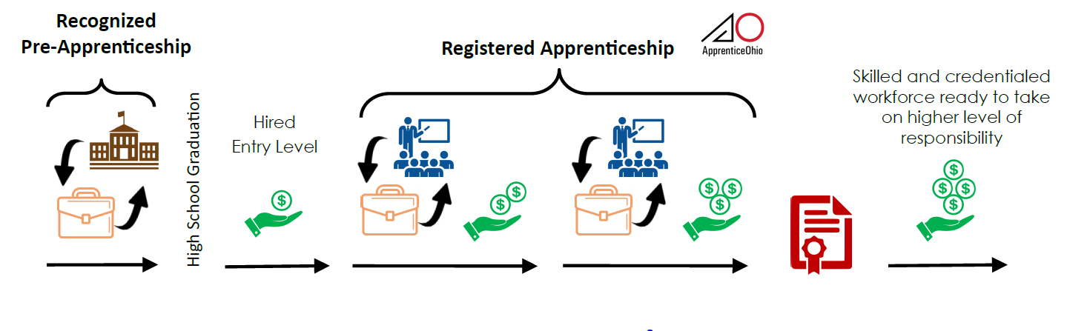
Establishing the Pipeline

Slide 7
Sinclair’s Office of Work-based Learning
Steps to Getting Started

Slide 8
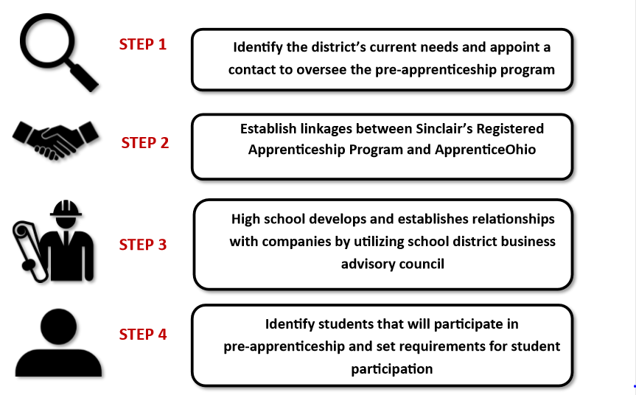
Pre-Apprenticeship

Slide 9

STEP 1: Identify POC
Identify the District’s current need(s) and area(s) of discipline and appoint a primary point of contact to oversee the pre-apprenticeship program.

Slide 10
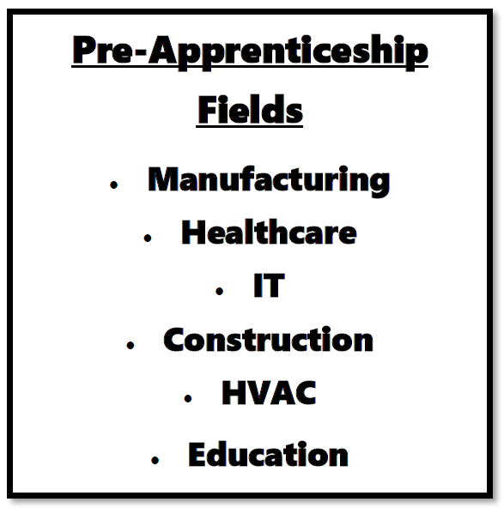
STEP 2: Establish linkages
Establish linkages between Sinclair’s Registered Apprenticeship Program and Apprentice Ohio.

Slide 11

STEP 3: Build Relationships
The high schools begin to build relationships with local companies utilizing their own school district business advisory councils. Can also use companies that are currently partnering with Sinclair.

Slide 12

STEP 4: Identify Students
Identify students that are interested and willing to participate in the pre-apprenticeship. Create requirements and setup expectations for student participation.

Slide 13
What is the role of the Secondary School?
Be the Provider of OSAC Recognized Pre-Apprenticeship:
- Research/determine occupations or occupational sectors
- Determine your related coursework
- Seek Registered Apprenticeships (Employers/Signatory Employers)
- Draft Operating Plan
- Gain Recognition
Administer Your OSAC Recognized Pre-Apprenticeship:
- Execute the content of your Operating Plan
- Maintain participant and programmatic records
- Oversee evaluations of both in school and on-the-job performance
- Submit for completion certificates
- Reach out to your ApprenticeOhio Field Rep. for assistance as needed and to update your Operating Plan as you grow.

Slide 14
What is the role of the Employers?
Companies must establish Signatory Employer relationship with Sinclair
Work with high school partners to provide work-based learning opportunities
Design learning experiences for students to learn the career field
Work with the high school contacts to report students progress
Provide students opportunities after graduation

Slide 15
Transitioning to Next Steps
Pre-Apprentice
Continue with Current Employer
Exploring Career Options in Different Field
Continue in Career Field – Seeking New Employer

Slide 16
Operating Plan Overview
The Components of an OSAC Recognized Pre-Apprenticeship
Operating Plan
    Section A: Equal Opportunity Pledge
    Section B: Enrollment
    Section C: Instructional Content
    Section D: Participant Status
    Section E: Safety and Welfare
    Section F: Program Administration
    Section G: Linkage(s) to Registered Apprenticeship
    Section H: Registered Apprenticeship Linkage Letter(s)

Slide 17
Questions

Slide 18
Sinclair’s Office of Work-based Learning
High School Administrator Discussion

Slide 19
What lead you to design a pre-apprenticeship program for your district?
Question

Slide 20
How did you decide on the industry sectors to utilize for your program?
Question

Slide 21
What do you see as the benefits of pre-apprenticeship?
Question

Slide 22
What challenges did you encounter in the design process?
Question

Slide 23
What advice do you offer to others?
Question

Slide 24
Questions

Slide 25
Contact Information
Pam Hunt
  Email: pamela.hunt@Sinclair.edu
Todd Schilling
  Email: todd.schilling@Sinclair.edu

Slide 26
Thank you!

