Slide 1
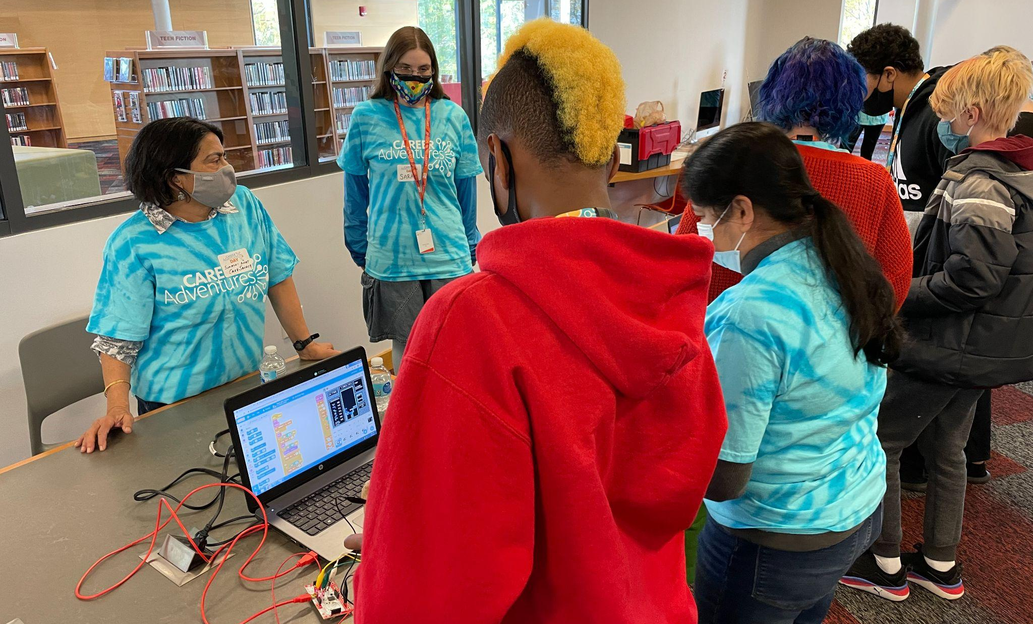
Business Advisory Councils
Leveraging opportunities for our region

Slide 2
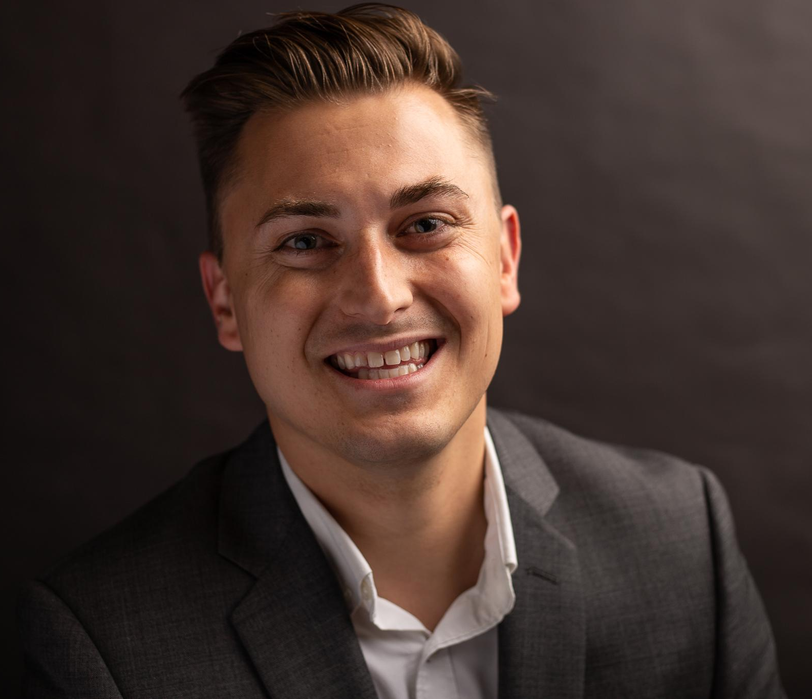
Presenter Info:
Bryan Stewart
Workforce Development Director
Bryan.Stewart@mcesc.org
Notes:
Quick audit of who is in the room.
Tom Lasley - CEO of Learn to Earn Dayton and Shannon Cox (Superintendent)

Slide 3
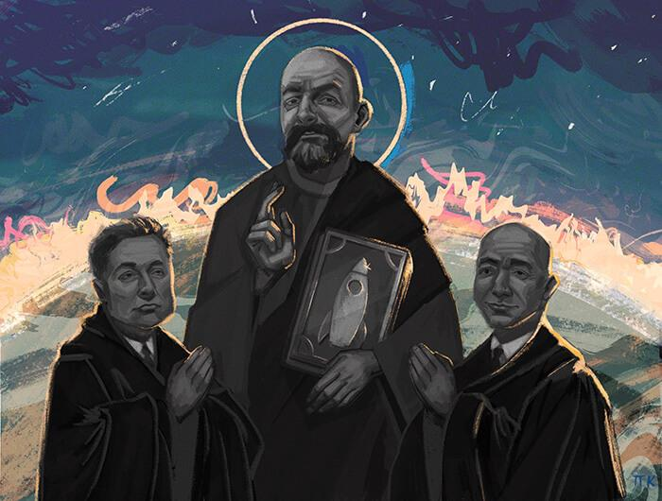

Slide 4
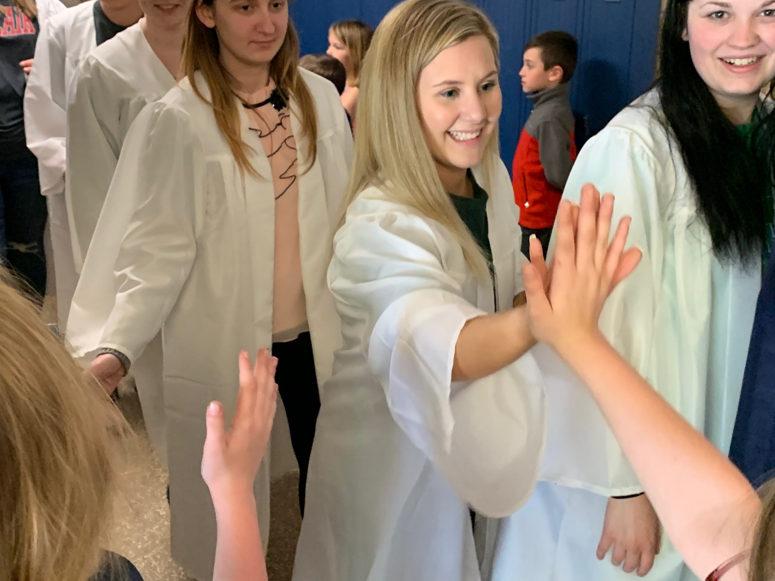
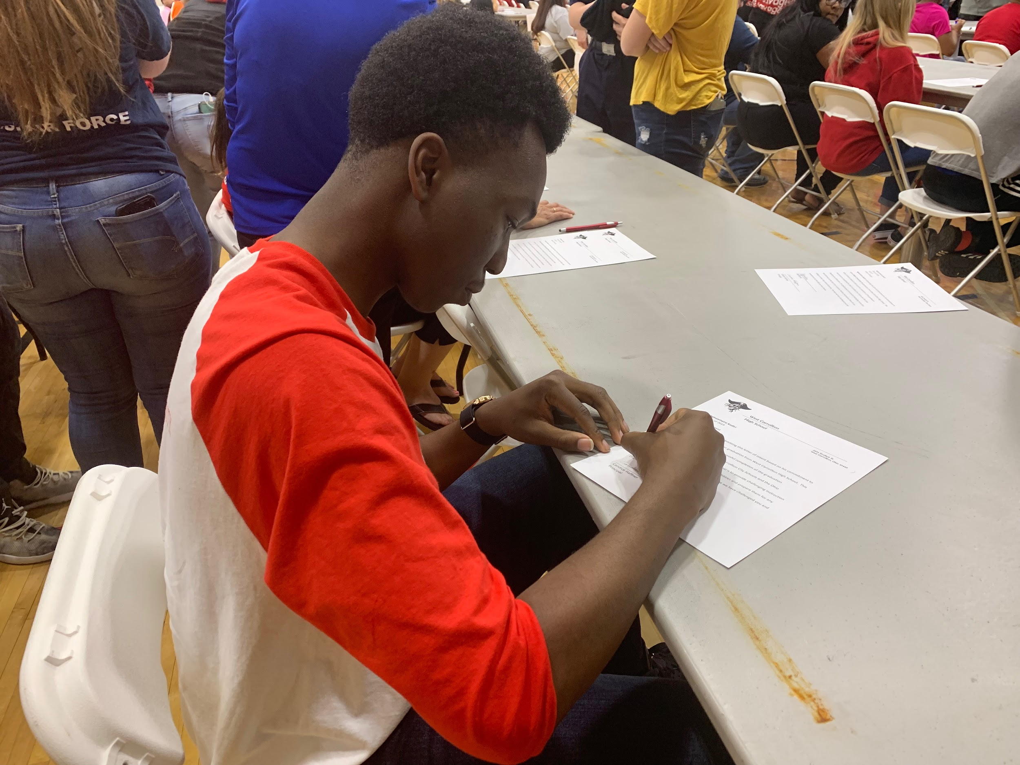
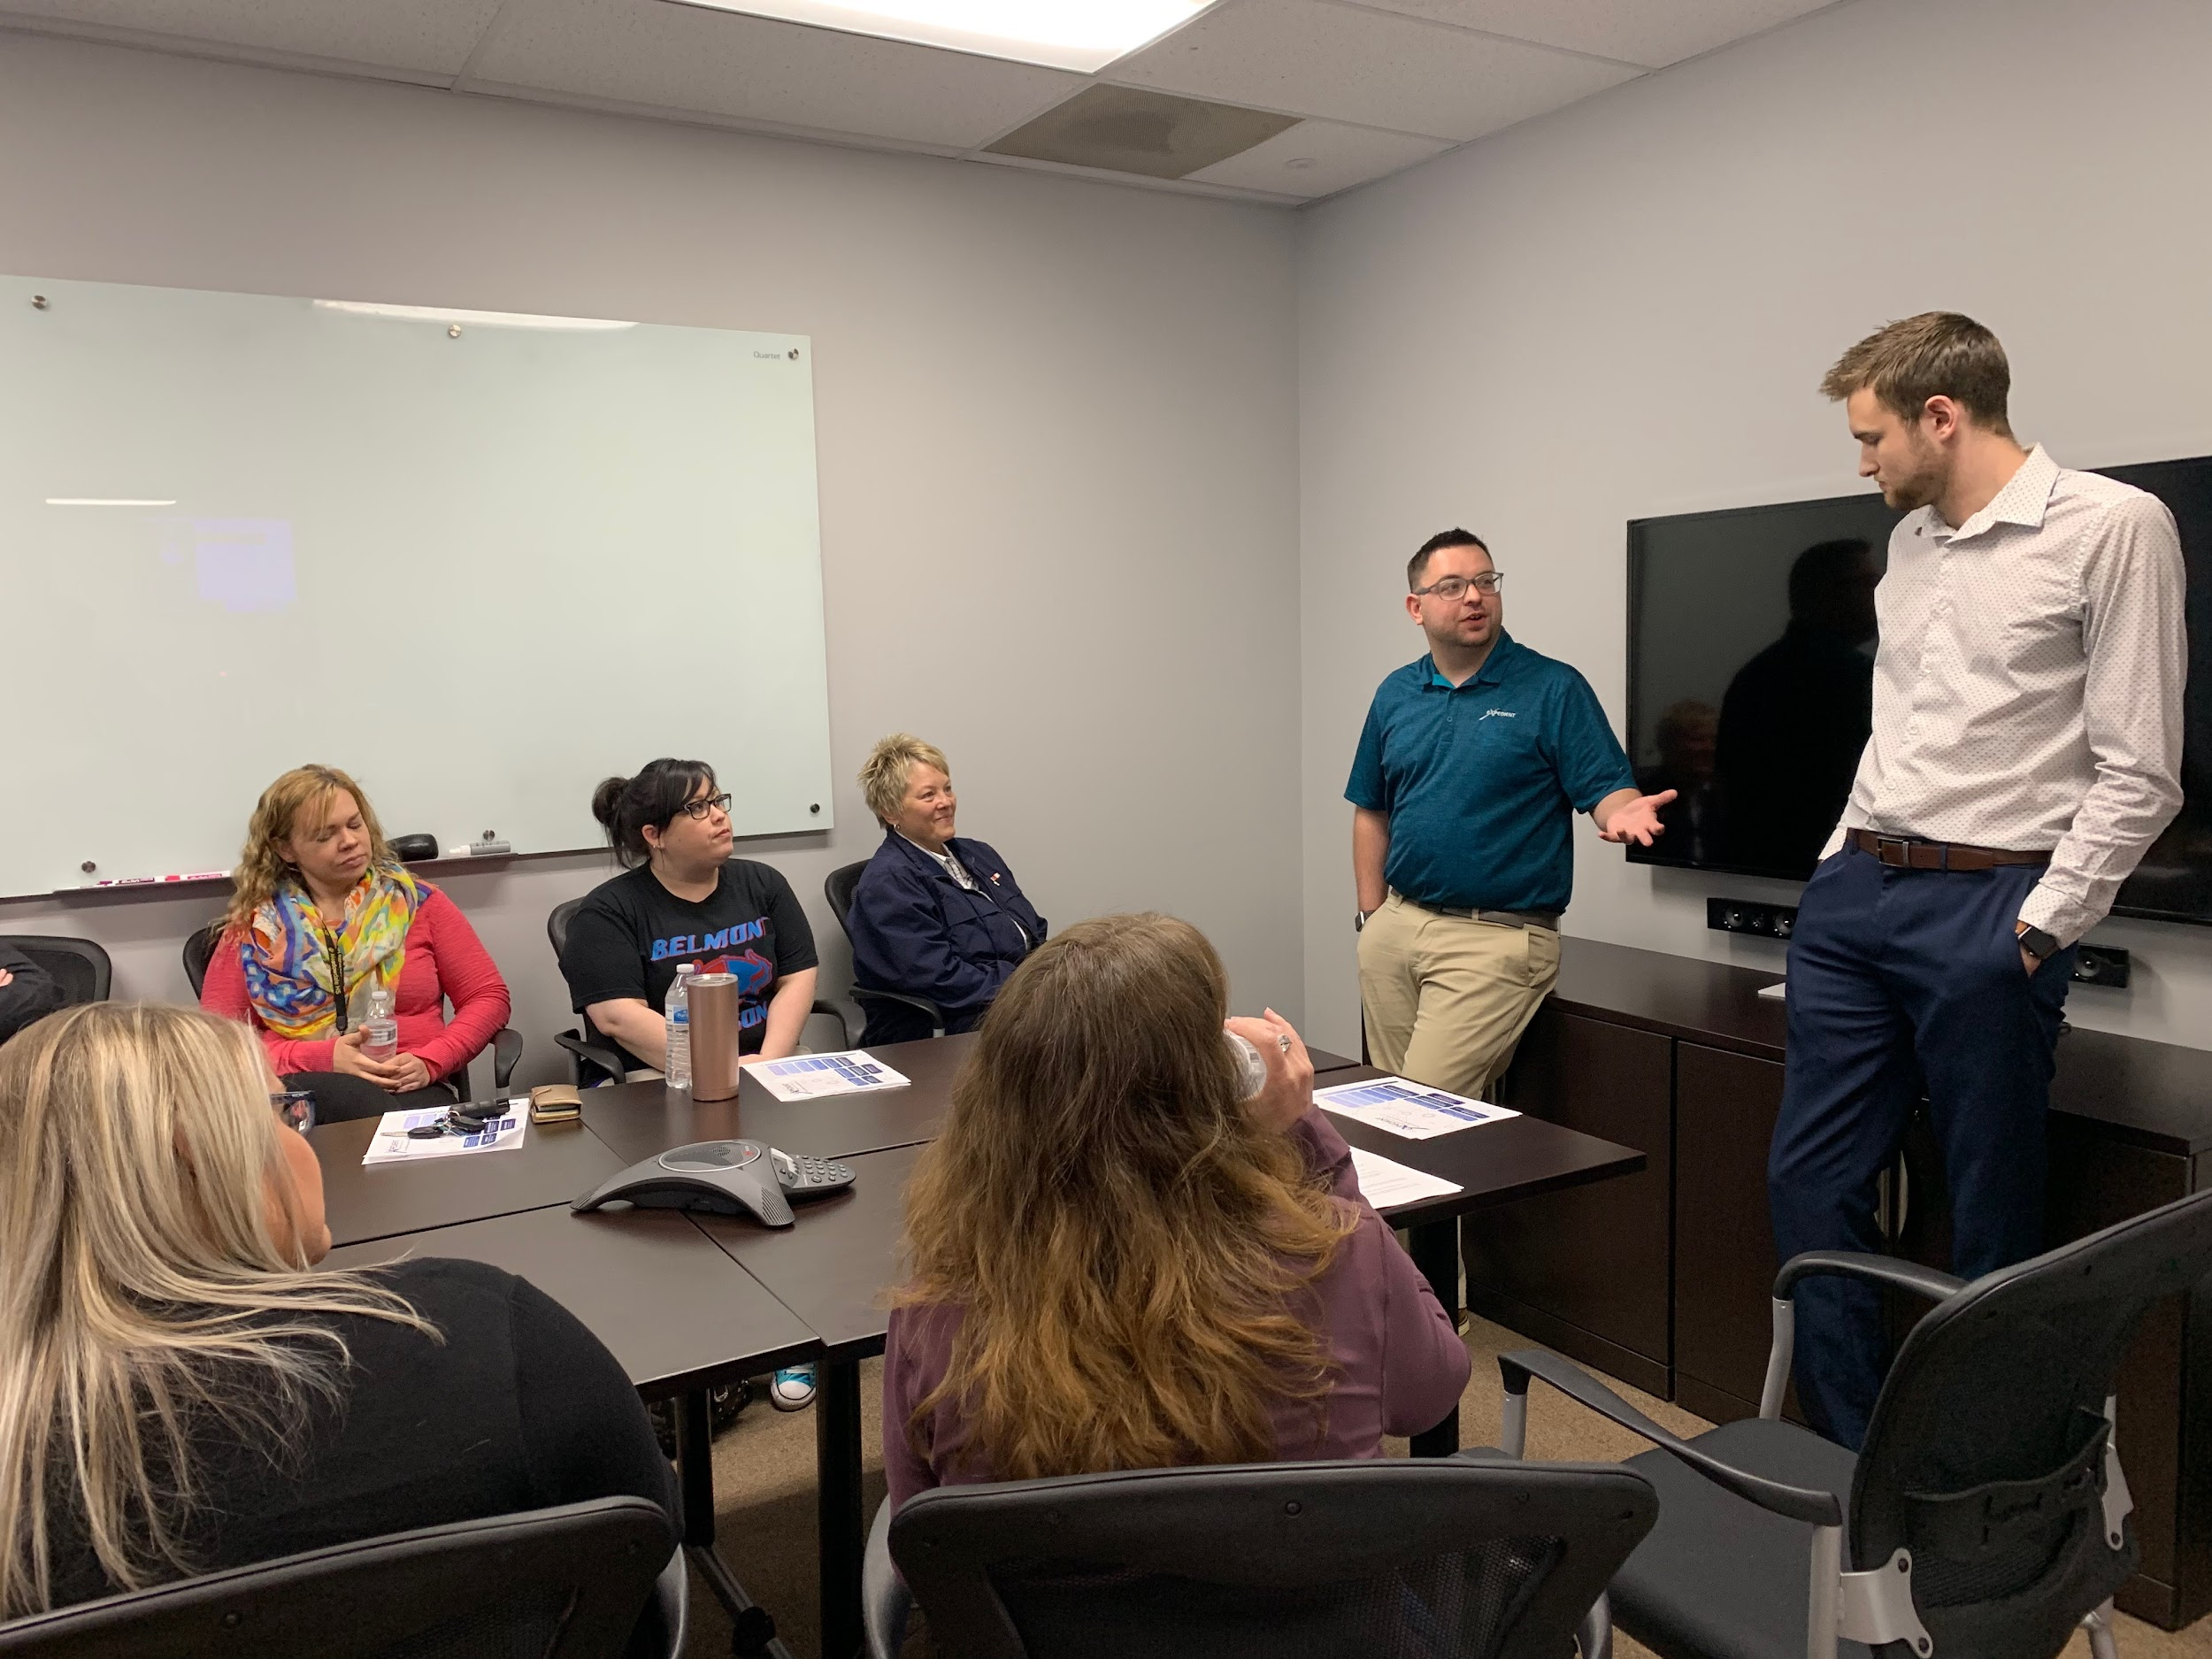
Montgomery County ESC Business Advisory Council
Ensuring our workforce can compete by enhancing partnerships between schools, higher education and employers
Ensuring student success and career-readiness
Helping existing and new businesses thrive
Keeping talent in our region
Making Montgomery County & Warren County great places to live and work

Slide 5
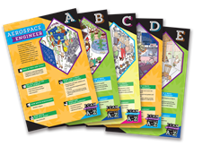
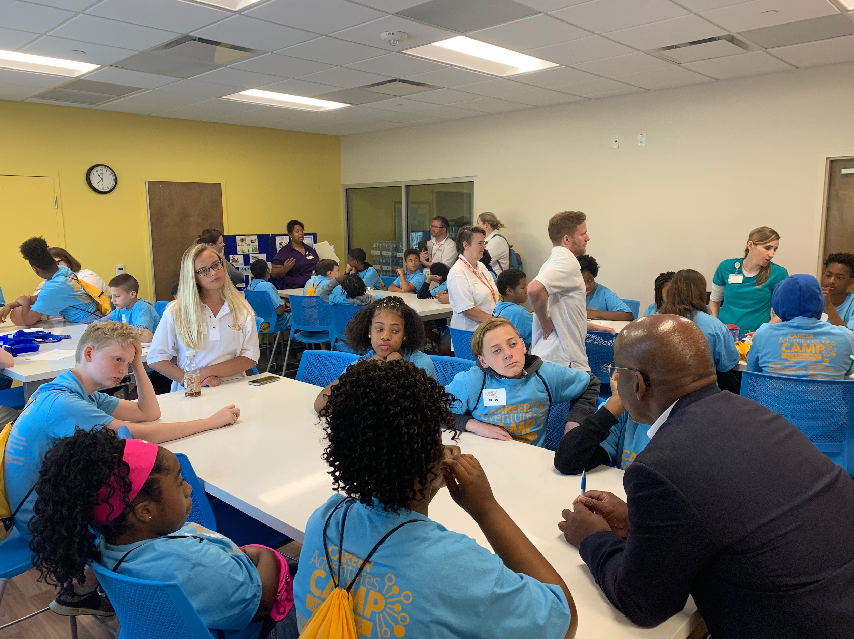
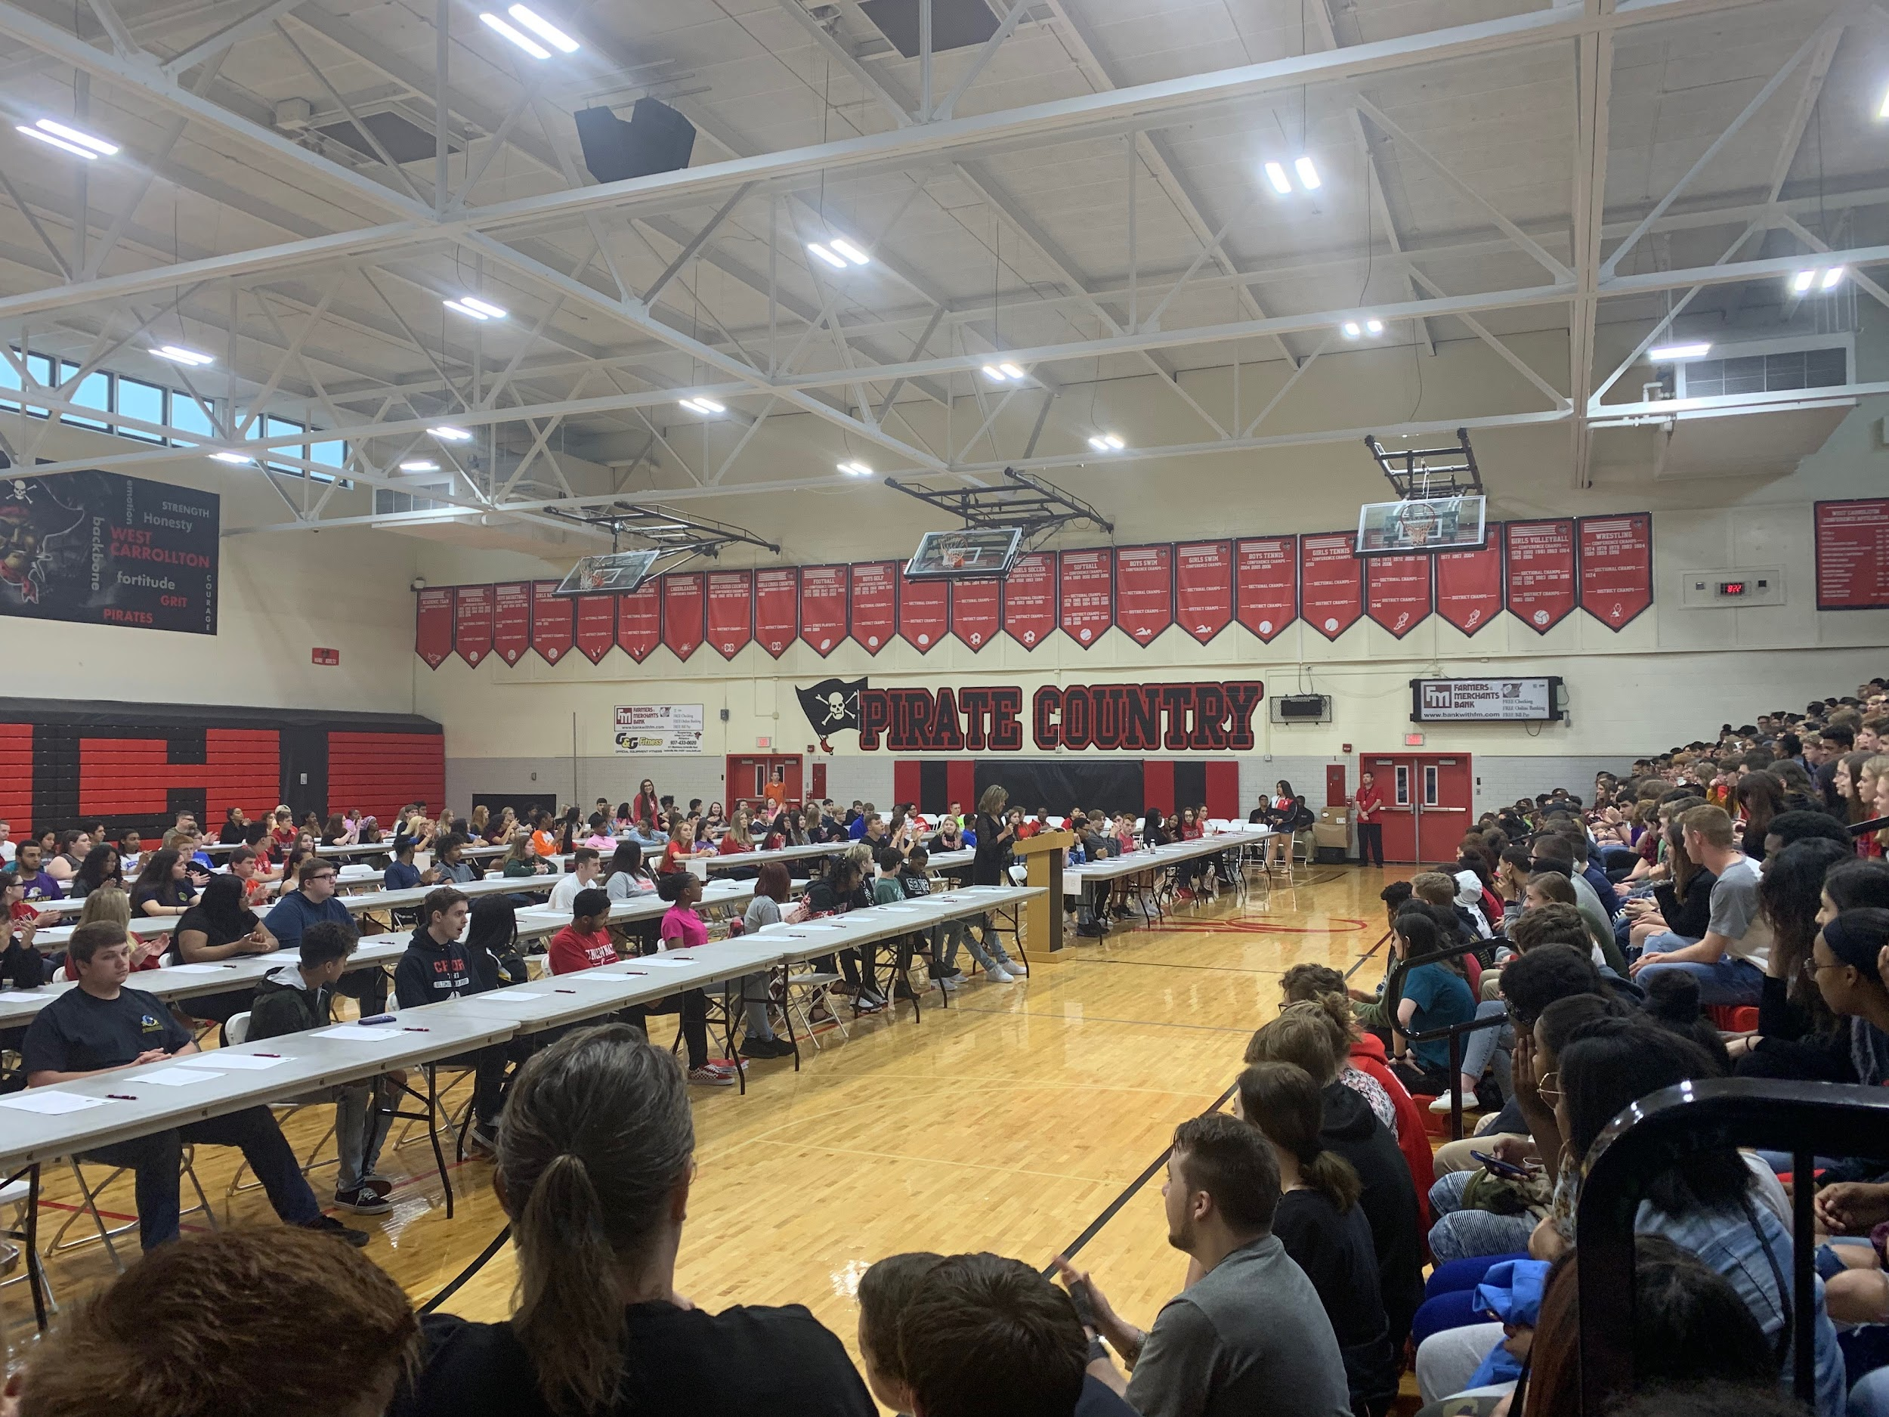

Slide 6
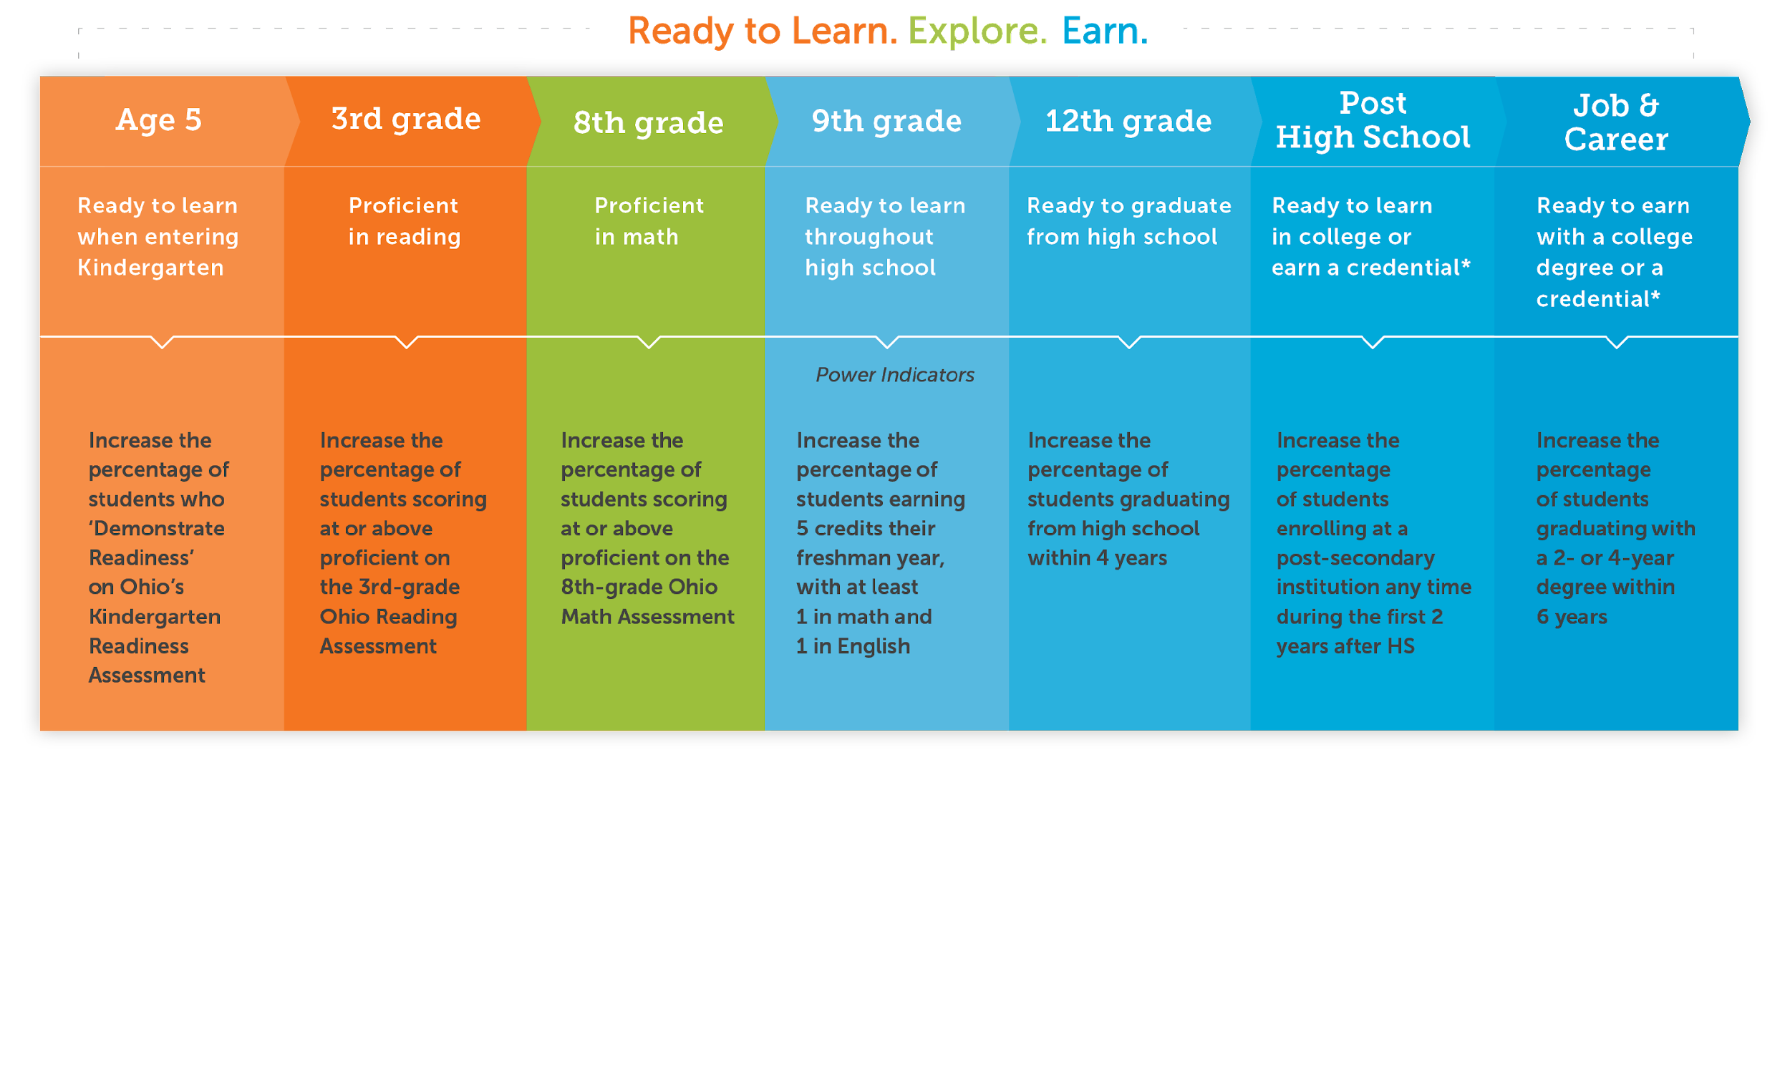
Ensuring Students Success
From Cradle to Career
Notes:
The work we do on the Business Advisory Council is done in concert with partners in K-12 Education and the larger community and major industries in our region.

Slide 7
Notes:
Shannon or Bryan - Everything we do in the Career Connections space is to move Montgomery County towards our big goal. At the end of the day, this is about the overall health and future of our region. We must prepare our students for careers. We cannot afford failing this mission. We must adapt and rapidly partner with the businesses in our community. The exciting thing is that we are providing vision and leading the way in this work!

Slide 8
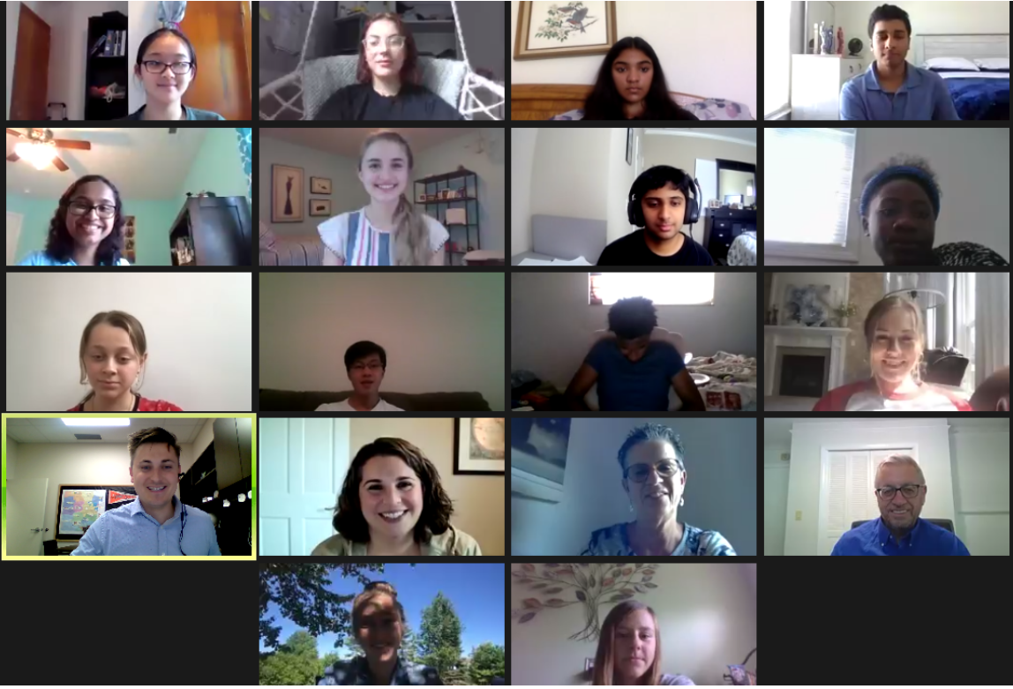
Our BAC represents 77,000+ Students

Slide 9
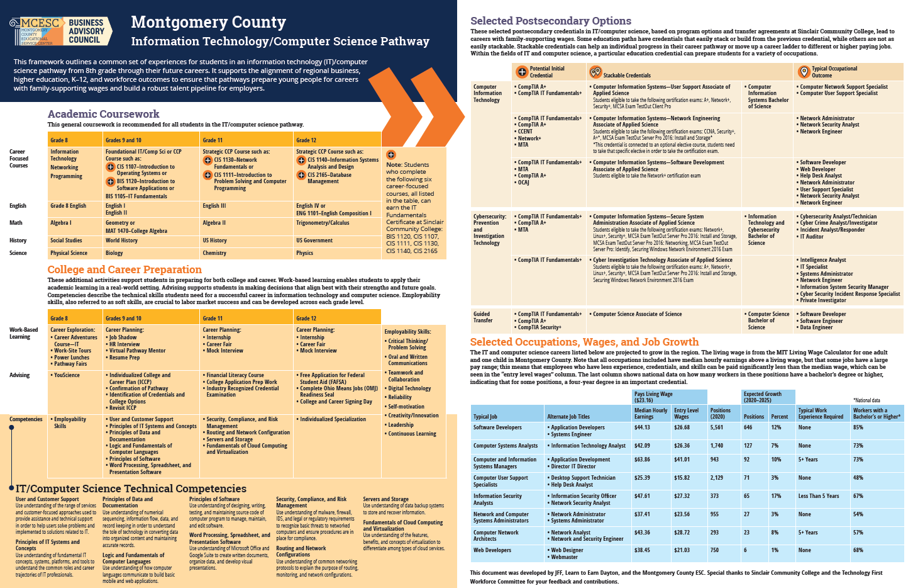
Notes:
The work we do on the Business Advisory Council is done in concert with partners in K-12 Education and the larger community and major industries in our region.

Slide 10
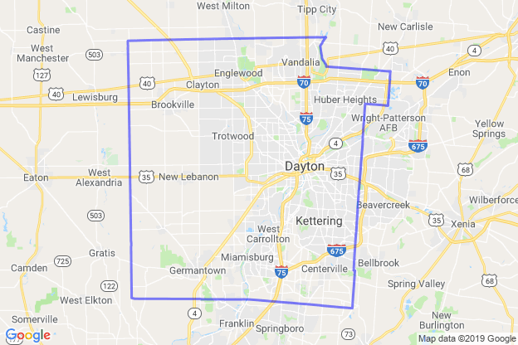
81
5*
35
233
94
80
28
IT/CS Program Footprint for Montgomery County

Slide 11
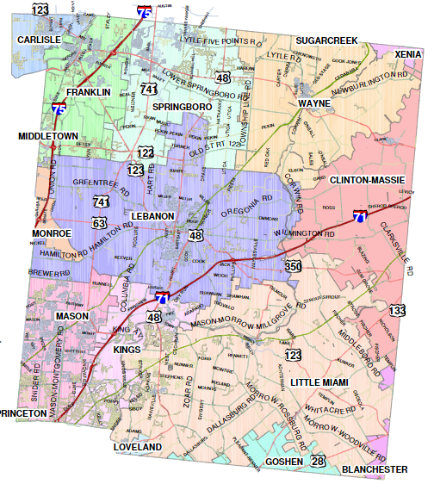
100
61
97
55
129*
117
126
685*
IT/CS Program Footprint for Montgomery County

Slide 12
Approximately 1,226 students are in a computer science pathway in our region...

Slide 13
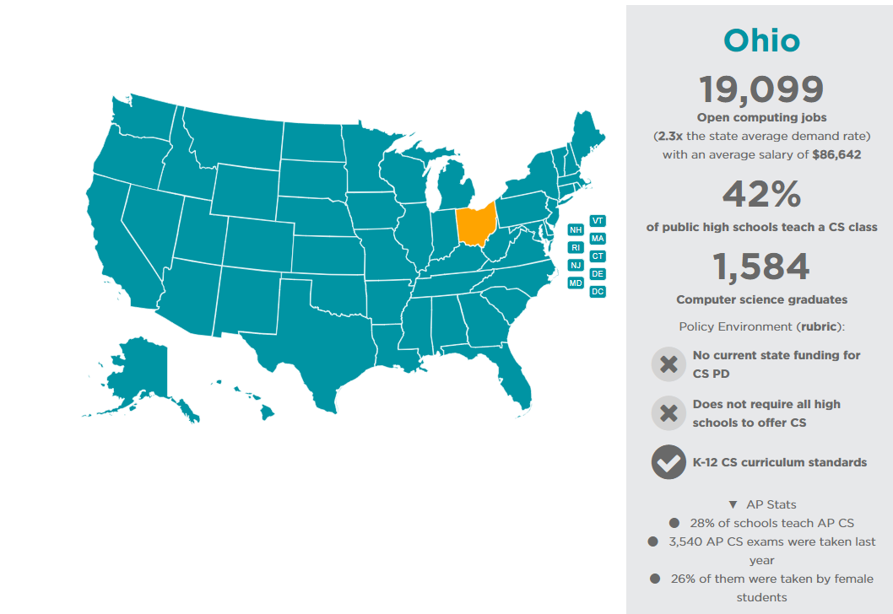
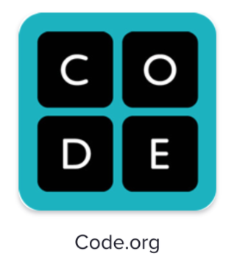

Slide 14
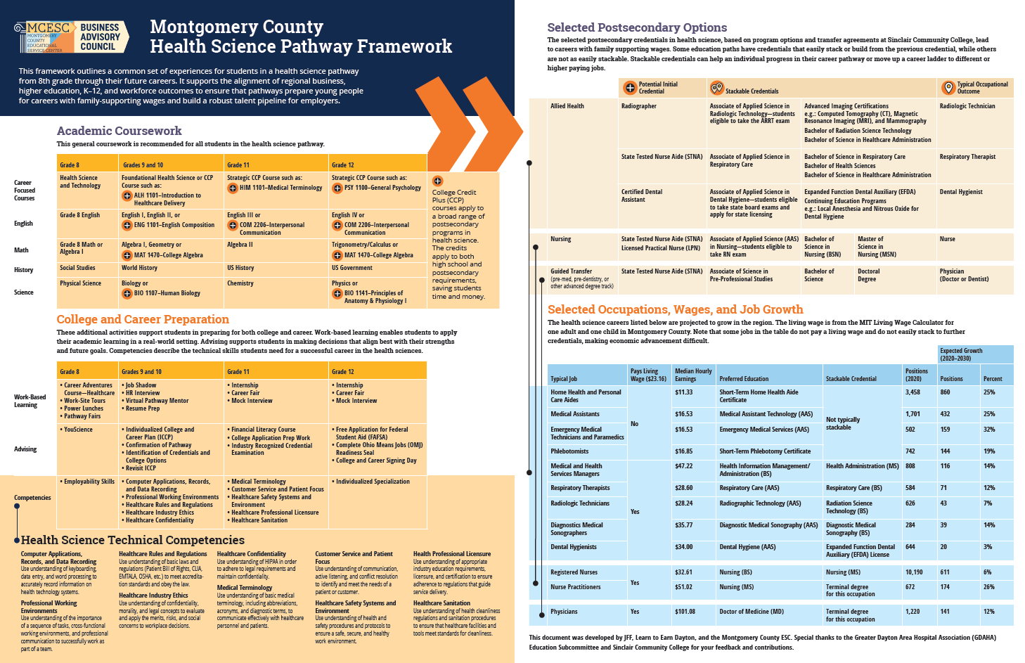
Notes:
The work we do on the Business Advisory Council is done in concert with partners in K-12 Education and the larger community and major industries in our region.

Slide 15
Education
Entrepreneurship
EMS/Fire/Police

Slide 16
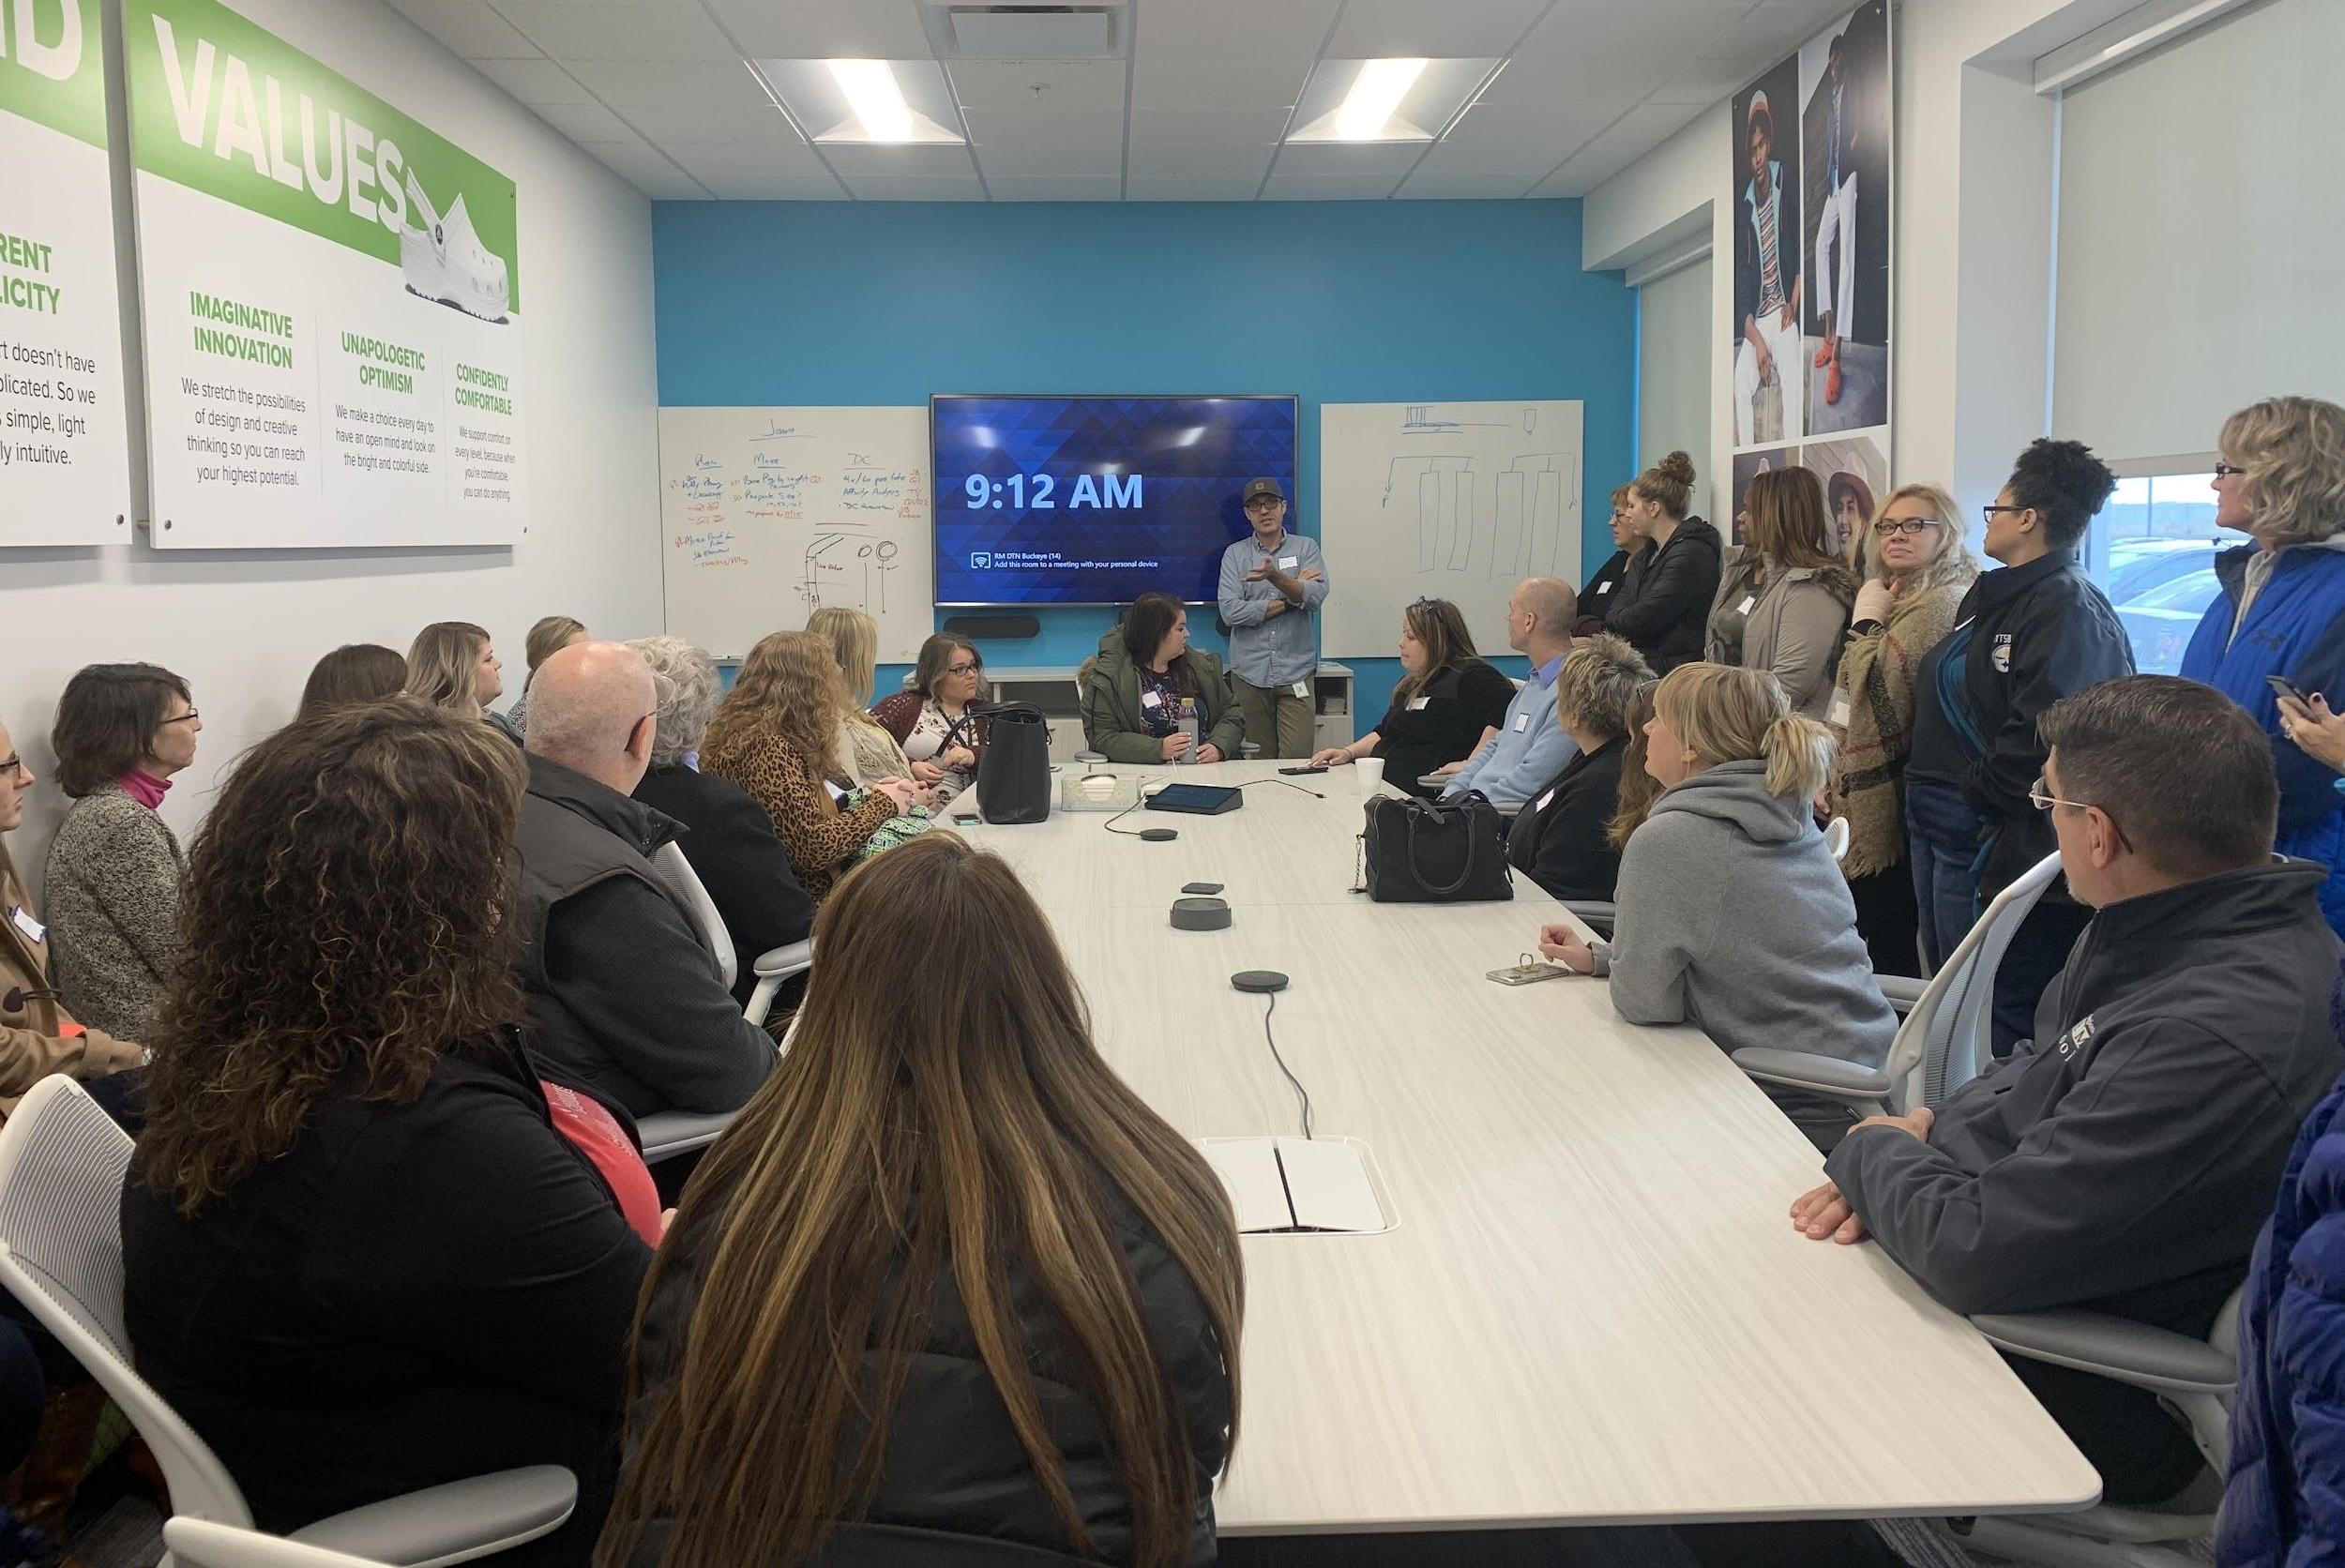
Career Champions and Counselors Academy
Crocs Distribution Center Tour on Nov. 19th 2019
Notes:
The work we do on the Business Advisory Council is done in concert with partners in K-12 Education and the larger community and major industries in our region.

Slide 17
Our Career Connections Weeks of Action
Notes:
The work we do on the Business Advisory Council is done in concert with partners in K-12 Education and the larger community and major industries in our region.

Slide 18
Construction Appreciation Week - Sept. 20th - 24th
Please contact our partners in construction to
ensure your district participates this year.

Slide 19
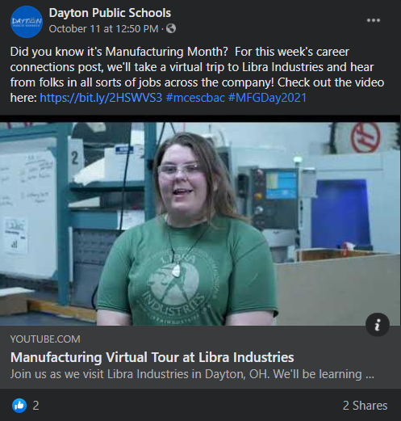
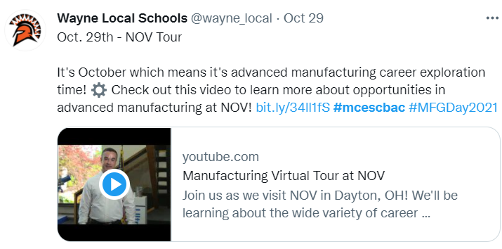
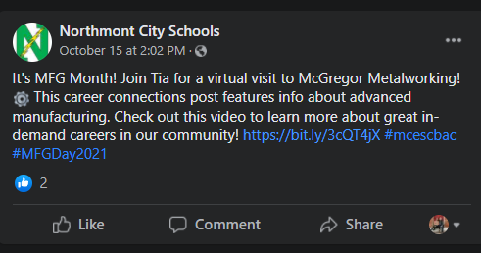
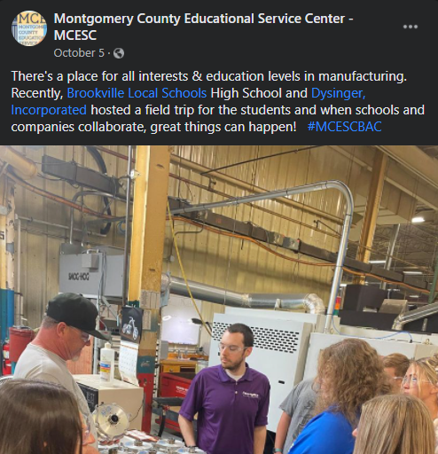
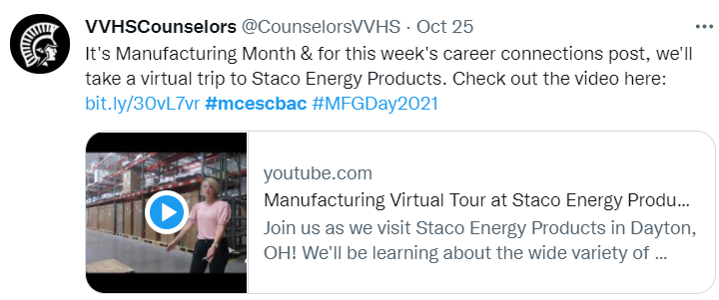
MFG Month - October

Slide 21
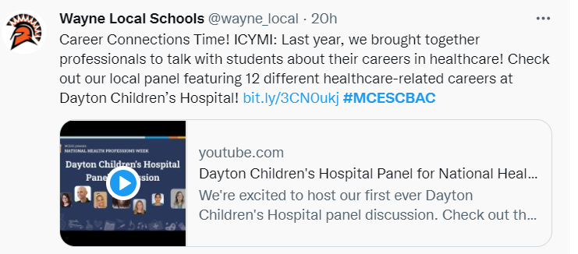
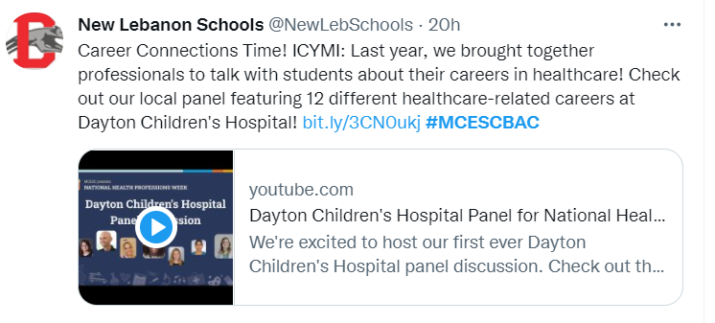

Slide 22
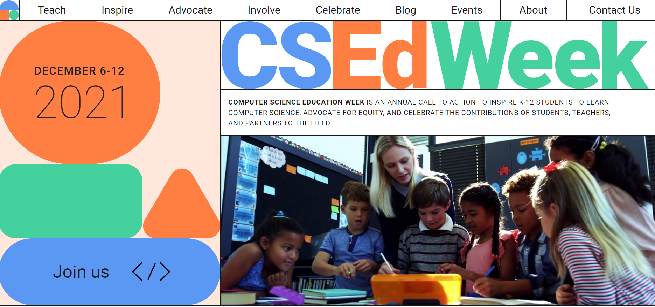

Slide 23
Expanding access to resources like:
So we can track and support you all better!

Slide 24
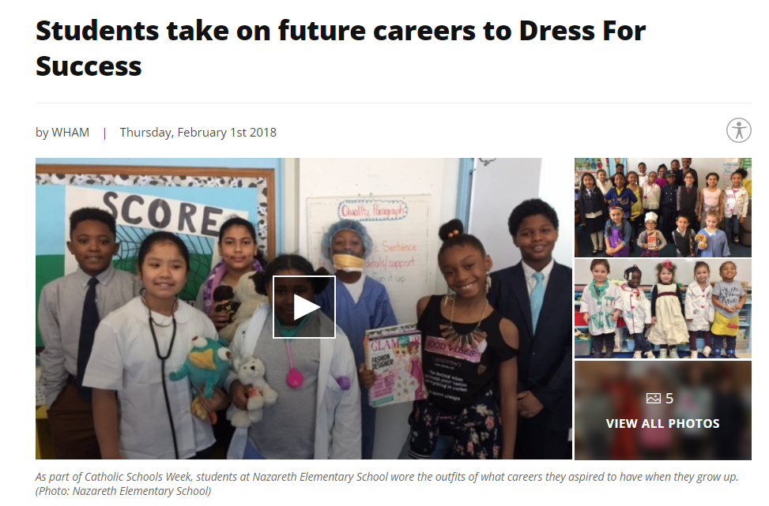

Slide 25
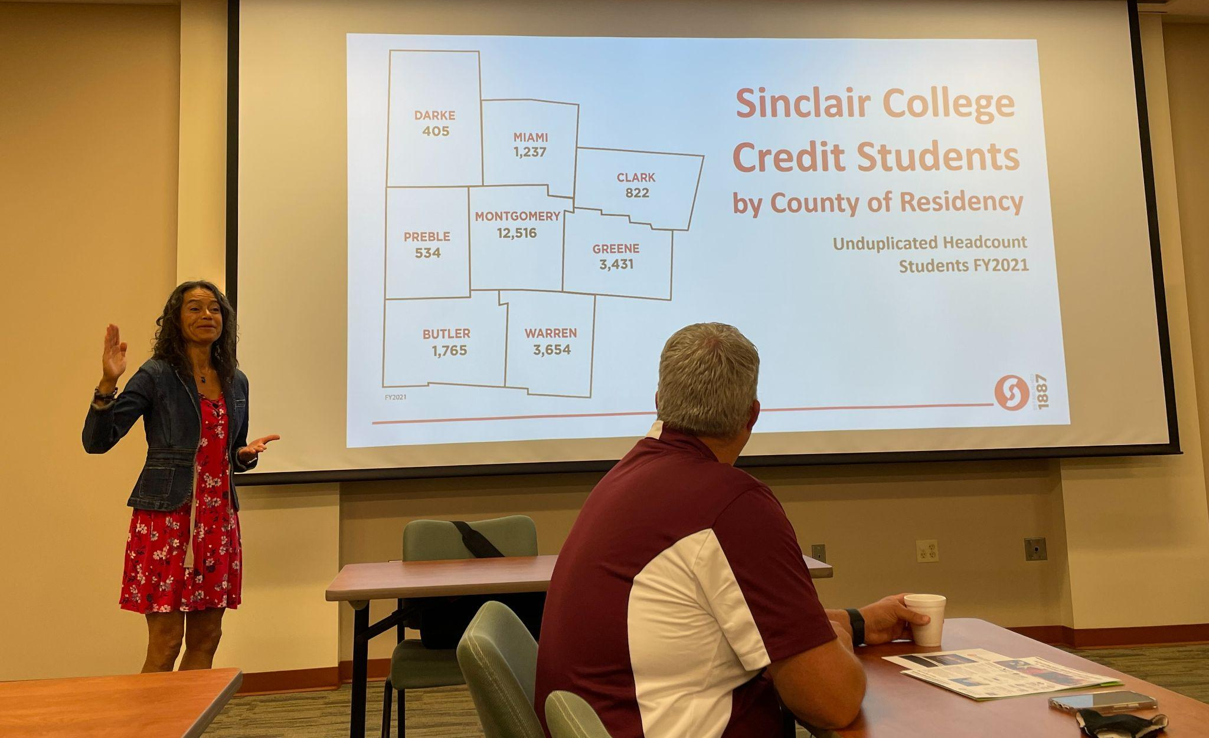
ACTION ITEM #1
Join a BAC or
schedule a follow up meeting with me to learn more.
Notes:
The work we do on the Business Advisory Council is done in concert with partners in K-12 Education and the larger community and major industries in our region.

Slide 26
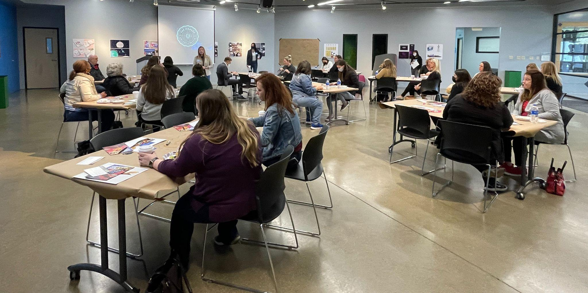
ACTION ITEM #2
Consider ways you can get your staff or district leaders out to meet with industry partners.
Notes:
Quick audit of who is in the room.

Slide 27
ACTION ITEM #3
Pick a career path for next school year and design a formal (or informal) pathway with your BAC leadership.
Notes:
Quick audit of who is in the room.

Slide 28
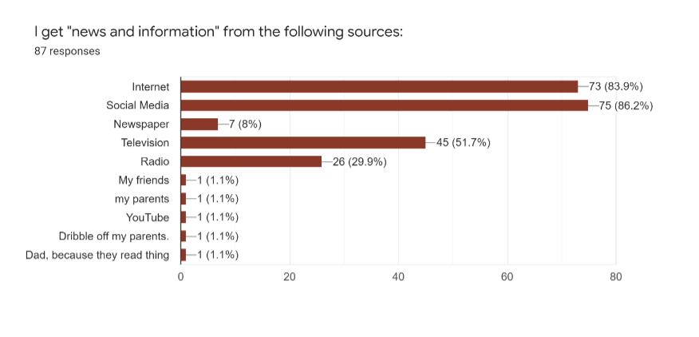
ACTION ITEM #4
Commit to incorporating student voice!

Slide 29
Begin designing system level tools like Career Fair Google Forms or implementing job shadow packets.
ACTION ITEM #5

Slide 30
ACTION ITEM #6
Help your region participate more deeply in weeks of career exploration like In-Demand Jobs Week in May!
Notes:
Quick audit of who is in the room.

Slide 31
ACTION ITEM #7
Commit your district to host a Dress for Success or Touch a Truck event for your elementary school students this spring.

Slide 32
Questions? Comments?
Bryan Stewart
Workforce Development Director
Bryan.Stewart@mcesc.org

