Slide 1
Career Education Northmont Middle School
Beth Cooper
March 23, 2022

Slide 2
Rotation Schedule
Spanish
Robotics
Phys. Ed.
One of four classes that all 8th grade students take
Career Ed.

Slide 3
Former focus of my course:
Content changed based on school needs
Used to focus on test scores
ODE established a “Career Advising Policy”

Slide 4
How is career advising implemented across grades 6-12?
Located within the Model Student Success Plan are recommended activities by grade level for grades 6-12. These activities can be integrated into an existing course, organized as a standalone course, or established as an advisory or school counseling curriculum for career advising. The resources are flexible for adapting to local resources.

Slide 5
Aileron
I attended a summer conference at Aileron which changed how I perceived Northmont’s career education efforts

Slide 6
change
Migrated from an “integrated course” to a “standalone course”

Slide 7
Content of Career Education
Compensation Package
Surveys
Naviance
CTC Week
College Tuition
Debt Talk
Trade School
Research Careers

Slide 8
This course was designed to assist students with exploring careers and developing skills necessary to make meaningful decisions about their career choice. Students will be made aware that there are many factors to consider before selecting a suitable career. This course will assist the students in assessing their personal strengths and weaknesses as they relate to career decisions.

Slide 9
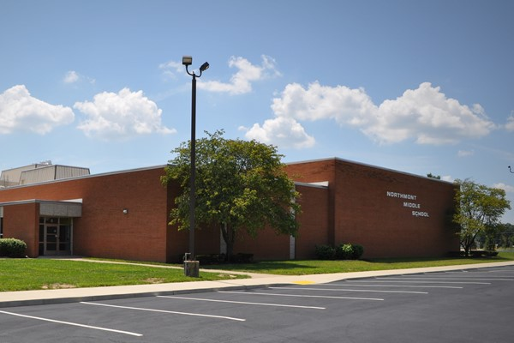
Preparation in 8th Grade
Scheduling classes
CTC advising
Scholarships
General direction

Slide 10
Thanks!
Any questions?
You can find me at:
bcooper@northmontschools.net
937.307.7519

