Slide 2
How We Started…

Slide 3
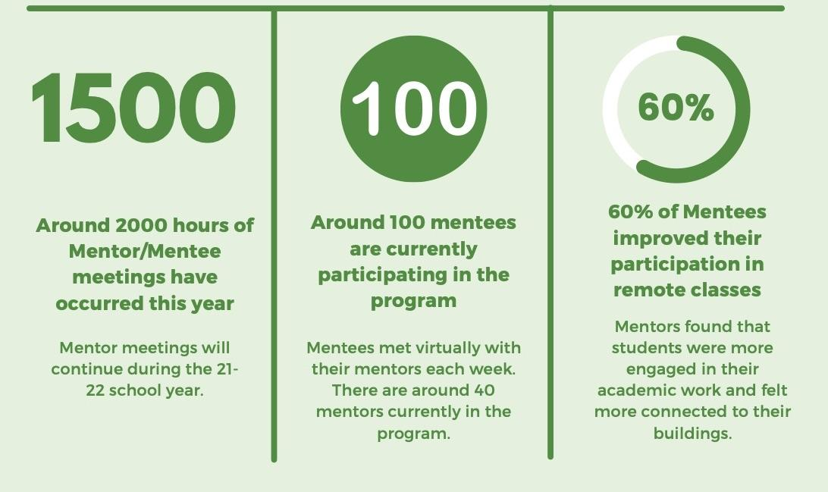
How We Ended the 2020-2021 school year

Slide 4
Where we are
Partnering with Miami Valley Leadership Foundation
Face to Face Mentoring
30 Community Mentors
20 Teacher Mentors
62 students matched with Mentors

Slide 5
How We Got There
Northmont Education Partnership Program
District had community mentors with MVLF in the district for the past few years
Mentors gathered through multiple sources
Mentees identified by each building’s staff

Slide 6
Why is this important to your company
Employees of your company talk to their mentees about what they do for their career
Employee mental health
Company exposure to hundreds of students through connecting with your local school district

Slide 7
Our Next Steps
Teacher Mentor Surveys
Community Mentor Surveys
Meeting with Northmont staff on the good, the bad and the ugly parts of the program
Streamlining

Slide 8
Questions?
Angie Clifford - Community Engagement Coordinator - Northmont City School District angela.clifford@northmontschools.net
Susanne Lintz - Assistant Superintendent - Northmont City School District
slintz@northmontschools.net
Shannon Todd - Mentoring Program Director - Miami Valley Leadership Foundation
shannon@miamivalleyleadership.com

