Slide 1
Career Connections that support the BAC Mission
Harold Niehaus

Slide 2
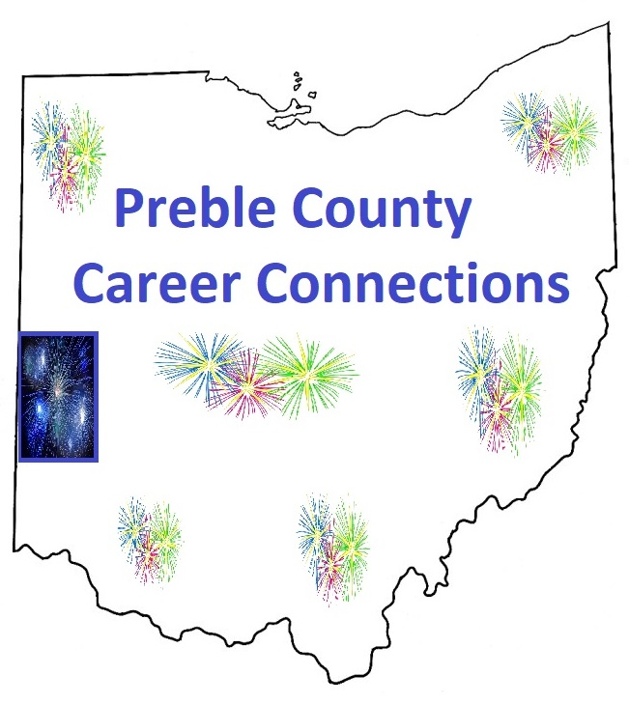

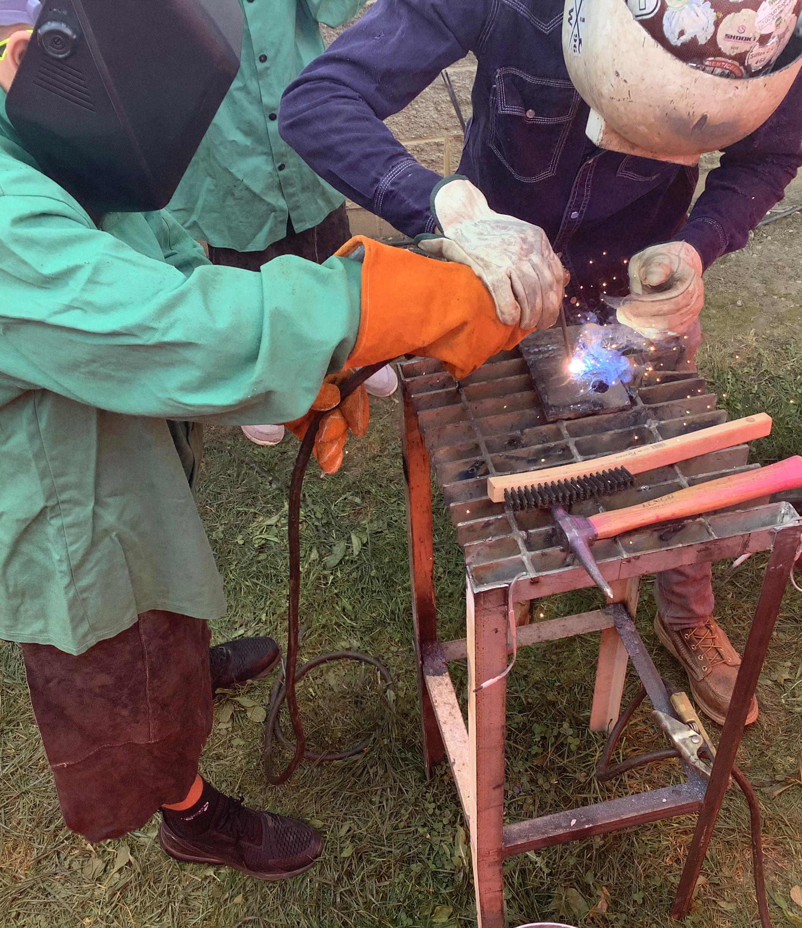
AGENDA
Preble Co BAC Mission
Career Connections Director “Charge”
Collaboration
Support

Slide 3


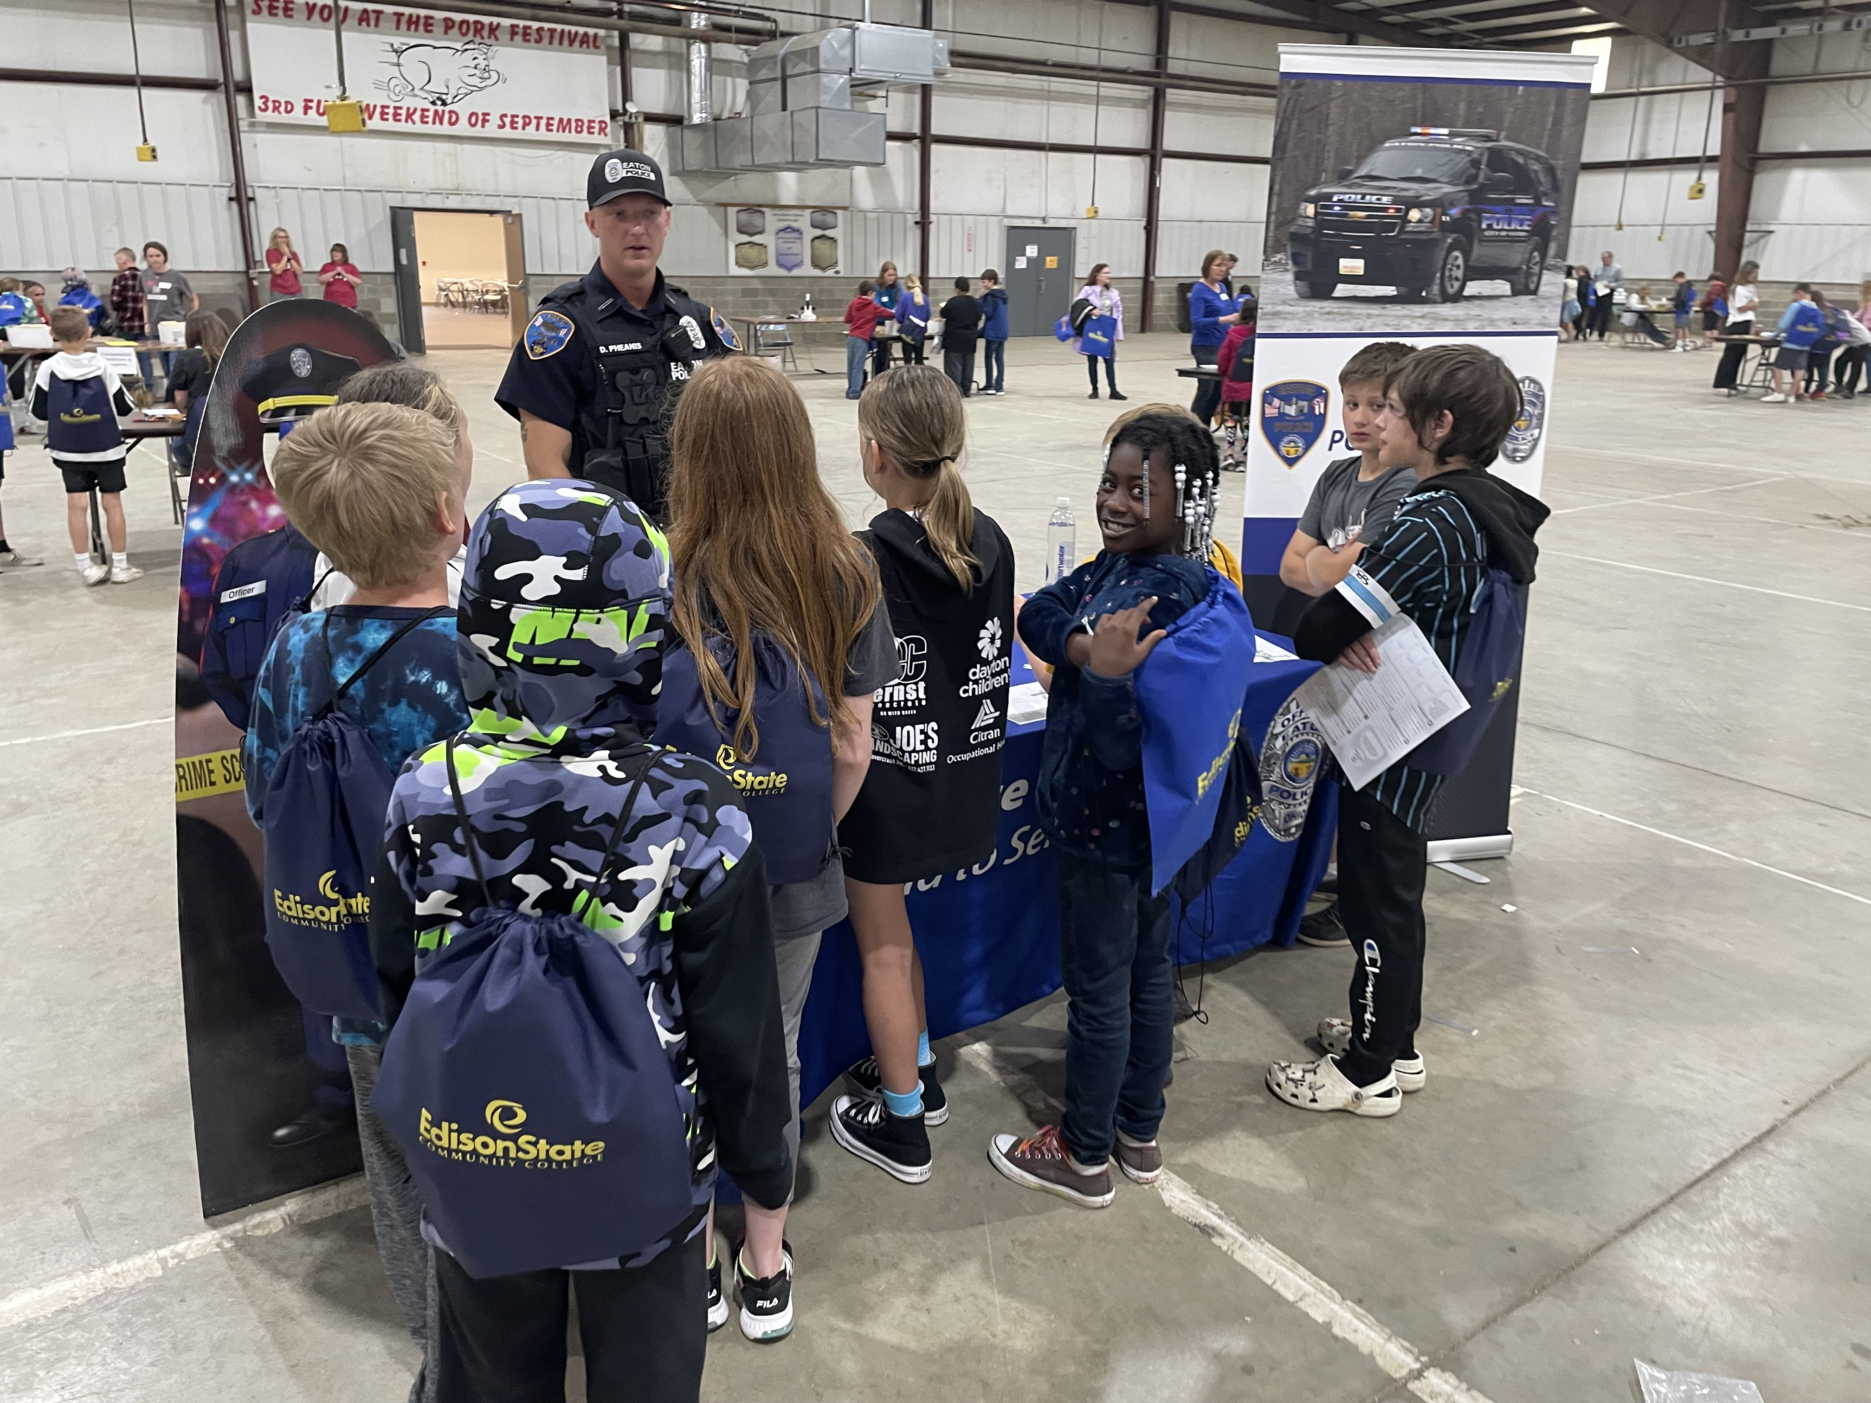


introduction
The power of Career Connections in driving forward the mission of the Preble County ESC Business Advisory Council (BAC).

Slide 4
Preble County BAC mission
Create productive partnerships that will keep our “people” resources in Preble County and work with these resources to develop the needed skills to create productive workers and assets for our community.

Slide 5
Career connections director “The charge”
The Preble County Career Connection Director position is the liaison between the school districts and area businesses to develop, market, and coordinate activities that will expand students’ knowledge of local career opportunities and facilitate the educational attainment needed for the workforce.

Slide 6


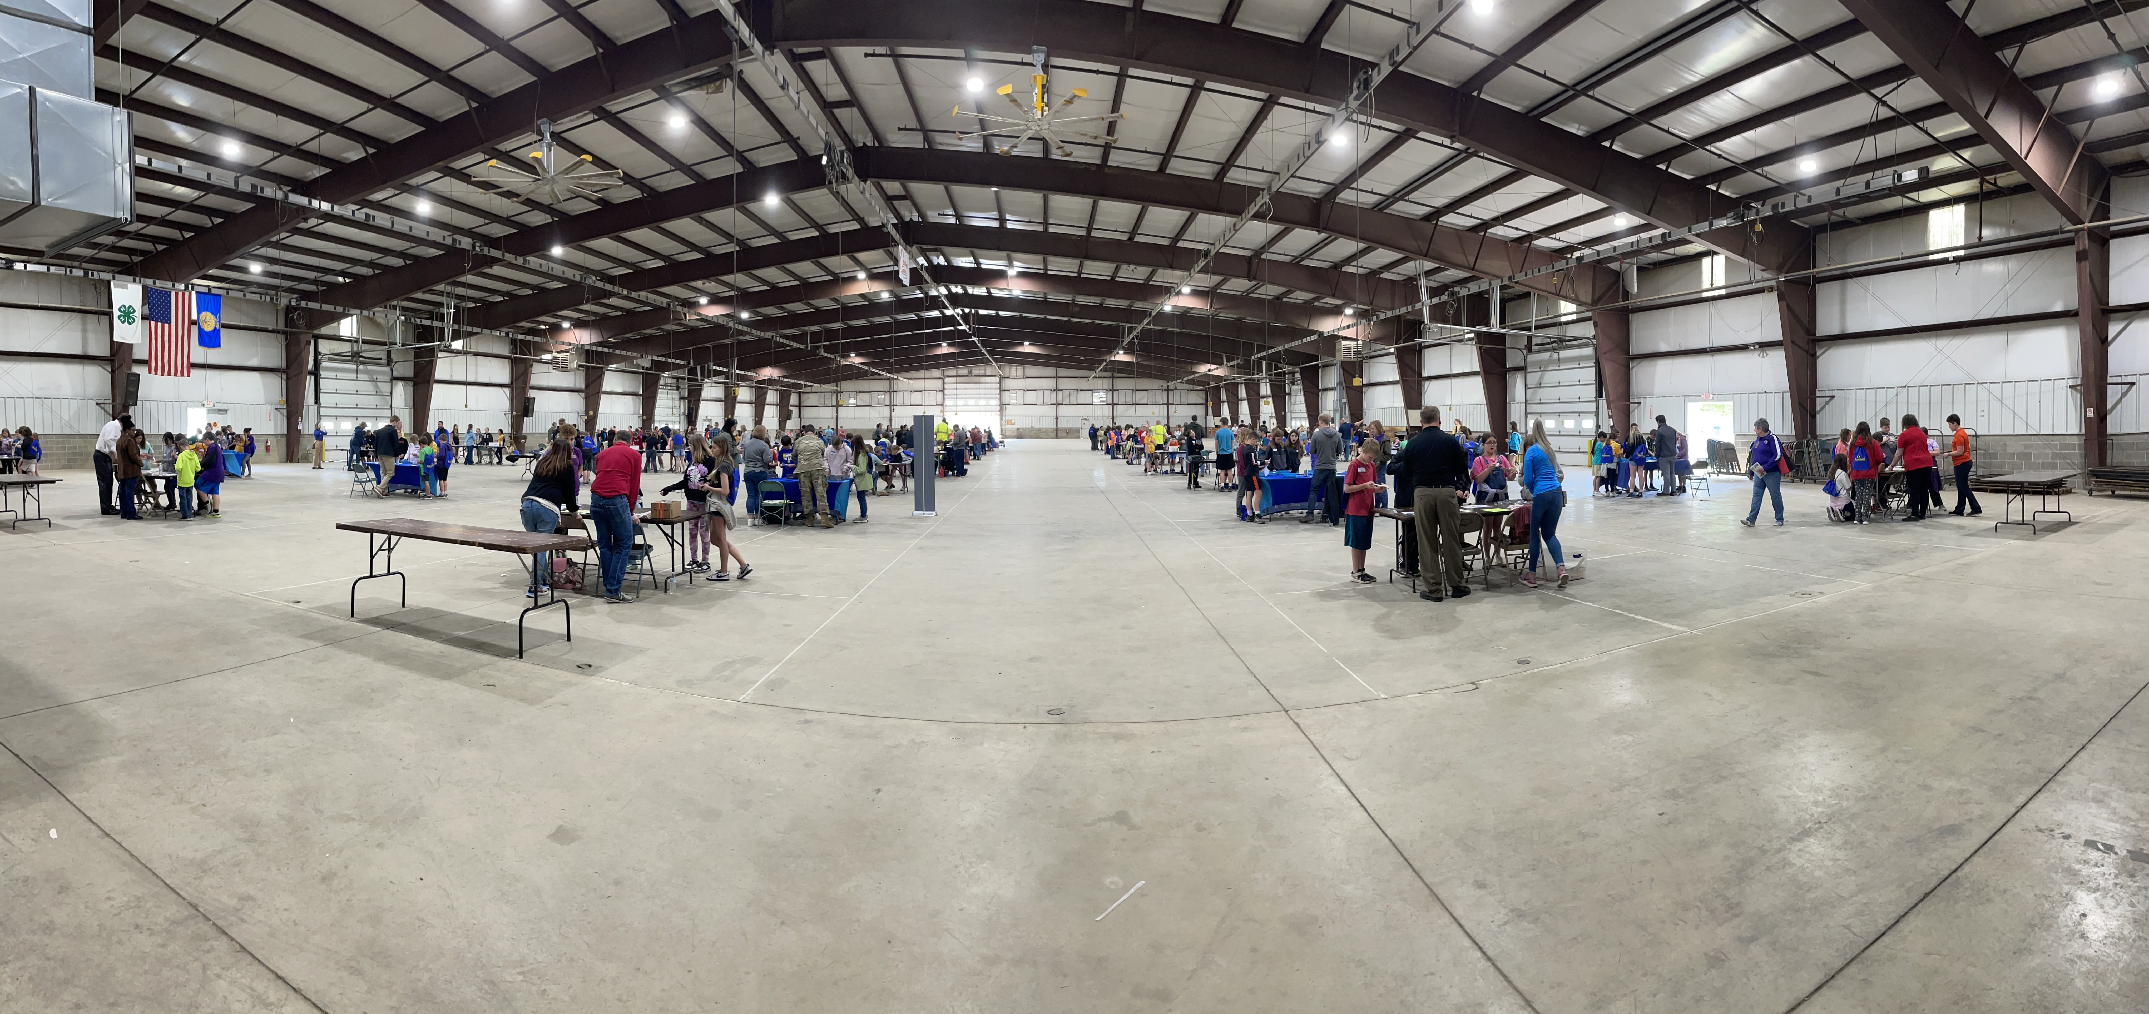
Collaboration
$
Community resources
Preble County Fairgrounds
Event locations – schools; fairgrounds; businesses
Transportation – schools
Preble County Development Partnership – funding for credentialing and event support

Slide 7
Collaboration
Schools
Monthly or quarterly meetings
Superintendents
Principals
Counselors
Staff
Share BAC input with these educators
Brainstorm possible solutions
Communicate Career Connections K-12 plan rollout and next steps

Slide 8
Collaboration
Businesses
Supportive contacts
Plant Managers
Human Resource Managers
Supervisors
Numerous Staff
BAC members and others offering their facilities for tours
Coming to schools for “Lunch and Learns”
Providing job shadowing opportunities
Grant support letters (IWIP $260K)

Slide 9
Support
Funders
Events and Curriculum Support
Area Business “seed” funding
School Districts all contribute
Preble County Development Partnership (Economic Development)
    Workforce committee support
    Credentialing and grant support
Full-time Career Connections Director support since 2019
K-12 plan
Career Awareness K-5
Career Exploration 6-8
Career Planning 9-12

Slide 10
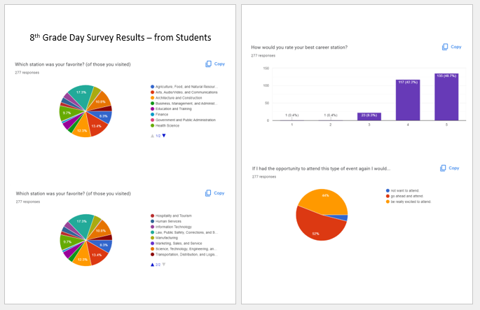
Results

Slide 11
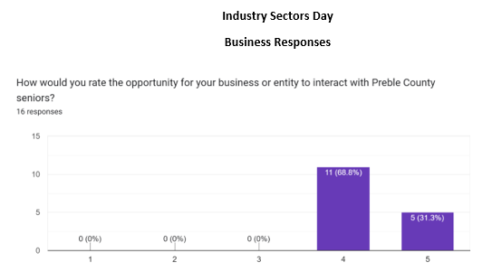
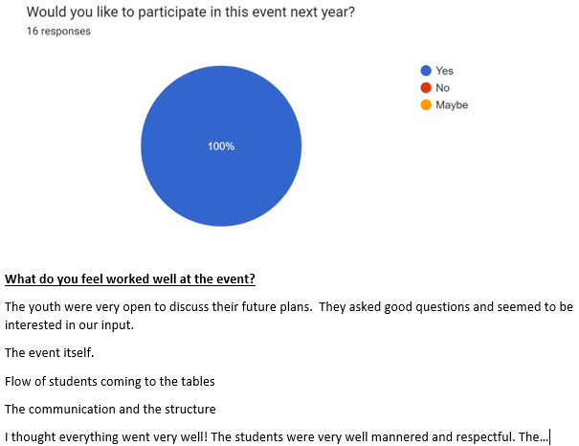
Results

Slide 12
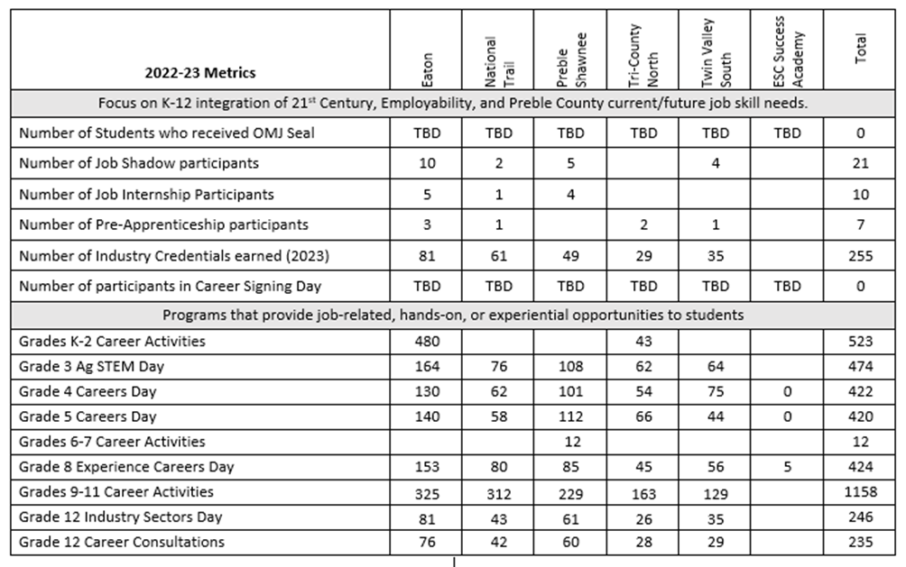
Results

Slide 13
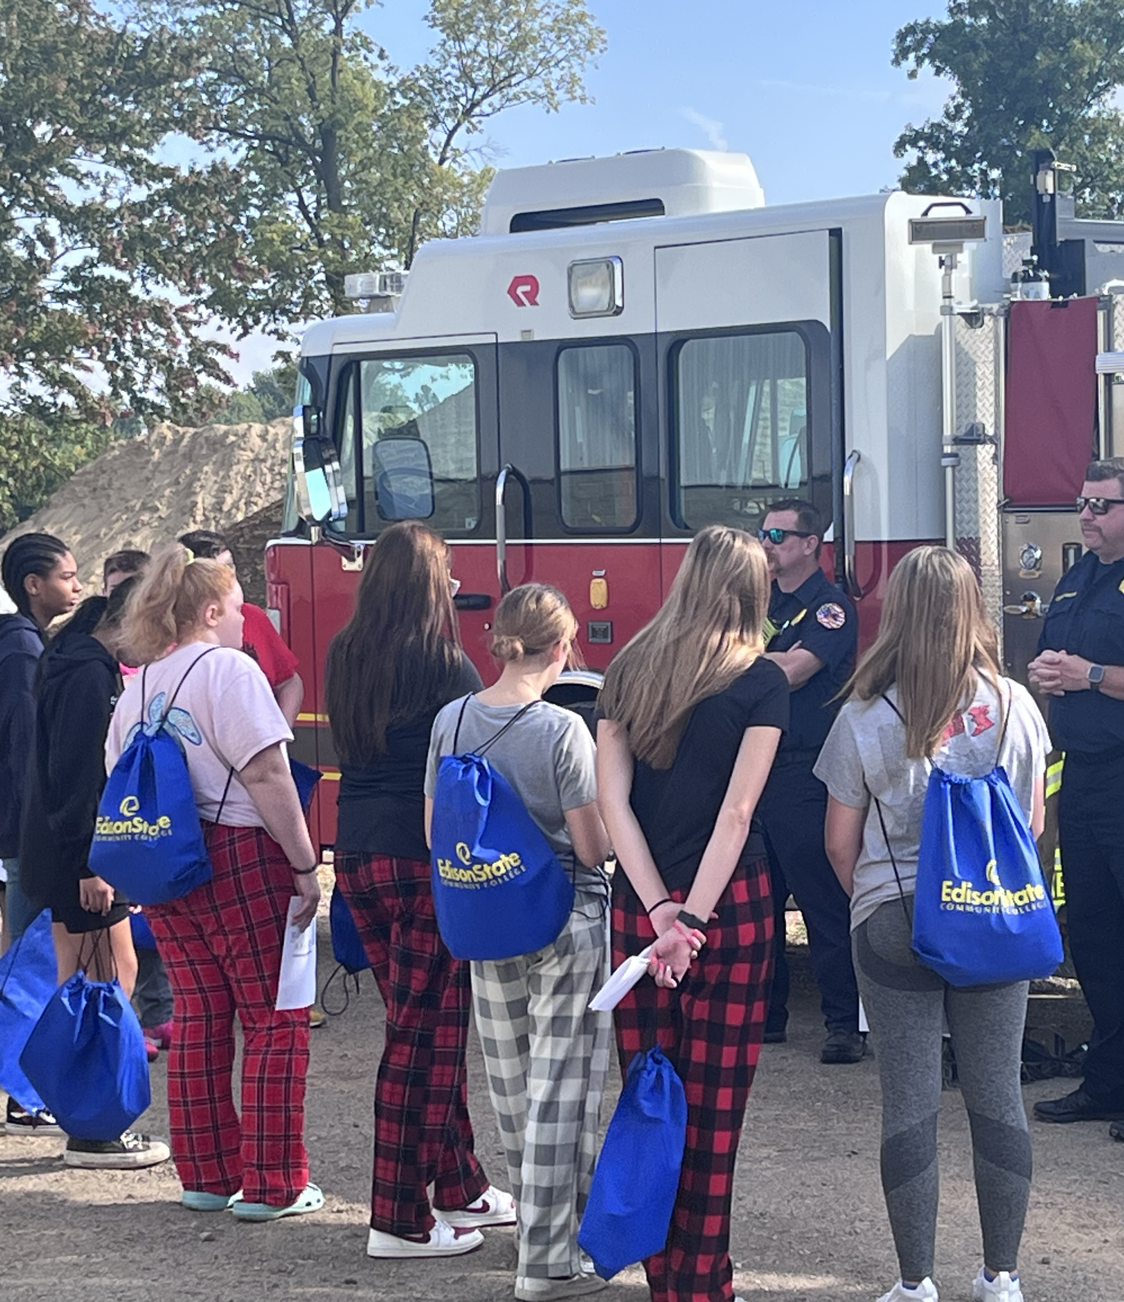
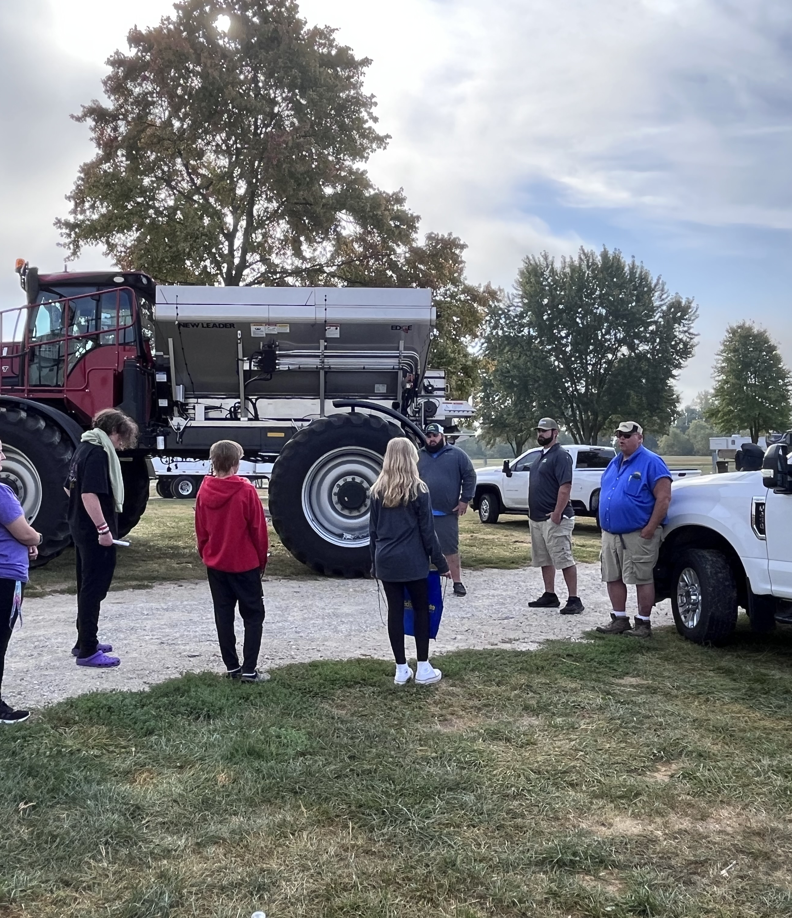
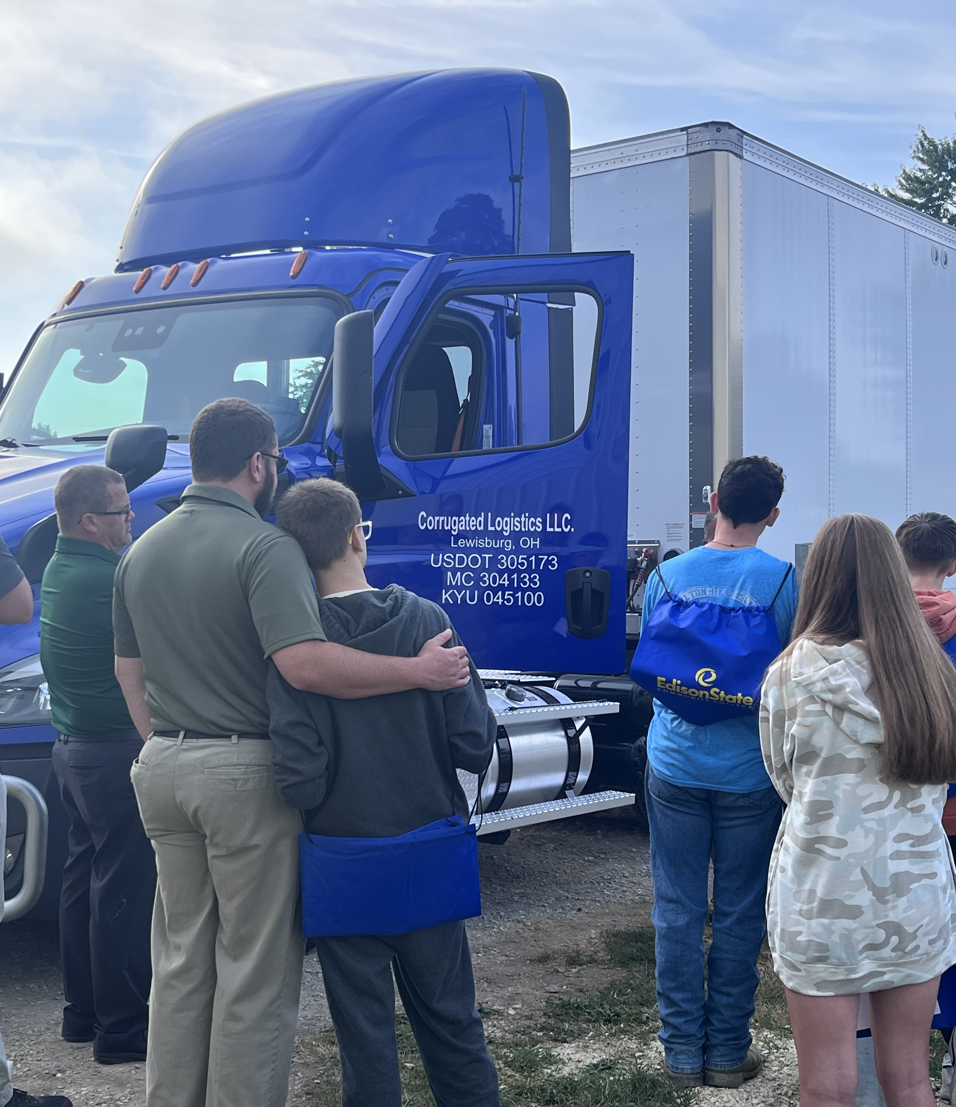
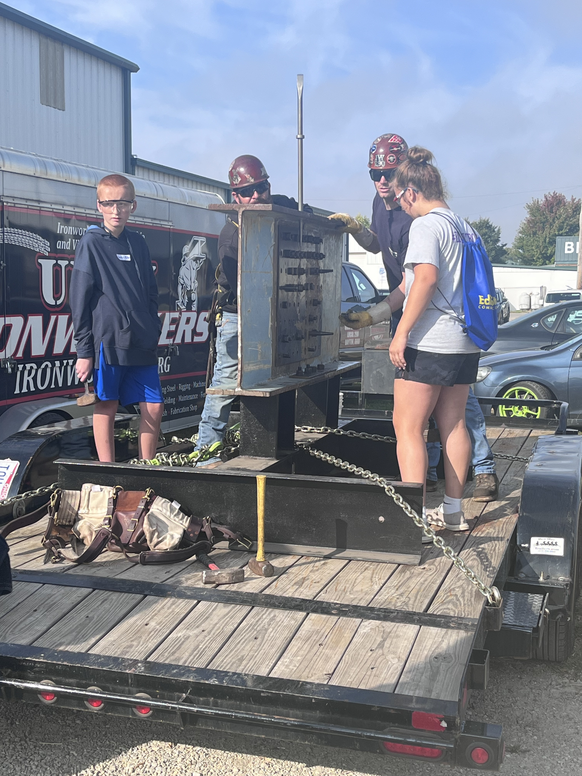
How can you support your Bac Mission?

Slide 14
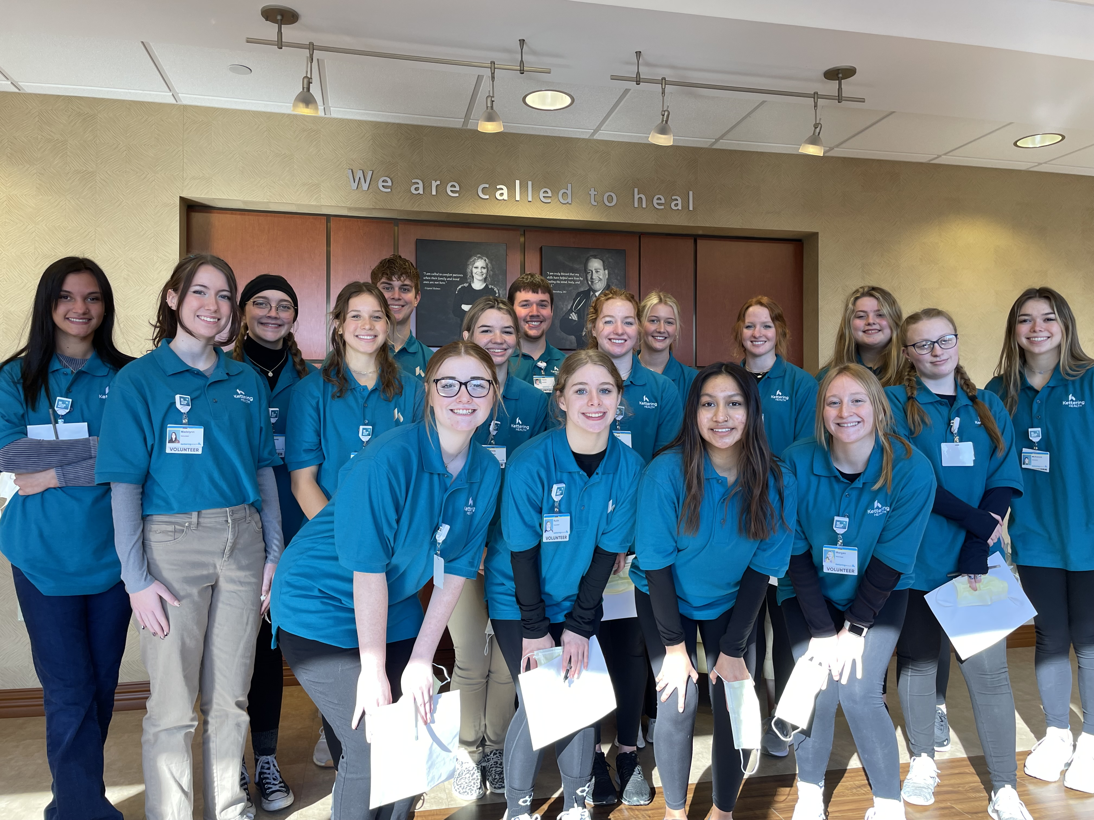
THANK YOU
Harold Niehaus
harold.niehaus@preblecountyesc.org

