Slide 1
STEM/Computer Science/CTE
info@learningblade.com
Get your free account at www.learningblade.com/OH
Provided by:
In strategic partnership with

Slide 2
“Missions” involve a societal challenge that interests students
Mission Challenge Career Clusters
12
Car Manufacturing | Use modern manufacturing techniques to design and build a new concept car | Advanced Manufacturing
Dolphin Rescue | Help rescue rehabilitate an injured dolphin, including creating an artificial prosthetic tail | Biomedicine, Marine Science
Energy Sources | Evaluate alternative or upgraded energy sources for a city that currently has an old coal-fired power plant | Energy Production, Environment
Entrepreneurship | Set up a new business with a focus on entrepreneurship | Finance, Business
Flu Outbreak | How health and IT professionals can use data warehousing and analysis to predict flu outbreaks using GIS and social media data | Information Technology
Fresh Food | Consider methods to increase production of local foods in a community | Agriculture
Hack Attack | Learn about methods to create and protect website, apps and social media after a school’s website and media are hacked | Computer Science
Haiti Orphanage | Design and build an environmentally-sound orphanage for children left homeless by an earthquake in Haiti | Construction, Sustainability
Heart Surgery | Conduct heart surgery and therapy for a child with a heart defect; evaluate the use of artificial hearts or heart components | Medicine
Lightweight Aircraft | Design a lightweight and easily maintained aircraft for distant missions | Lightweight Metals Manufacturing
Rescue Robots | Explore technology used for robotics design, such as sensors, electrical circuits, industrial design and computers | Electronics, Computer Science
Transportation Congestion | Evaluate new transportation methods for a city that has a traffic congestion problem | Transportation
“Missions” that engage all students

Slide 3
Each Mission includes an interactive toolbox of lessons and activities
Interactive online lessons, ready-to-use lesson plans and activities for middle and high school students. Can be used by any teacher, anywhere. Validated and proven to increase STEM/CS/CTE career interest.
Interactive Lessons
Hands-On Projects
Design Thinking
Parent Discussions
Over 400 online lessons tied to academic standards
Mission challenges are project-based lessons using common materials
Solve complex problems with the 5-step creative thinking process
Handouts and easy experiments for at-home discussions
Career Videos
3D Printing Activities
Intro to Coding
Papercraft Figures
Introduce over 50 careers with real-life people
Create objects that demonstrate science principles
20-hour middle school course providing robust coding experiences
Students make origami-type figures of 100 careers and technologies

Slide 4
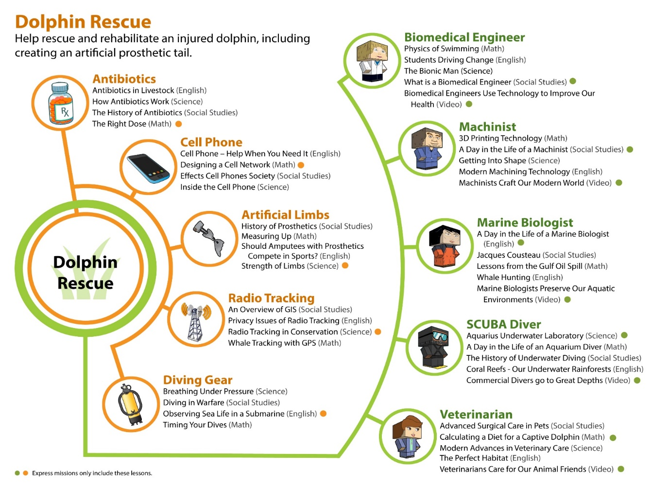
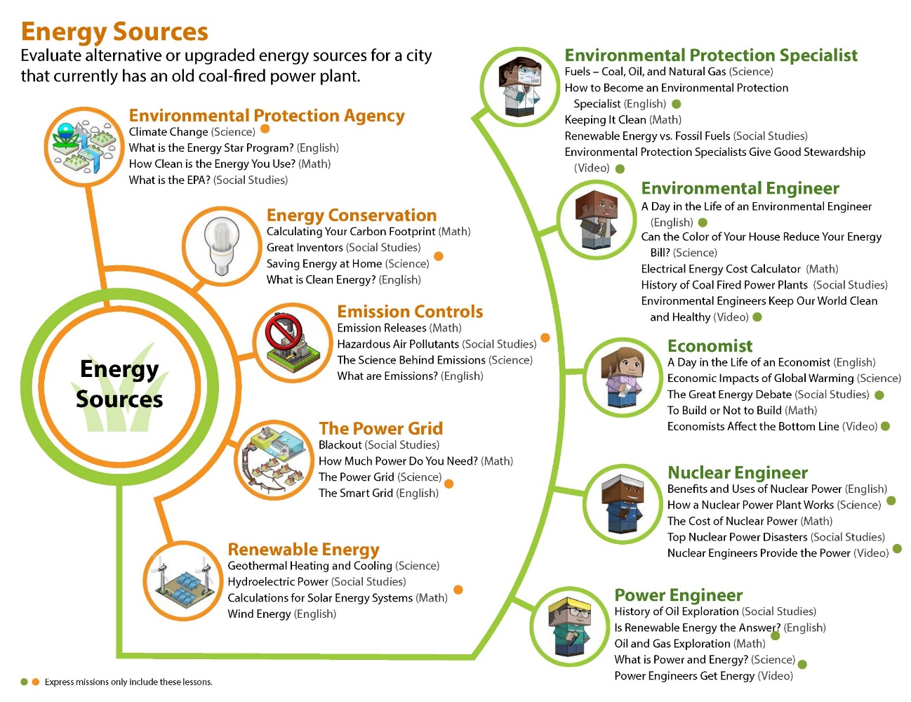
LB contains over 100 careers and technologies, 400 lessons in the specific contexts of science, math, English and social studies
Sample mission outlines showing Science, Math, English and Social Studies lessons for each career and technology
Tools
Teammates

Slide 5
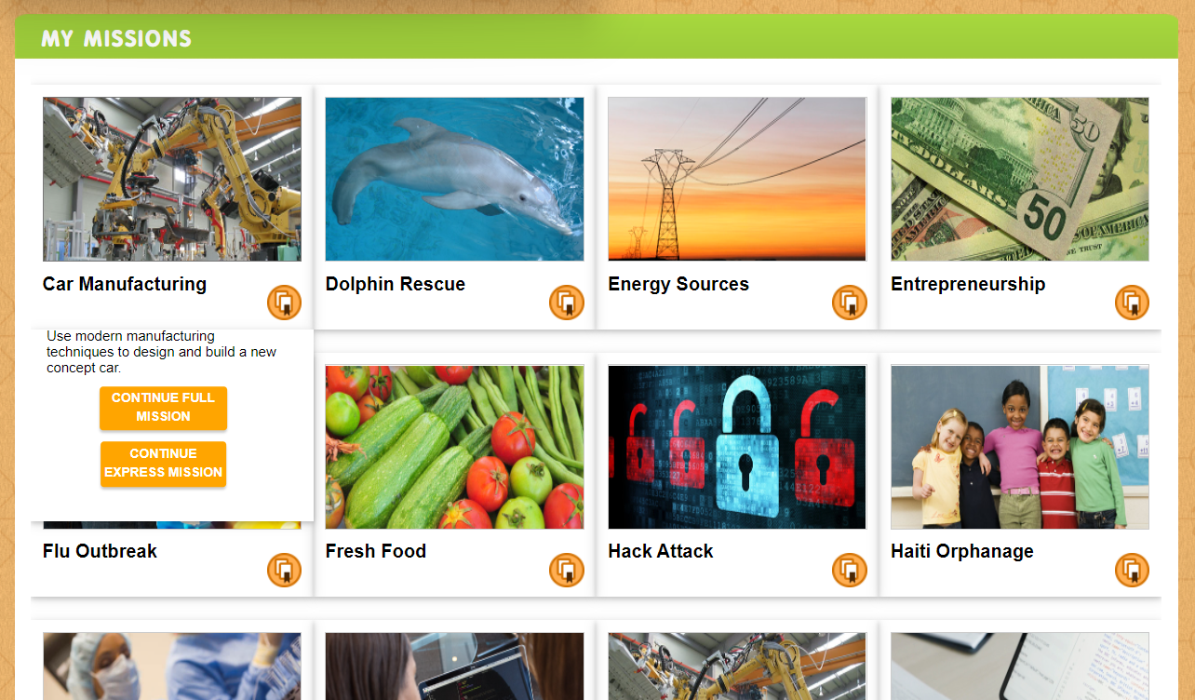
Students Can select a Mission, or teachers can assign specific Missions

Slide 6
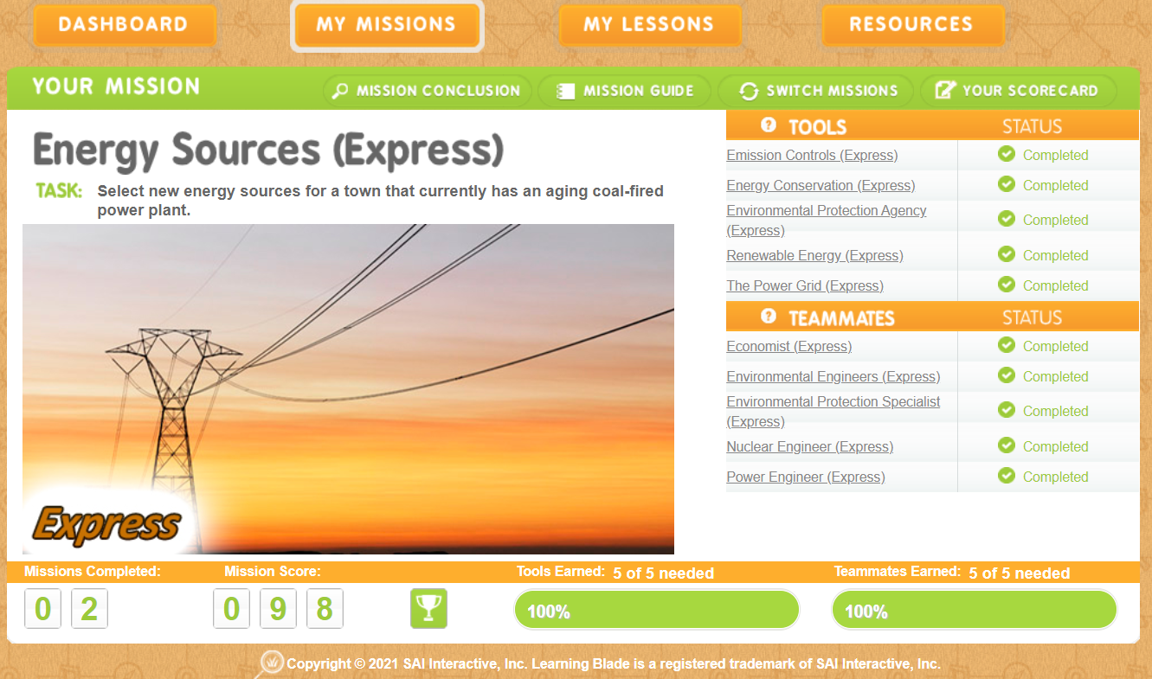
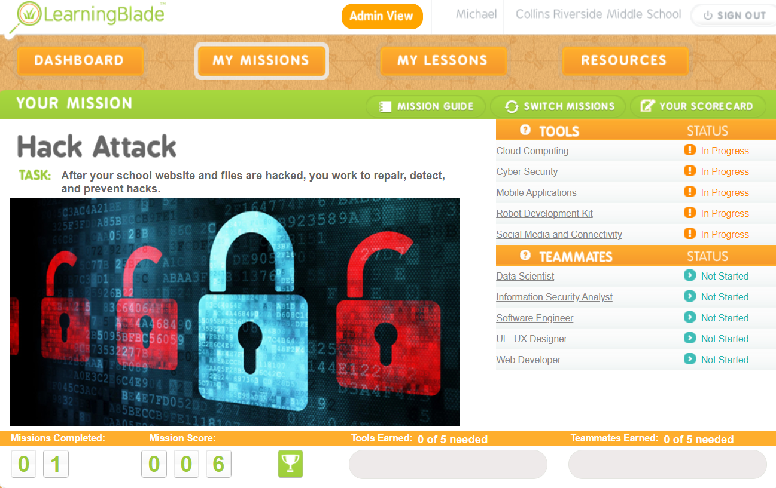
Students operate missions from a mission dashboard

Slide 7
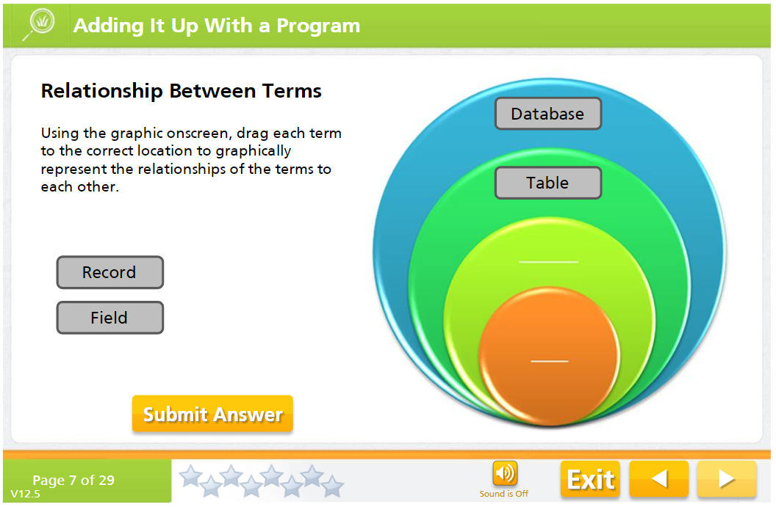
LB interactive lessons introduce careers while reviewing academics

Slide 8
OH Career Connections Framework
Learning Blade curriculum is aligned to middle school standards while exploring 100 STEM careers and technologies:
Grades 6-8: identify interests, develop self-awareness, determine personal motivations related to work and income
Accountant | Environmental Engineer | Nuclear Engineer
Agricultural Engineer | Environmental Protection Specialist | Nurse
Agronomist | Epidemiologists | Paramedic
Anthropologists | Food Assurance Technician | Power Engineer
Architect | Industrial Designer | Safety Administrator
Automotive & Engineer Technician | Industrial Engineer | SCUBA Diver
Automotive Designer | Information Security Analyst | Software Engineer
Biomedical Engineer | Investor | Statistician
Business Consultant | Logistics Engineer | Therapist
Civil Engineer | Machinist | Transportation Engineer
Computer Programming | Manufacturing Technician | Transportation Planner
Data Scientist | Marine Biologist | UI/UX Designer
Database Administrator | Mechanic | Veterinarians
Doctor | Mechanical Drafter | Web Developer
Electrical Technician | Mechanical Engineer | Welder
Electrician | Microbiologist
8

Slide 9
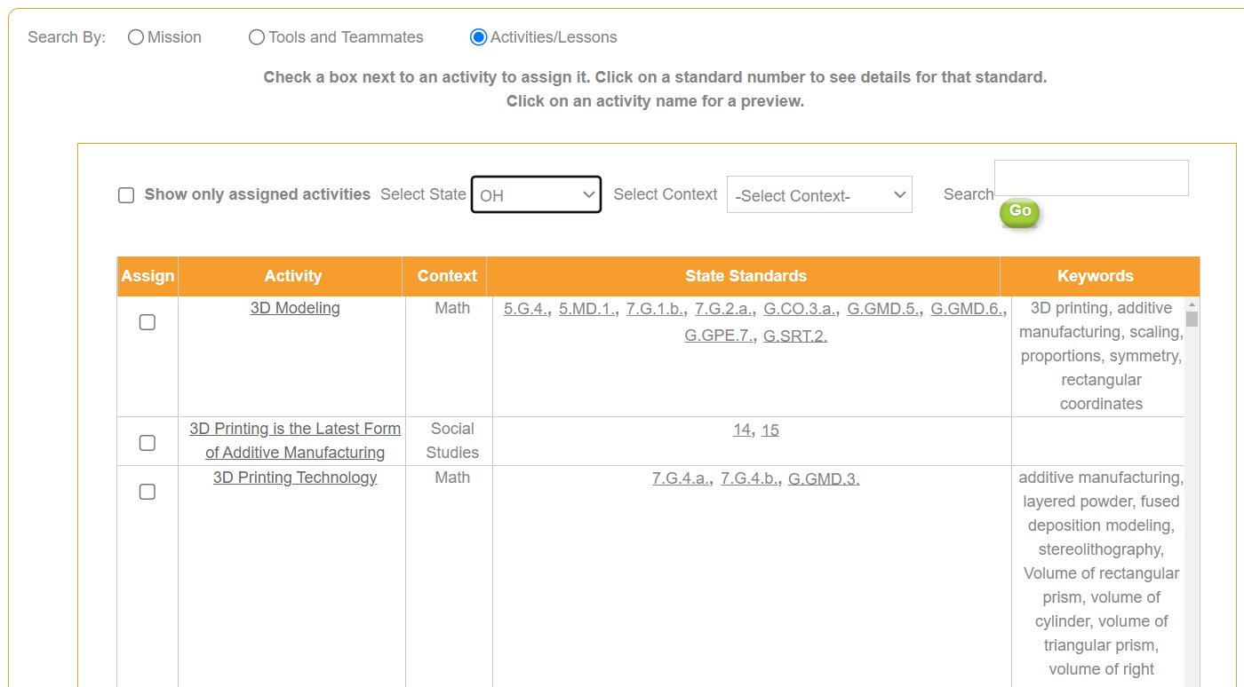
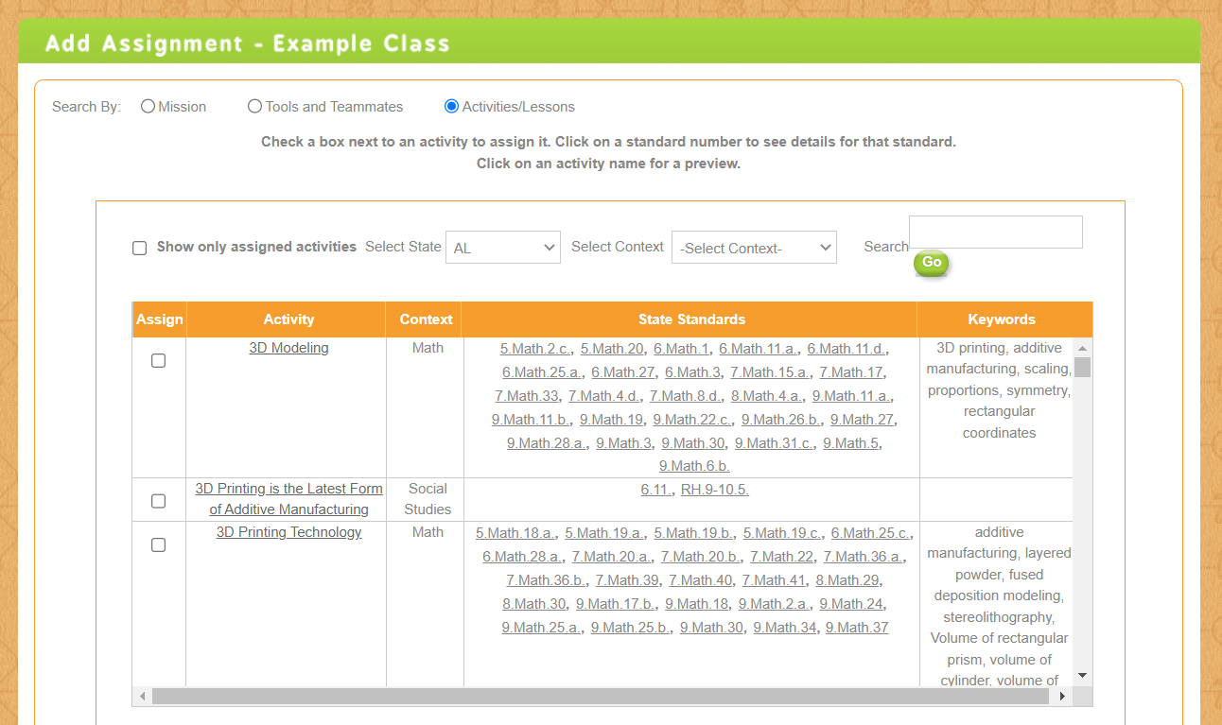
Lessons are specifically aligned to state academic standards.

Slide 10
Teachers Feel Confident With Learning Blade Teacher Survey Data
92% is Easy to Use
91% helps students visualize themselves in STEM career paths.
93% helps students understand how STEM careers solve real-world problems
93% provides students practical examples of the application of science concepts
92% Provides practical examples of the application of math skills
80% provides useful hands-on lesson plans
“This is so good, what Learning Blade offers is missing from every class I've seen. This reinforces skills across the curriciulum.“
Jason Hubbard - Teacher on Special Assignment, Perrysburg Schools, STEM K-12

Slide 11
Ohio Success Story
Springboro Middle School
5+ Years using Learning Blade
1,579 Students Impacted
78,000+ Online STEM Lessons Completed
10,000 Downloads
Lori Langdon, Technology Teacher, Springboro Middle School "Learning Blade is innovative, it's exciting, it's new, it's interesting for the kids, the kids love it. It's interactive and students are drawn in. The fact that it's so geared toward their interests and relates to a 12 year-old, yet it introduces things that I don't even know about.”
Chad Lensman, Principal, Graham Middle School.
As a rural school, we don't have a lot of access to manufacturing your different careers within our own backyards, …, this really levels the playing field.“
Dan Leffingwell, Superintendent, Noble Local Schools
"A great supplement to any curriculum! Making the connection between curriculum and future career opportunities help students identify their 'why' and increases the course 'relevance'."

Slide 12
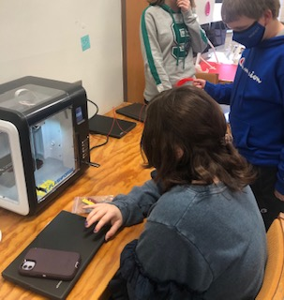
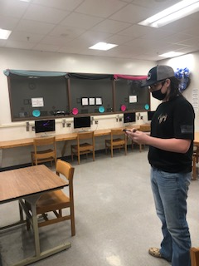
Administration and Teacher Feedback
“My students love learning about the different STEM careers, and they like learning all the different ways they can use English, Math, Science and Social Studies in the real-world."
Middle School Principal
“Students really seem to enjoy completing the Learning Blade lessons. The activities do a great job of connecting cross-curricular content with real-world scenarios.”
Middle School Science Teacher
“I love Learning Blade because the STEM-focused lessons are applicable to many different career fields. The missions keep all types of learners engaged!”
Middle School Teacher

Slide 13
Thank you!
Get your free fully funded account at
www.LearningBlade.com/OH

