Slide 1
NAVIGATING FUTURE PATHWAYS: Intersecting Education and Labor Markets to Increase Opportunities Using the Ohio In-Demand Jobs & CTE Pathways Alignment Map

Slide 2
GATHER DATA TO DETERMINE “NEEDS”
COMMUNITY AND BUSINESS/INDUSTRY
Assess labor market information locally and for the region and state to gain insights about conditions and trends in the job market for a career field pathway and determine if training will lead to sustainable-wage, high-skill and in-demand employment
Chambers of Commerce Workforce/Economic Development Agencies
Post-Secondary Institutions—Community Colleges/Technical Schools and Ohio Technical Centers Ohio In-Demand Jobs and CTE Pathways Alignment Map Ohio_Experience_022823 (arcgis.com) Ohio’s Top Jobs Top Jobs in Ohio | Ohio’s Top Jobs
Ohio Means Jobs OhioMeansJobs | Ohio.gov Ohio Labor Market Data Home (ohiolmi.com)

Slide 3
FUNCTIONALITY
PURPOSE
MAP OVERVIEW
AUDIENCE
DATA SOURCE

Slide 4
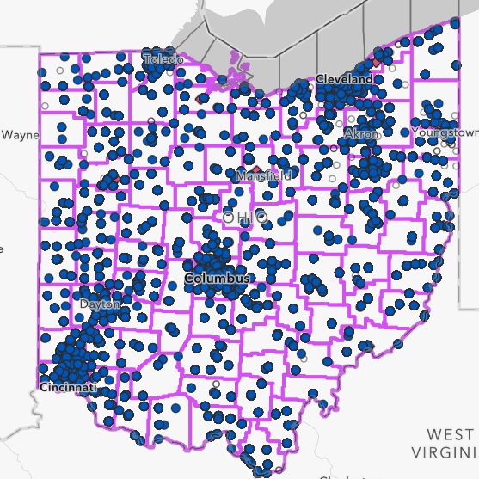
KEY FEATURES

Slide 5
DEFAULT MAP
VIEWS
ZOOM SELECTION

Slide 6
Be sure to scroll down!
SELECTION CRITERIA
RESULTS PANE AND LEGEND
POPULATION SELECTION

Slide 7
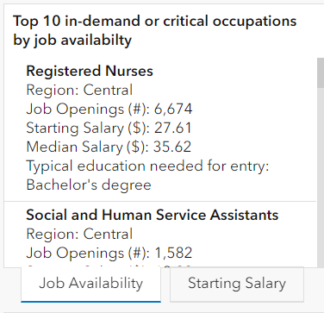
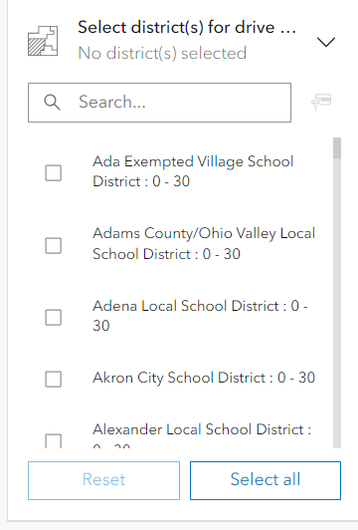
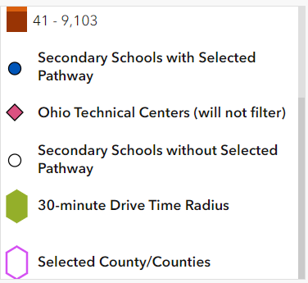
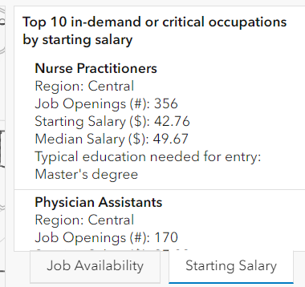
ADDITIONAL MAP INSIGHTS
LEGEND Insight: Pink outline for county/counties selection
Job Availability & Starting Salary are two separate views in the RESULTS PANE
Ability to select school districts for driving route

Slide 8
MAP IN ACTION

Slide 9
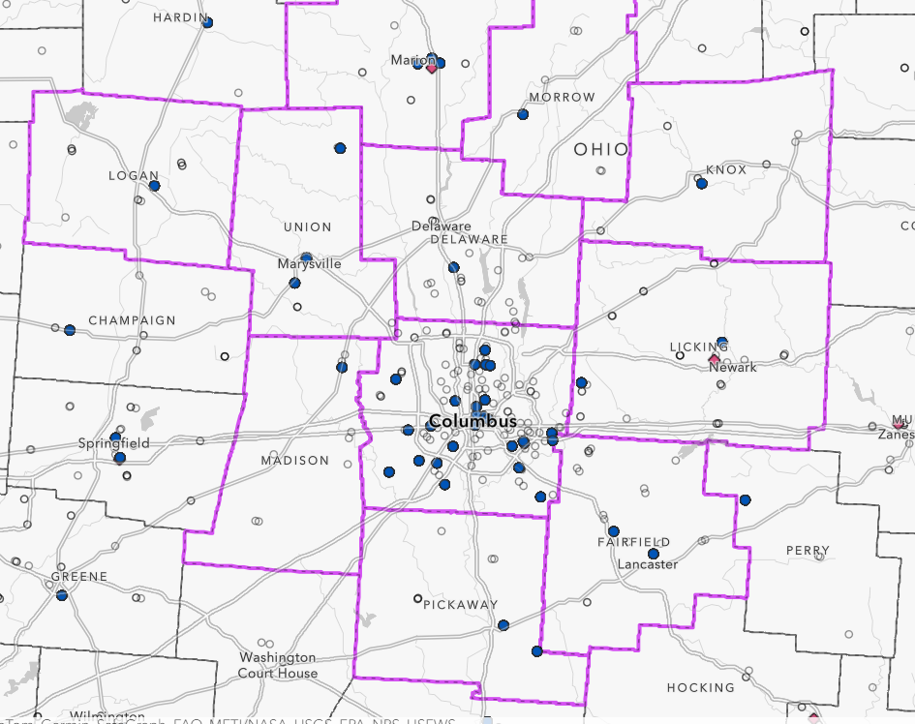
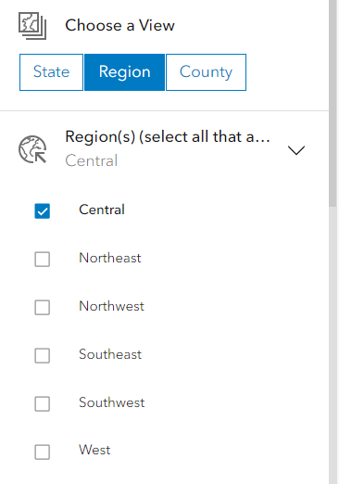
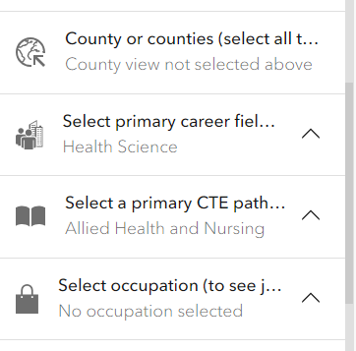
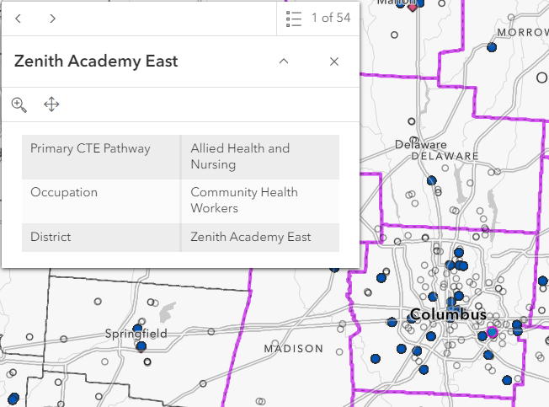
EXAMPLE #1
Using the following criteria:
Region: Central
Primary Career: Health Science
Primary CTE Pathway: Allied Health and Nursing
No occupation
All populations
RESULTS
Additional information pops-up when hovering over blue result dots

Slide 10
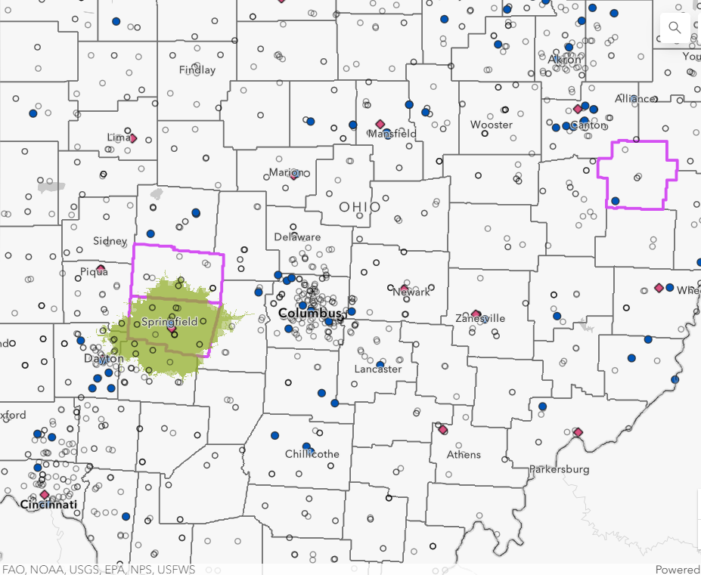
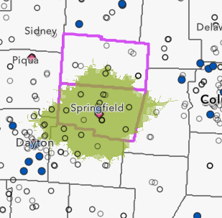
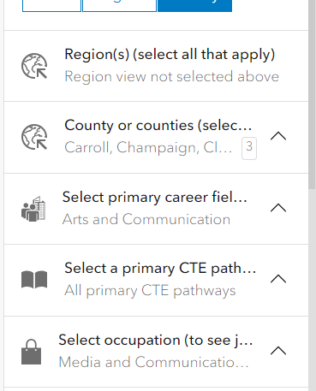
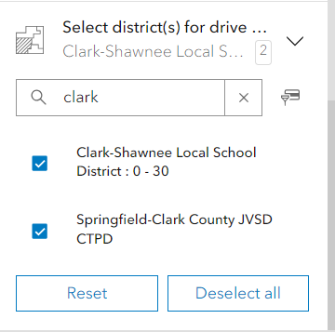
EXAMPLE #2:
Using the following criteria:
Counties: Champaign and Clark
Region: West and Central
Primary Career: Arts and Communication
Primary CTE Pathway: All primary CTE pathways
Occupation: Media and Communication Workers, All Other
All populations
District: Selecting Clark-Shawnee & Springfield Clark School Districts
RESULTS
Green outline shows
30-minute drive time from chosen school district

Slide 11
SELECTION #3: LET’S PRACTICE LIVE!
Ohio In-Demand Jobs and CTE Pathways Alignment Map

Slide 12
SELECTION #4: LET’S PRACTICE LIVE!
Ohio In-Demand Jobs and CTE Pathways Alignment Map

Slide 13
EFFECTIVENESS
USABILITY
FEEDBACK AND QUESTIONS
USEFULNESS
INSIGHTS

Slide 14
THANK YOU! Rosie Matthies Tech Prep Coordinator – West Region Clark State College matthiesr@clarkstate.edu

