Slide 1
Sinclair Pre-Apprenticeship Basics & Transition to Registered Apprenticeship
March 5, 2024

Slide 2
Pre-Apprenticeship
Pre-apprenticeship is an opportunity to provide high school students with the basic technical and job readiness skills in preparation to enter a Registered Apprenticeship program. The best pre-apprenticeship programs are set up with close collaboration between the high schools, employers and Sinclair’s Office of Work-Based Learning. The purpose of this program is to provide the students with in-depth exposure to a career field that he/she may be interested in pursuing after high school.

Slide 3
Sinclair’s Pre-Apprentice Plan
Pre-Apprentice
Continuing with Current Employer
Exploring New Career Options
Continuing in Career Field – Seeking Employer

Slide 4
Sinclair’s Office of Work-based Learning
Miami Valley CTC
Upper Valley CTC
Grant Career Center
YouthBuild – Dayton
Stebbins High School
Springfield-Clark CTC
Northmont City Schools
Goshen Local Schools
Greene County Career Center
Southwest Local School District
Wayne High School
Oakmont Education
Education Service Center of Central Ohio
Warren County Career Center
Arcanum High School
Centerville High School
Tipp City Exempted School District
Dayton Public Schools
Greenville CTEC
Cincinnati Public Schools
Deer Park High School
Loveland High Schools
East Central Ohio ESC
West Clermont High School
Putnam County ESC
Williamsburg Local School District
New Richmond Schools
Hamilton City Schools
Reading Community School District
Norwood High School
Northwest Local School District
Brookville Local School District
Finneytown Secondary Campus
Dominion Academy of Dayton
Tri-County ESC
Springboro Community School District
Dayton Business Technology High School
Dayton Regional STEM School

Slide 5
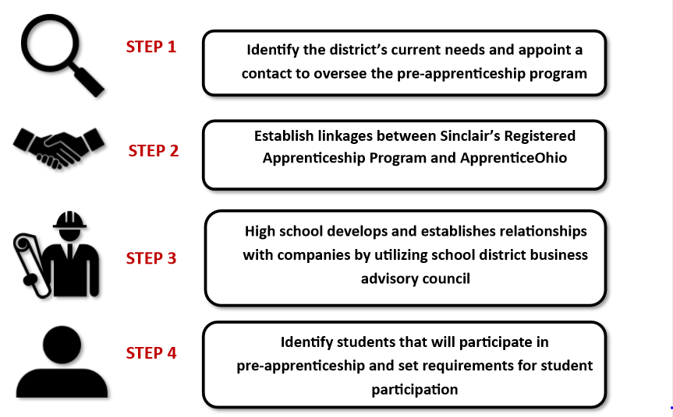
Pre-Apprenticeship

Slide 6
Pre-Apprenticeship

Slide 7
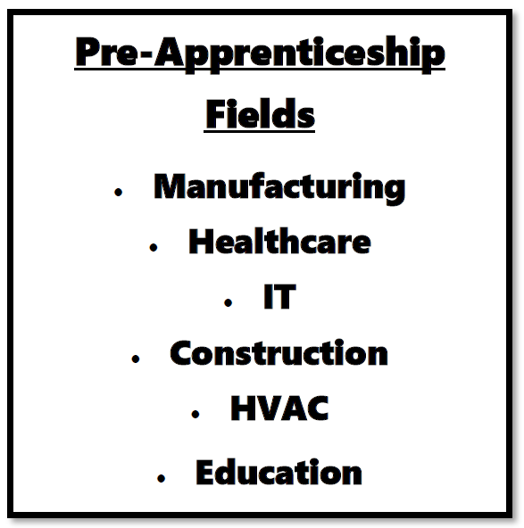
Pre-Apprenticeship

Slide 8
Pre-Apprenticeship

Slide 9
Pre-Apprenticeship

Slide 10
Operating Plan Overview
The Components of an OSAC Recognized Pre-Apprenticeship Operating Plan
Section A: Equal Opportunity Pledge
Section B: Enrollment
Section C: Instructional Content
Section D: Participant Status
Section E: Safety and Welfare
Section F: Program Administration
Section G: Linkage(s) to Registered Apprenticeship
Section H: Registered Apprenticeship Linkage Letter(s)

Slide 11
What is the role of the Secondary School?
Be the Provider of OSAC Recognized Pre-Apprenticeship: - Research/determine occupations or occupational sectors - Determine your related coursework - Seek Registered Apprenticeships (Employers/Signatory Employers) - Draft Operating Plan - Gain Recognition
Administer Your OSAC Recognized Pre-Apprenticeship: - Execute the content of your Operating Plan - Maintain participant and programmatic records - Oversee evaluations of both in school and on-the-job performance - Submit for completion certificates - Reach out to your ApprenticeOhio Field Rep. for assistance as needed and to update your Operating Plan as you grow.

Slide 12
Linkages to Registered Apprenticeship
WBL role in Pre-Apprenticeships is to provide the link of Registered Apprenticeships to a High Schools Recognized Pre-Apprenticeships
The link represents the connection of an Industry to one of Sinclair's Registered Apprenticeship Occupations
The linkage allows High Schools to work directly with companies who are partners with Sinclair Registered Apprenticeship Program

Slide 13
Win-wins
Student Engagement
High School Communication
Working with Employers
Transitioning to Post-Secondary

Slide 14
Transitioning to Next Steps
Pre-Apprentice
Continuing with Current Employer
Exploring New Career Options
Continuing in Career Field – Seeking Employer
Transition Student to Registered Apprenticeship Manager
WBL Staff Identifies Employers Seeking Registered Apprentice
Student meets with WBL Professional Coach
Student works with Sinclair Admission Team
If the Student is Placed: If Apprenticeship placement available, Begin Apprenticeship
If the Student is not Placed: Begin Academic Program but still seeking

Slide 15
OSAC Recognized Pre-Apprenticeship Transition to Registered Apprenticeship

Slide 16
Sinclair’s Office of Work-based Learning
Registered Apprenticeship Transition

Slide 17
Prior to transitioning student to Apprenticeship Project Manager
Student applies to Sinclair
Student has high school transcript, ACT/SAT scores sent to Sinclair
Student applies to Registered Apprenticeship program
Note: This is a wish list, and we can provide support for students who have not yet completed these steps

Slide 18
Transition of student to Registered Apprenticeship
Student meets with APM to fill out paperwork and go over program
Introduce student to campus, parking, etc.
Assist student in registration for classes
Provide student with single point of contact for questions/concerns
This could occur prior to graduation, or soon after

Slide 19
Transition of employer to Registered Apprenticeship
Apprenticeship Project Manager will meet with employer
- Tour work environment
- Meet mentor(s)
- Review expectations
- Complete final paperwork
- Demonstrate OJT Tracking
Provide employer with single point of contact for all questions and concerns going forward

Slide 20
Questions and Discussion

Slide 21
Thank you!

