Slide 1
Success Bound at Piqua City Schools

Slide 2
Take Away From Today:
WorkKeys Curriculum vs. WorkKeys Assessments
How do High Schools use the WorkKeys Assessments?
Using the NCRC to Align with Career Interests
ACT Work Ready Communities

Slide 3
Success Bound: ACT WorkKeys Curriculum
WorkKeys Curriculum is different than the WorkKeys Assessment
The WorkKeys Curriculum builds the career skills that are necessary for learning, personal development and effective job performance
Three Main Areas of Focus with the WorkKeys Curriculum
Applied Math: Math principles to problems in the workplace
Graphic Literacy: Ability to find, analyze and apply information presented in workplace graphics
Workplace Documents: Understand and apply written information presented in the workplace
These are the three main areas assessed with WorkKeys Assessments, the NCRC and in Workplace Profiling

Slide 4
Success Bound: ACT WorkKeys Curriculum
Piqua currently uses this with Work Based Learning courses and Pre-Apprentice courses (Law Enforcement, STEM, Grounds and Maintenance, Manufacturing)
Plan to bring this to some resource room settings to build job and career skills
ACT WorkKeys Courses
Piqua does purchase the full suite of courses (around $2500/year)-
Essential Skills Courses are the focus of our upcoming work with a wide range of students
Easy to manage and assign- students complete a pre-assessment and are assigned Skill Levels

Slide 5
Success Bound: ACT WorkKeys Curriculum
WorkKeys Curriculum Skill Levels are matched to the Skill Levels measured by the actual WorkKeys Assessment
Levels range from 1-7, and students can score in the 1-7 Range on the WorkKeys Assessment
Using the WorkKeys curriculum allows us to prepare students for the WorkKeys Assessment and helps to demonstrate the types of questions that they will see at at each level of the WorkKeys Assessment

Slide 6
Success Bound: ACT WorkKeys Curriculum
Sample Applied Math Question
Sample Graphic Literacy Question
Sample Workplace Documents Question
* Please Note- Students in Ohio must Score a 14 on the WorkKeys Assessment to meet graduation requirements. This equal a combination of a 5,5 and 4 in the above three areas.

Slide 7
Success Bound: ACT WorkKeys Assessment
Online for students
Can do one section at at time (I advise this!)- Roughly 50 minutes per section
We schedule this around WorkKeys Curriculum Progress
We schedule for whole class or individual students
Instant results and reporting
Enroll students and manage the assessments locally
Monitor student progress in real time

Slide 8
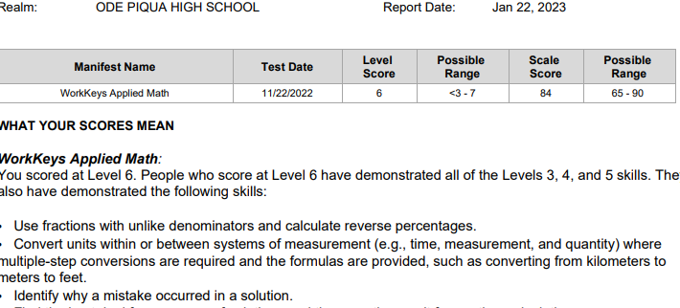
Success Bound: ACT WorkKeys Assessment
Sample Student Report

Slide 9
Success Bound: ACT WorkKeys Assessment
WorkKeys Assessment Considerations:
This can be a part of a Graduation Pathway (coupled with a Credential, Pre-Apprenticeship, etc.
14 is the score needed in Ohio to meet graduation requirements
Every high school in Ohio has been assigned a Testing Realm - you will need to find the Realm ID for your school if you have not done so already. That information can be found at the ODE WorkKeys Information website
It can be tricky to get started - the testing site can be a little archaic and confusing. Reach out to me if you have any questions and I will be happy to help!
Schools are reimbursed for student assessment
District will pay the cost for each test, and then submit to ODE for reimbursement
This is done through the Financial section of the OHID site
Important- use SSIDs for students. This is needed for reimbursement

Slide 10
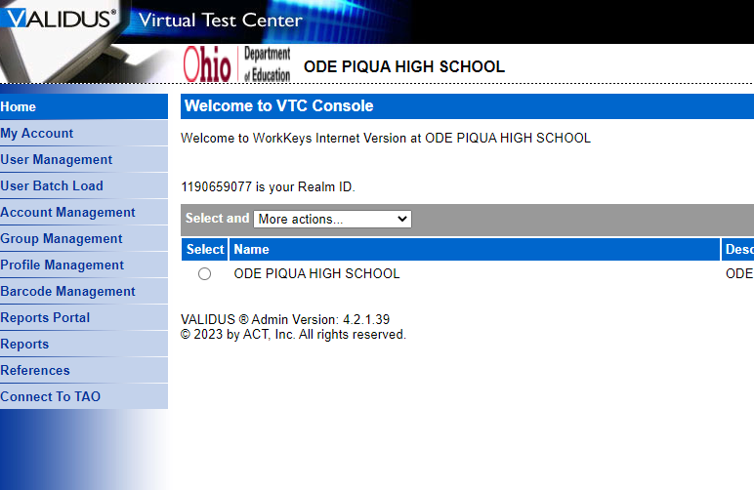
Success Bound: ACT WorkKeys Assessment
Basic Steps for Using the WorkKeys Assessment Suite in your district:
Obtain the Realm ID for your school and log into the testing Site
Determine the district Test Admin and set up roles in the testing site
Enter student testing info- Remember to use SSIDs!
Set up Groups for testing
Register students for testing
Administer tests and obtain reports
Pay ACT- and then submit for reimbursement

Slide 11
Success Bound: The NCRC
The National Career Readiness Certificate - assessment-based credential for JOB SEEKERS!
Close Skill Gaps, Improve Workforce Development Skills, and Obtain Employment Across Industries
This NCRC measures achievement in Applied Math, Workplace Documents, and Graphic Literacy
This has benefits for Job Seekers, Employers, Students, Workforce Developers, Economic Developers, Industry Associations, and Legislators
There are 4 Levels of NCRC:
Platinum: Scores of Level 6 on all three exams
Gold: Scores of Level 5 on all three exams
Silver: Scores of Level 4 or higher on all three exams
Bronze: Scores of Level 3 or higher on all three exams
Students must reach the Score Level to obtain the NCRC:
Example: Scores of 4 on Math, 5 on Graphic Literacy, and 5 on Documents would earn Silver NCRC (this happens to be the base score for graduation in Ohio)

Slide 12
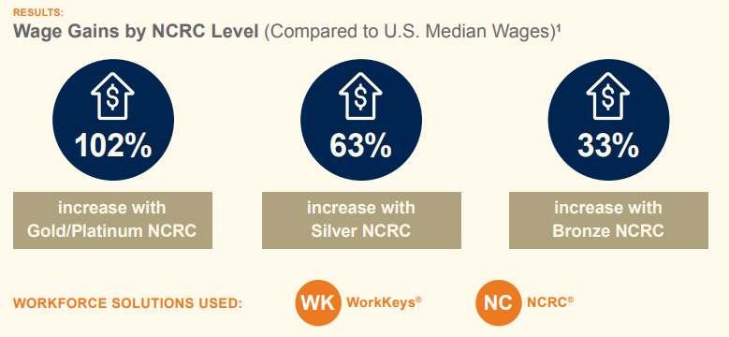
Success Bound: The NCRC

Slide 13
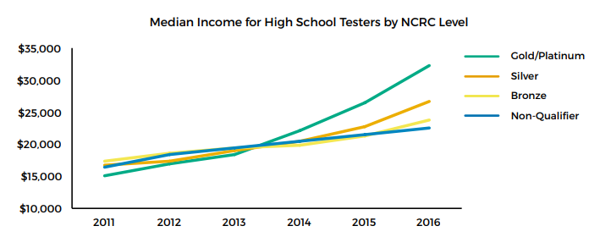
Success Bound: The NCRC

Slide 14
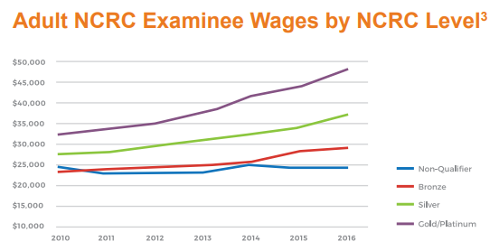
Success Bound: The NCRC

Slide 15
Success Bound: The NCRC and Occupations
WorkKeys scores, and the NCRC, relate directly to Job Skills and Career Readiness
Ohio Means Jobs Occupation Search ACT Occupation Profile Search

Slide 16
Success Bound: The NCRC
NCRC earners can now share their credentials digitally with an employer- these digital badges can be shared with employers around the country
The NCRC and College Credit
American Council on Education recommended that certain colleges award:
3 Semester hours in Technical Math and Introduction to Information Literacy to Platinum NCRC earners (6 Semester Hours)
2 Semester hours in each for Gold NCRC status (4 Semester Hours)
1 Semester in each to Silver NCRC status (2 Semester Hours)
We have not done this yet- but are working towards this with Edison State Community College
Piqua Works to help each student obtain their NCRC as they complete the WorkKeys Curriculum and Assessments
Piqua is working with our Business Advisory Council members to recognize and reward NCRC status
NCRC Website

Slide 17
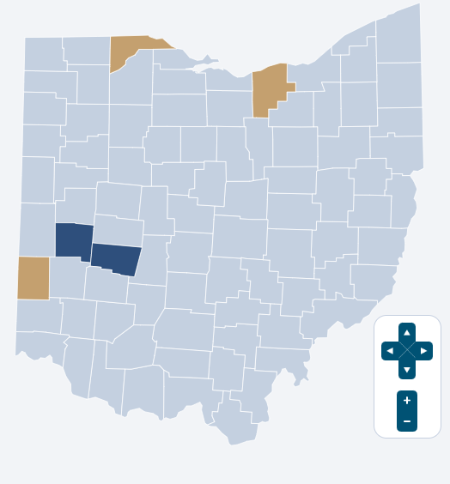
Miami County ACT Work Ready Community
What Are Work Ready Communities?
Miami County, OH: A Work Ready Community in Progress

Slide 18
Questions? Need Help or Someone to Talk To?
Scott Bloom
Curriculum Director
Piqua City Schools
blooms@piqua.org
(937) 773-4321

