Slide 1
Title Slide
EMPOWERING INTENTIONAL, INDIVIDUAL SUCCESS.
Sinclair Community College
Katie Grothaus
Career Navigation Specialist
katie.grothaus@mcesc.org

Slide 2
Notes:
Discovery is most frequently used by districts, Insights as well
Certification involves students taking exams that measure what employers are looking for and then they are awarded a certificate

Slide 3
How we used to do things….
Career guidance solely by interest survey’s is limited by a student’s exposure.
Notes:
Students struggle to see the value and application of what they’re learning in school.
Career guidance based solely on interest surveys is limited by a student’s exposure. Harmful to women, minorities and rural/urban students.
Slide Credit: Trevor Perkins

Slide 5
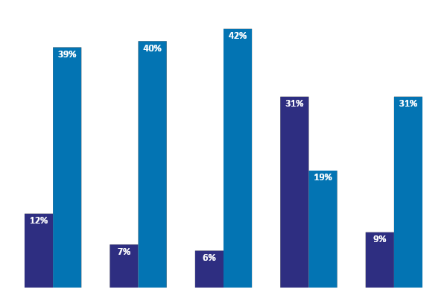
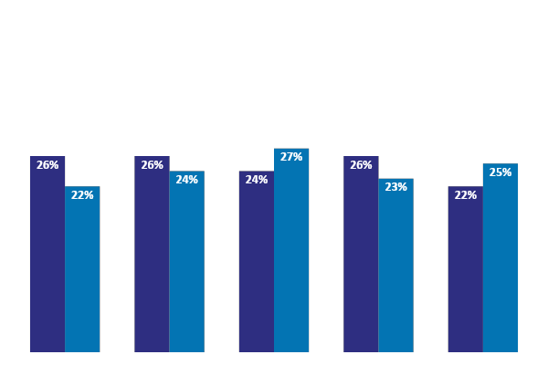
Aptitudes Remove Societal Bias
Interest
Aptitude
Percentages of GIRLS and BOYS
with Top Quartile scores in each category

Slide 6
An Education & Workforce Disconnect
CUSTOMER SUCCESS
40%
UN- & UNDER-EMPLOYED
COLLEGE GRADS
85%
High school graduation rates
33%
HS students are engaged in their education
27%
College graduates work in a field related to their major
Millions
of Jobs going unfilled
WIDENING
SKILLS GAP
Notes:
Forbes “About 40% of recent graduates are underemployed, working in jobs that do not require their level of training.” At the same time, 89% of employers report difficulty finding employees with the requisite skills for job openings.
Education and workforce systems have been disjointed.
How can we align students innate abilities with in-demand jobs?

Slide 7
All Students Have Talent
Our nation’s economy needs everyone
Notes:
By helping students identify their talent, they will be confident in their future decisions.
Traditionally we find that in schools talent tends to be identified through academic measures (GPA, test scores, etc.)
However, we know that not every student fits this mold.
BUT EVERY SINGLE STUDENT HAS TALENT (pause)
and our nation’s economy needs everyone (pause)
So how can we help you identify talent? And in return help students recognize their own talent?
Slide Credit: Jenny Padilla

Slide 8
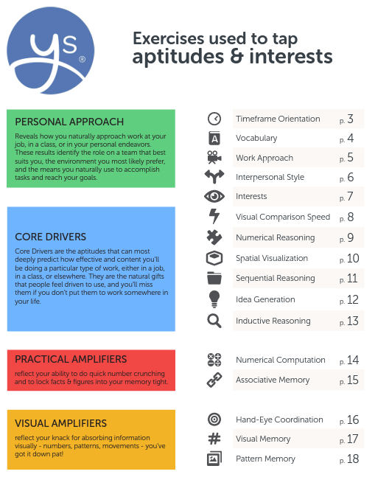
What type of work
do you prefer?
What drives you?
(Putting your skills to work)
Number cruncher?
Visual learner?
Notes:
What We Measure and Sample Exercises in Handout

Slide 9
Notes:
What We Measure and Sample Exercises in Handout

Slide 10
Important to know
Aptitudes are different from Skills or Interests.
Aptitudes solidify at
age puberty
90 minutes total,
You can take breaks, don’t try to finish all at once.
Notes:
aptitude = potential
interest = preference
Aptitudes Solidify at ages 14-15
Profile: 9th and 10th Grade and above
Snapshot: 7th and 8th Grade
First Online-Based Aptitude Exercises
Digitized Ball Aptitude Battery
Backed by decades of psychometric validation
Measures aptitudes- not self-reported
Normed and Verified

Slide 11
What are aptitudes?
An aptitude is a natural ability. Understanding your aptitudes can be helpful in making education and career choices that align with your strengths and interests.

Slide 12
Confident About The Future
“I love this. No one ever told me I was good at anything”
“I didn’t even know these careers existed.”
“I didn’t know I had the talent to do something like this”
The Georgia Governor’s Office of Student Achievement (GOSA) piloted YouScience in 51 state high schools with over 8,500 students participating. 54% of students were free and/or reduced lunch eligible, 51% female and 54% non-white.
Notes:
Based on a study done by YouScience. I believe the main thing we should mention from the Georgia study is that not only did the results show the positive correlation in the five areas measured, but it simply gave students confidence about their future. If you know where you’re going, you can go there in confidence without being worried about the unknown or the stress of not knowing where you’re going!
Slide Credit: Payton Loreen

Slide 13
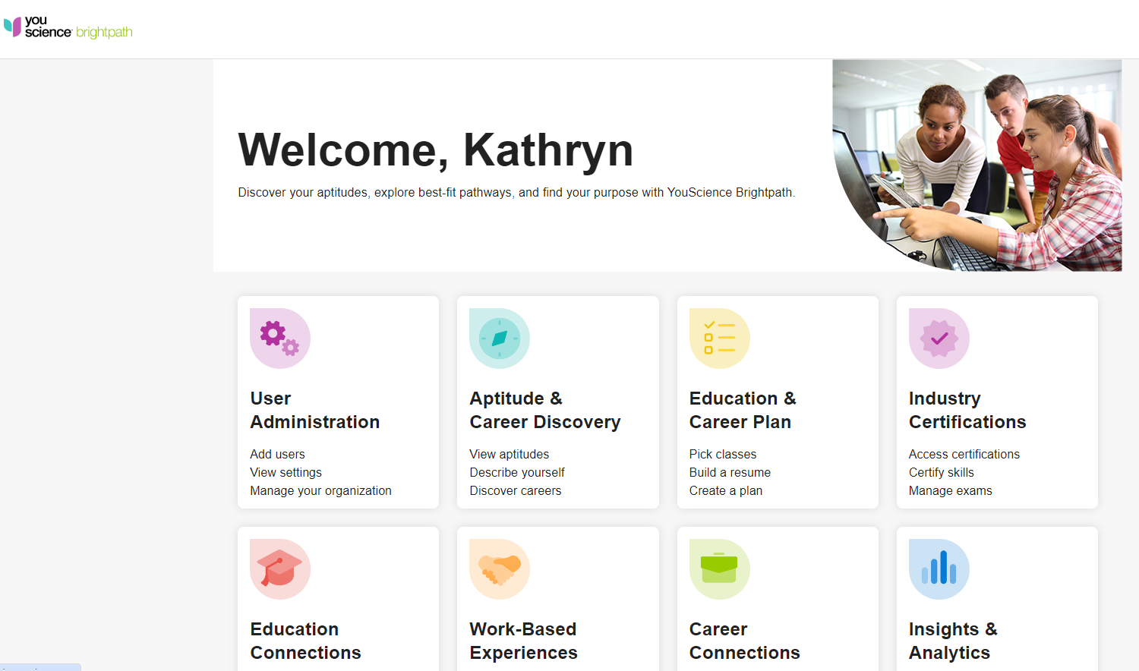

Slide 14
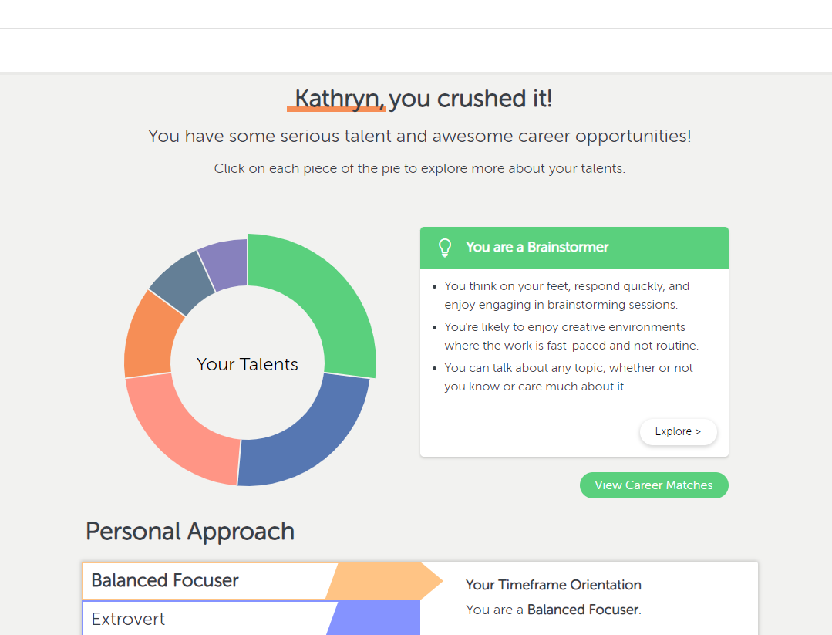

Slide 15
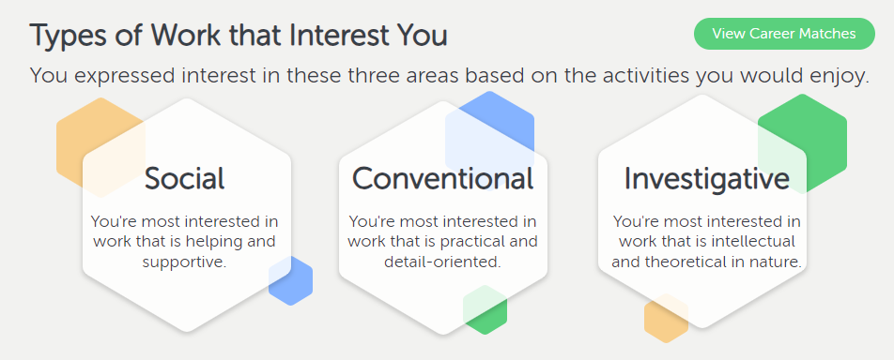
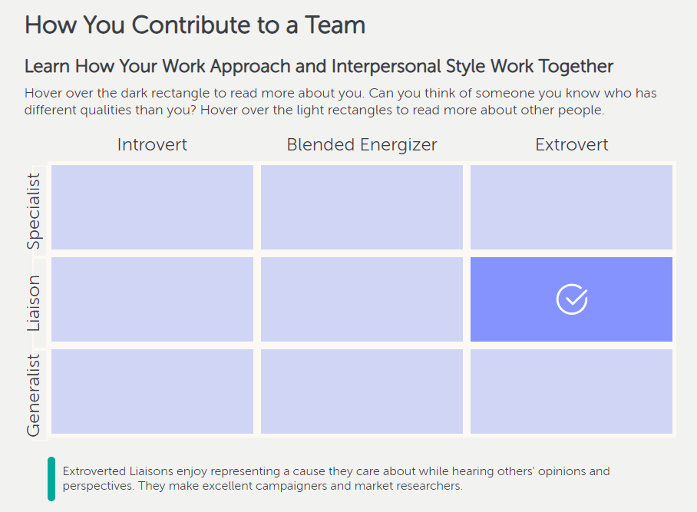

Slide 16
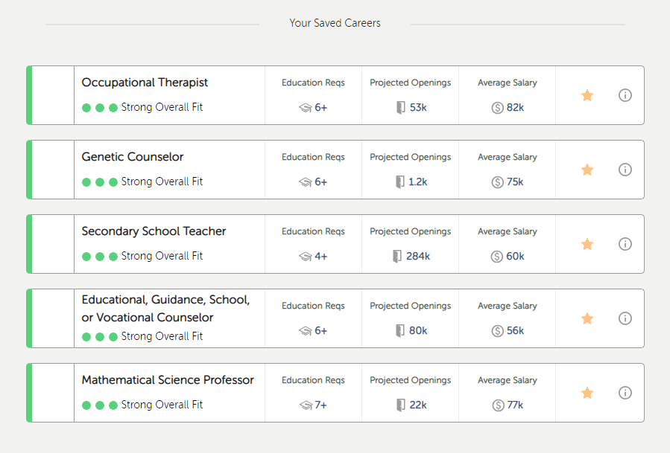

Slide 17
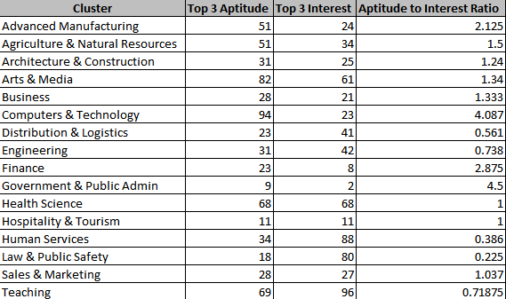
VALLEY VIEW
SPARTANS

Slide 18
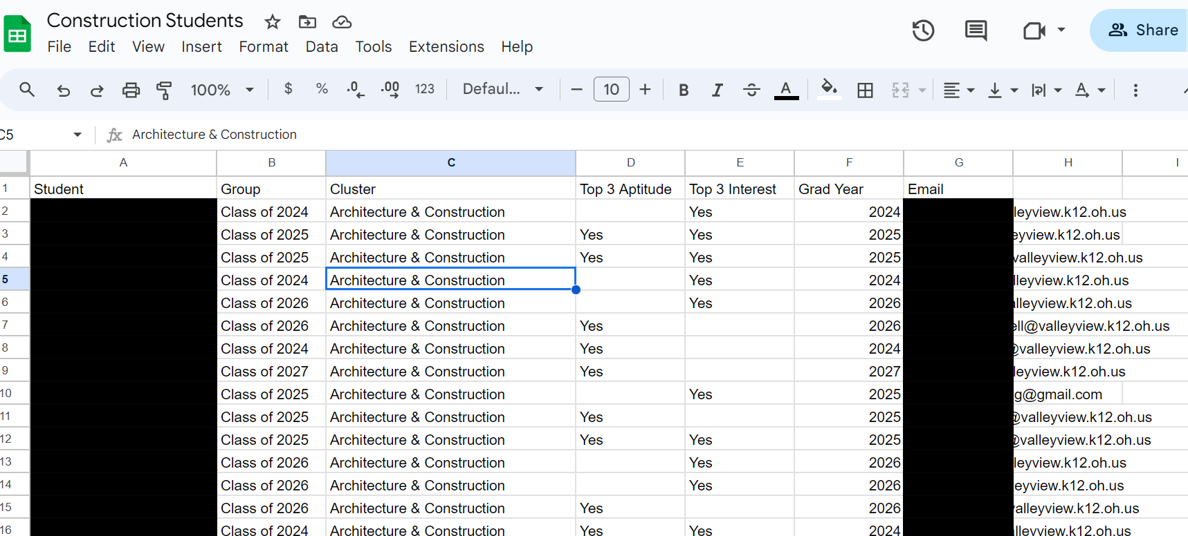
Certifications Intro Slide
DISCOVERY
Educator Tools

Slide 19
Title Slide
Course Offerings Adjusted
Job Shadowing Experiences
Lunch and Learn Invitations
Specific Career Exploration
Work Based Learning/
Pre-Apprenticeship
DATA

Slide 20
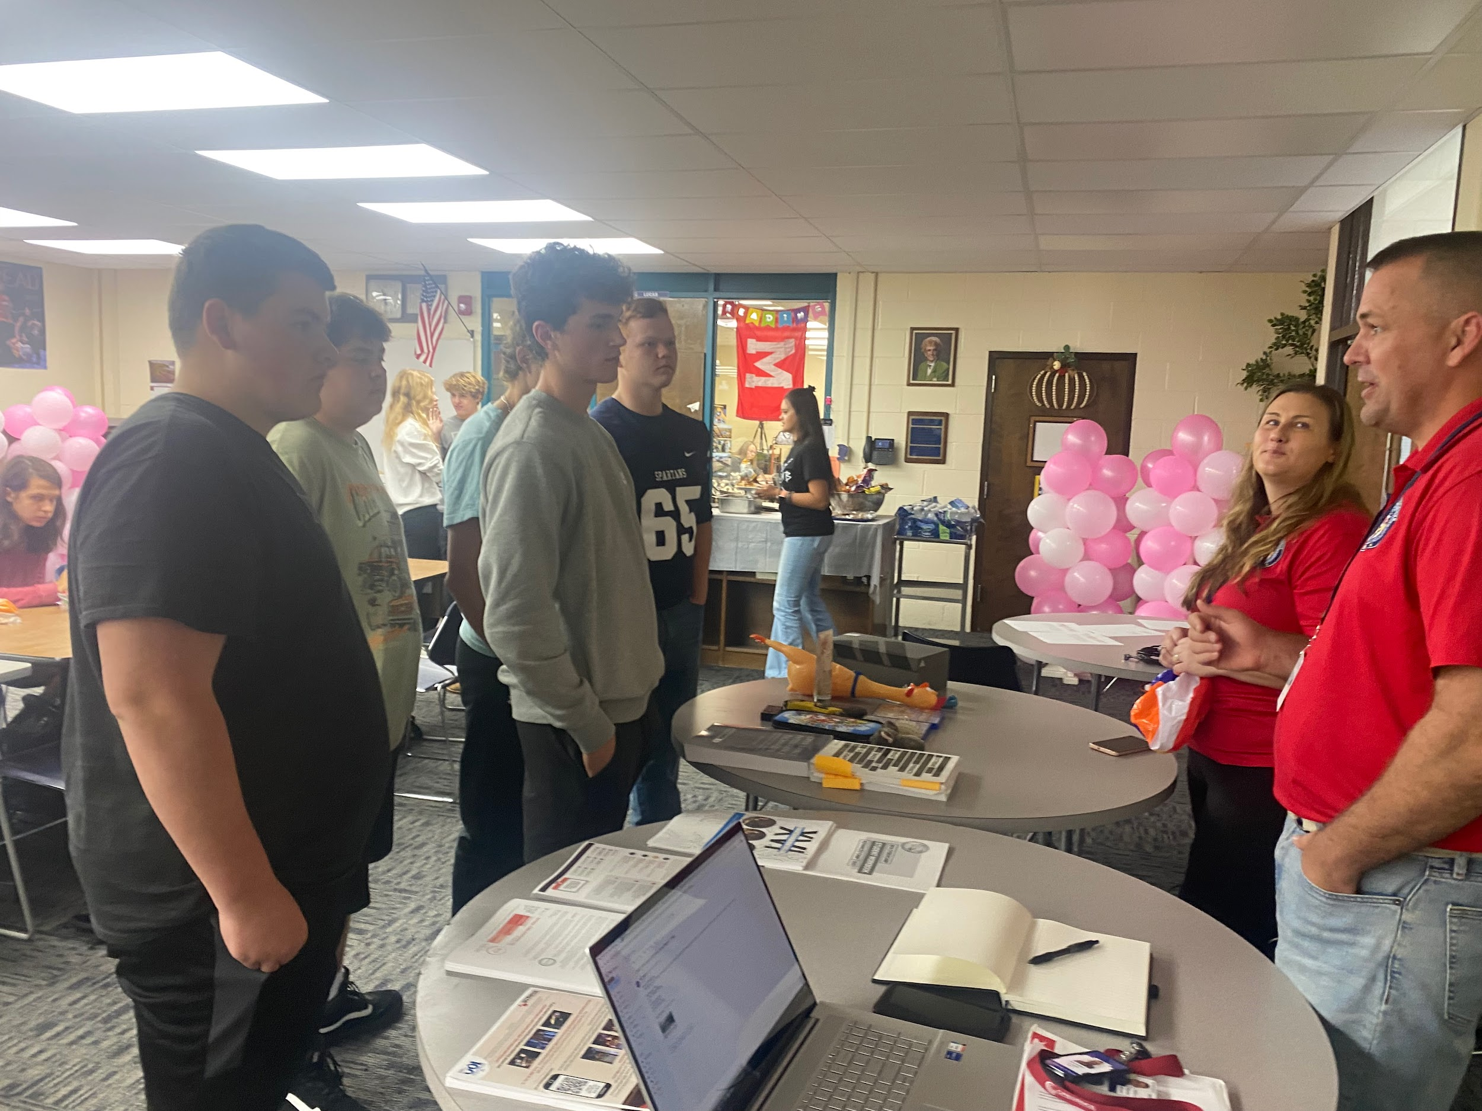
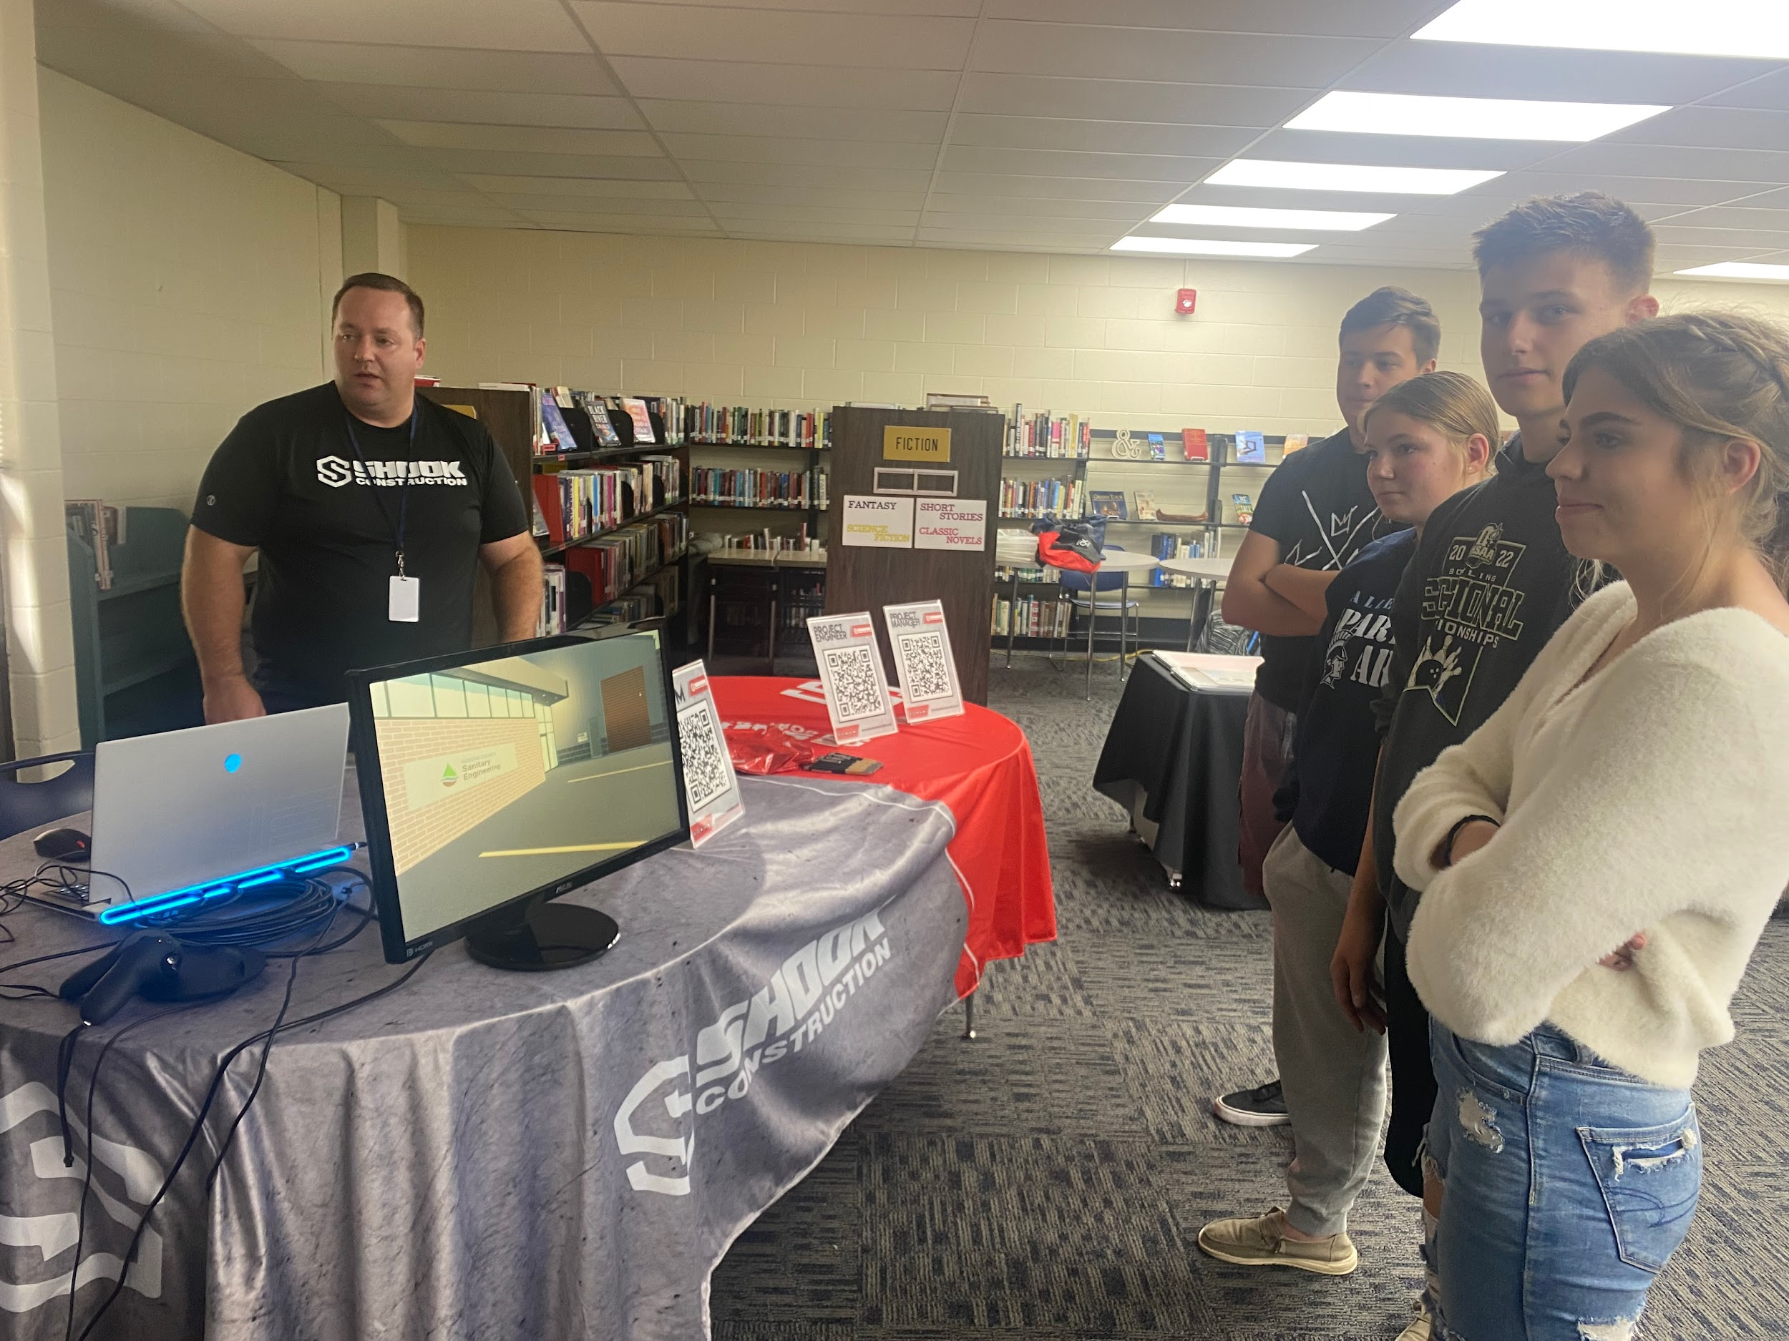
Ohio Tech Day
-Ohio Cyber Reserves
-Sinclair Digital Media Design; Graphic Design, Interior Design,
Video Production & Web Design
-Microsoft TEALS
-Shook Construction
-WPAFB; Emergency Mgt, Civil Engineering, Air Force Institute of Technology
VALLEY VIEW

Slide 21
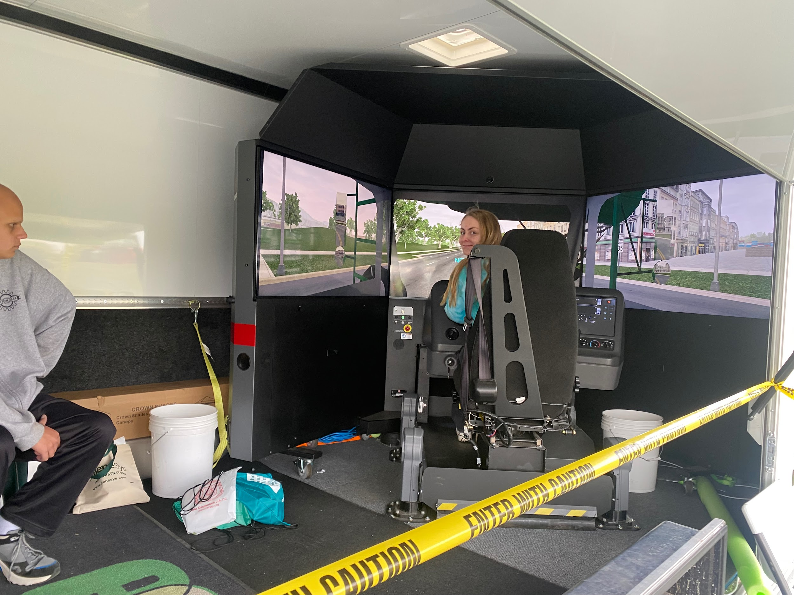
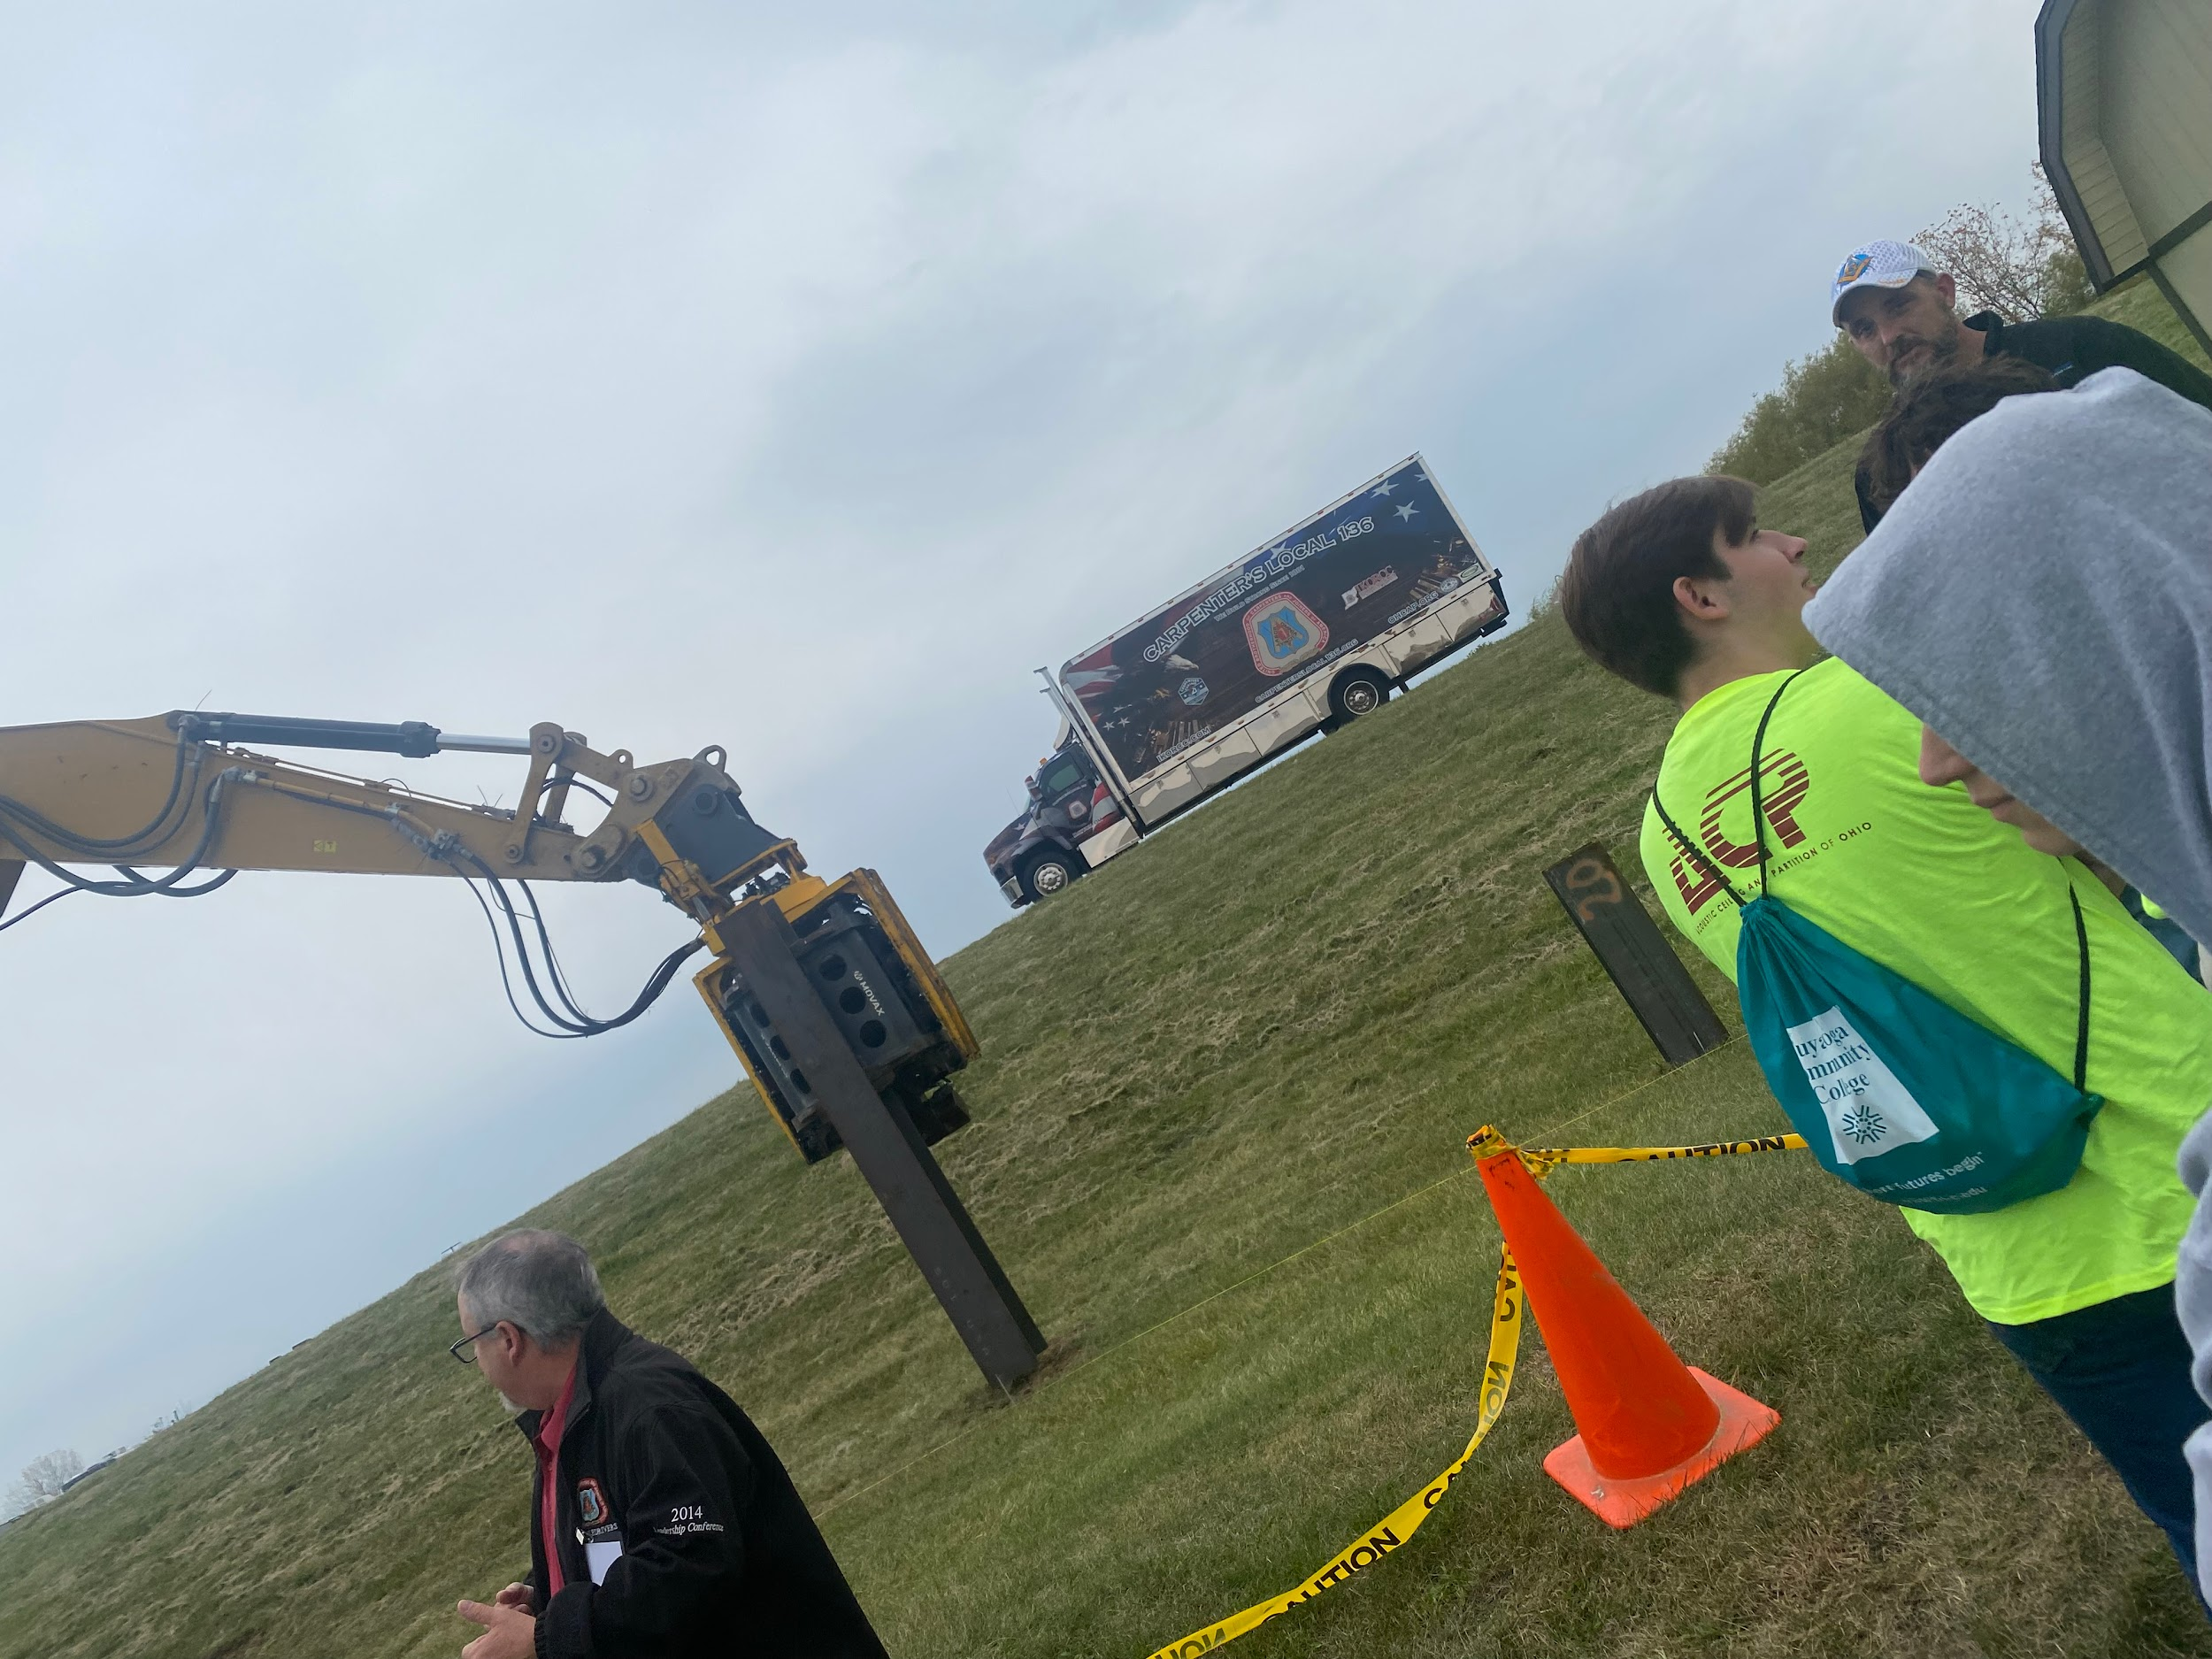
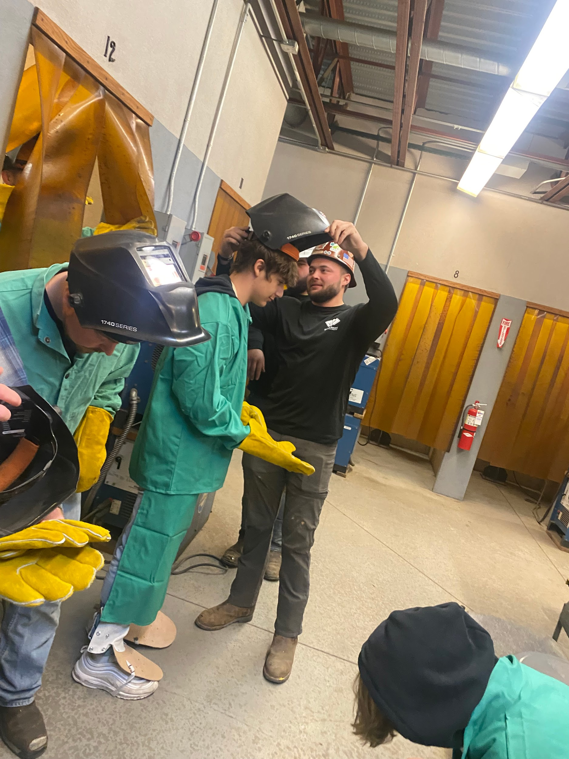
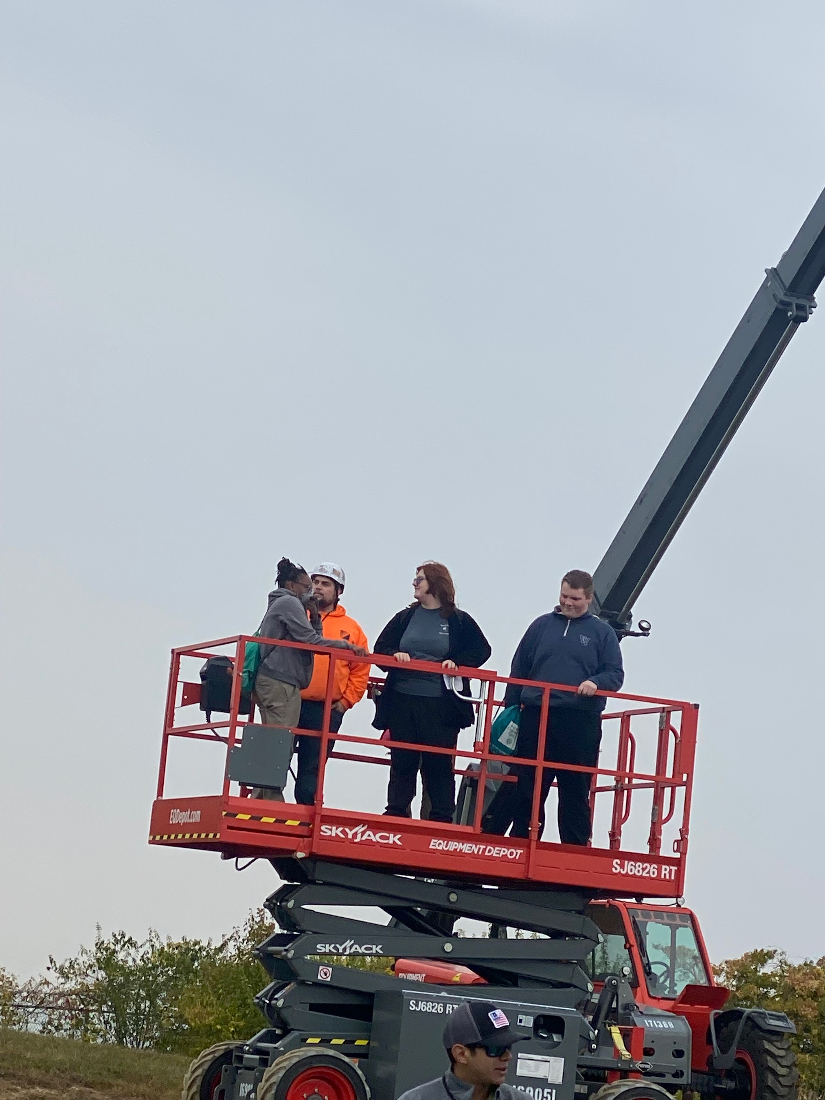
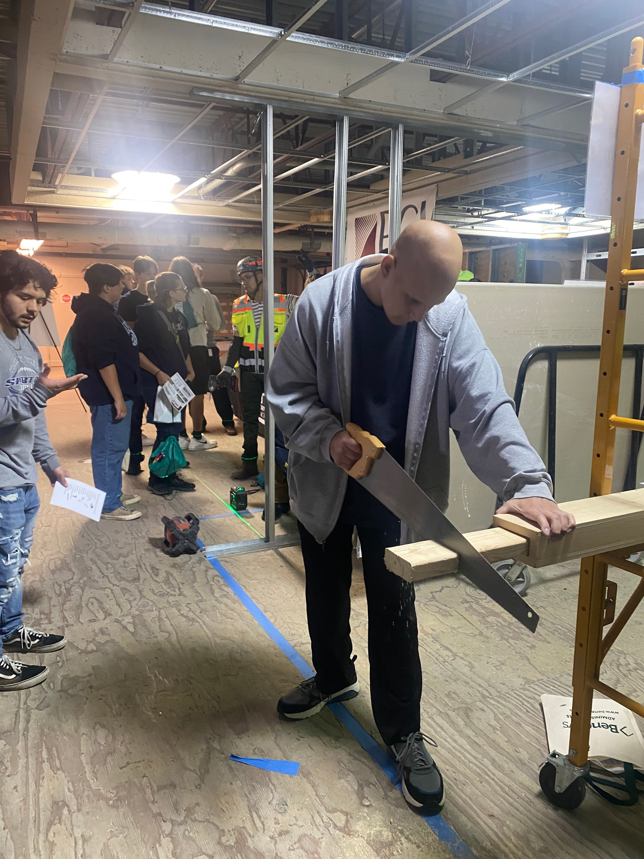
JATC- The Ohio Carpenters
Joint Apprenticeship

Slide 22
Learn about Kettering Health
Sterile Processing
Kettering College & Sinclair College Presentations
Unit Tour
Role
Hands on Experience
Career Growth Opportunities

Slide 23
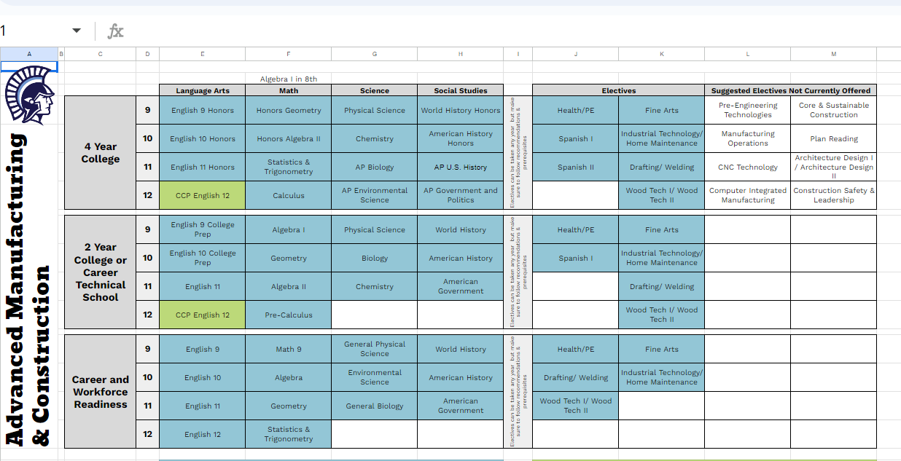
Certifications Intro Slide
DISCOVERY
Educator Tools

Slide 24
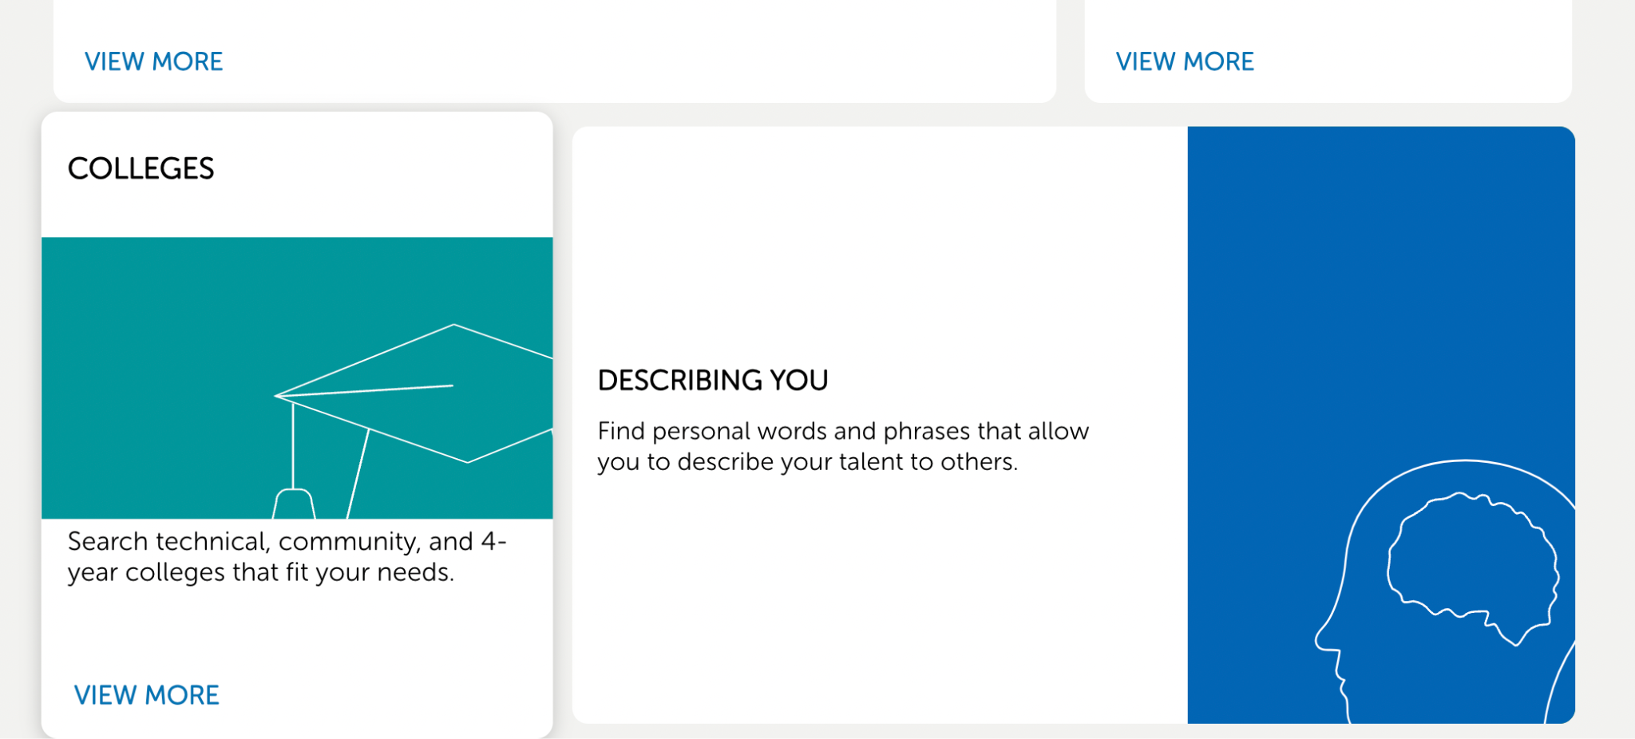
Certifications Intro Slide
DISCOVERY
Educator Tools

Slide 25
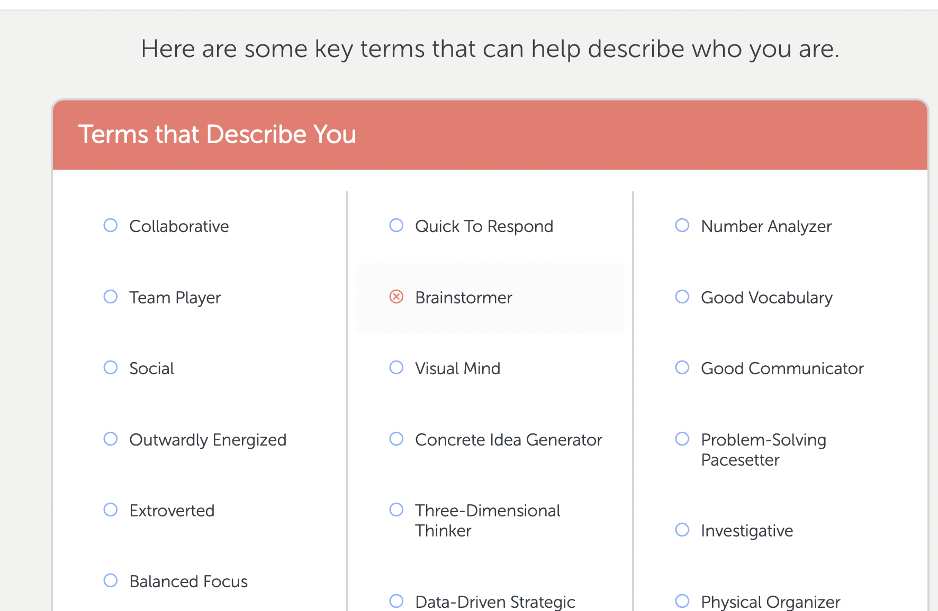
Certifications Intro Slide
DISCOVERY
Educator Tools

Slide 26
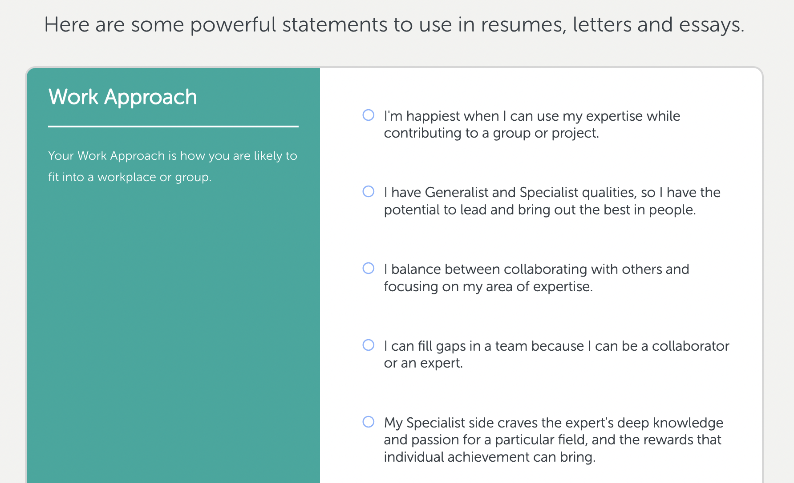
Certifications Intro Slide
DISCOVERY
Educator Tools

Slide 27
Certifications Intro Slide
DISCOVERY
LAUREN | MARIN | LUKAS | KEATON
Classroom Application

Slide 28
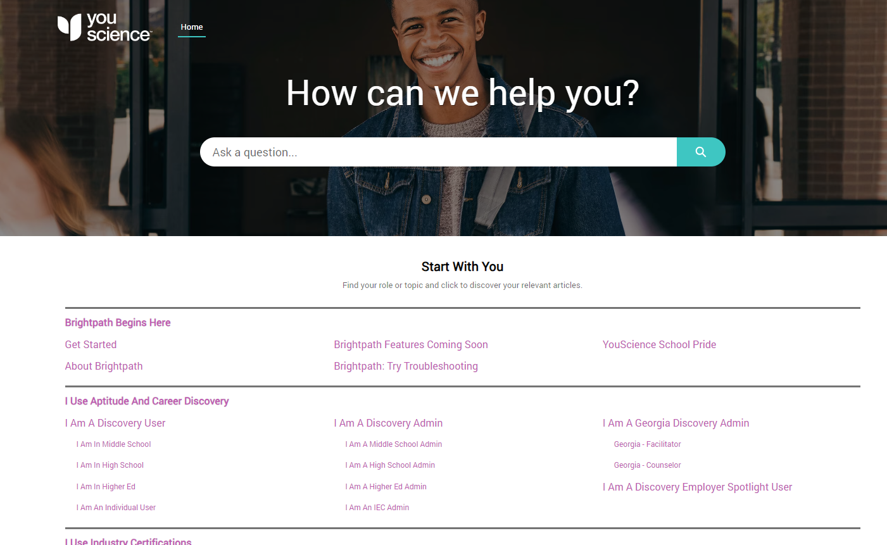

Slide 29
Certifications Intro Slide
Katie Grothaus
Career Navigation Specialist
katie.grothaus@mcesc.org

