Slide 1
Ohio College Tech Prep West Regional Center
Pre-Apprenticeship Learning Series
Session Two: Pre-Apprenticeship Best Practices
October 26, 2022

Slide 2
Agenda
Time | Information
1:00 pm | Introductions: Pam Hunt, West Region, Chief Administrator
1:05 pm | Pre-Apprenticeship Refresher: Todd Schilling, Pre-Apprenticeship Coordinator
1:10 pm | Panel Discussion: Jeff Berk – Stebbins High School Mark Edwards – Reading Community Schools Corrine Hayes – Southwest Local Schools Tony Trapp – Upper Valley Career Center Jessie Zink – Northmont City Schools
2:05 pm | Open Discussion with Panelist
2:25 pm | Wrap up and Survey

Slide 3
Welcome
Pam Hunt
Ohio Tech Prep Chief Administrator West Regional Center
Sinclair College
pamela.hunt@sinclair.edu
C: 513.708.3726

Slide 4
Pre-Apprenticeship: Refresher

Slide 5
Introductions
Todd Schilling – Pre-Apprenticeship Coordinator: Sinclair

Slide 6
Sinclair’s Office of Work-based Learning
Work-based Learning (WBL) is the meaningful connection to bridge academic course work with in-demand career opportunities. WBL opportunities allow students to directly apply skills learned in the classroom to future career opportunities. They are designed to provide authentic learning experiences to students that link academic, technical and professional skills.
WBL bridges the gap between high schools, post secondary education, and the workforce.
Sinclair College
Employers
Students HS & College
WBL

Slide 7
Pre-Apprenticeship
Pre-apprenticeship is an opportunity to provide high school students with the basic technical and job readiness skills in preparation to enter a Registered Apprenticeship program. The best pre-apprenticeship programs are set up with close collaboration between the high schools, employers, and Sinclair’s Office of Work-based Learning. The purpose of this program is to provide the students with in-depth exposure to a career field that he/she may be interested in pursuing during and after high school.

Slide 8
Sinclair’s Role
Serve as Registered Apprenticeship Sponsor
Assist with design and implementation of Pre-Apprenticeship Program
Assist in Building Industry/Business Partners
Co-Tracking Students
Transitioning Students to Registered Apprenticeship or one of Sinclair’s Programs

Slide 9
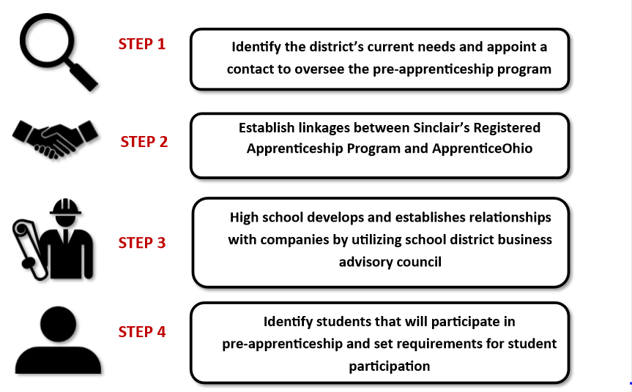
Pre-Apprenticeship

Slide 10
What is the role of the Employers?
Companies must establish Signatory Employer relationship with Sinclair
Work with high school partners to provide work-based learning opportunities
Design learning experiences for students to learn the career field
Work with the high school contacts to report students progress
Provide students opportunities after graduation

Slide 11
Working with Businesses
Establish partnerships with companies
BAC, Chamber of Commerce, Sponsors
Work with company to design unique opportunities
Understanding minor labor laws
SB 166
Sinclair is here to help!

Slide 12
Session Two: Pre-Apprenticeship Best Practices
Panel Discussion

Slide 13
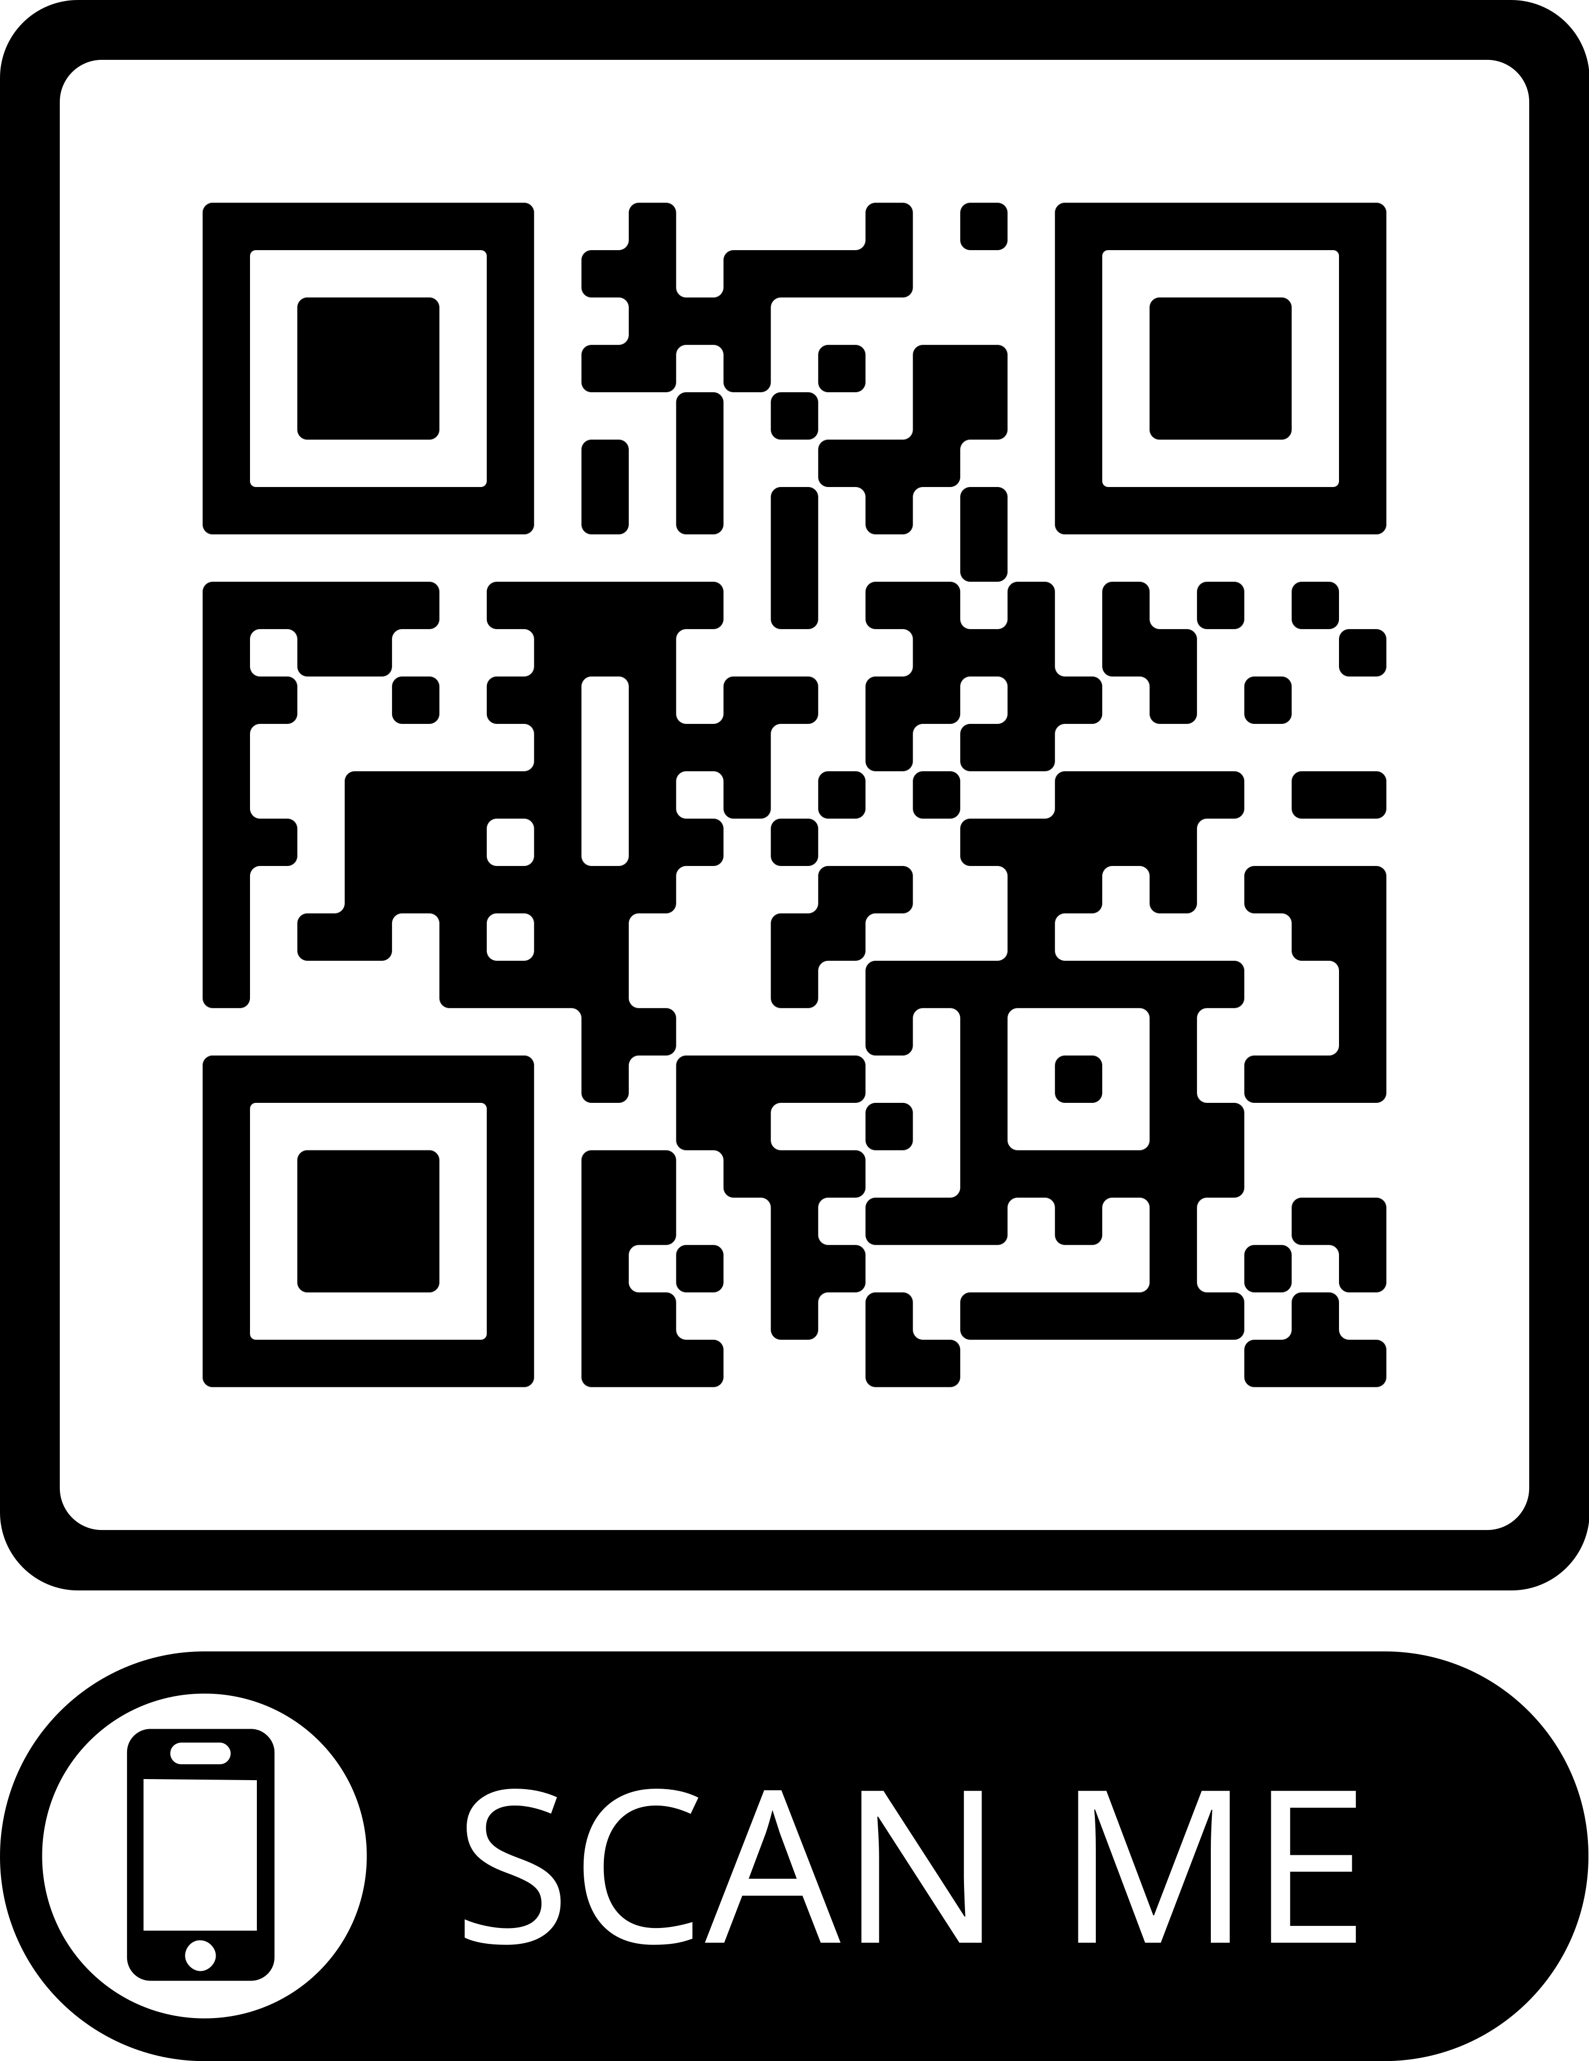
Survey

Slide 14
Questions

Slide 15
Contact Information
Todd Schilling
Email: todd.schilling@Sinclair.edu
Phone: 937-512-3355

Slide 16
Thank you!

