Slide 1


Work-Based Learning Series
Session 2
November 14th, 2022
Notes:
Cassie

Slide 2

Ohio Tech Prep Chief Administrators
Pam Hunt
West Ohio Regional Tech Prep Chief Administrator
Rita Graf
Southwest Ohio Regional Tech Prep Chief Administrator
Katie Good
Southeast Ohio Regional Tech Prep Chief Administrator
Dr. Kathy Siebenaler Wilson
Northwest Ohio Regional Tech Prep Chief Administrator
Naima Lusane Northeast Ohio Regional Tech Prep Chief Administrator
Carrie Scheiderer Central Ohio Regional Tech Prep Chief Administrator

Slide 3
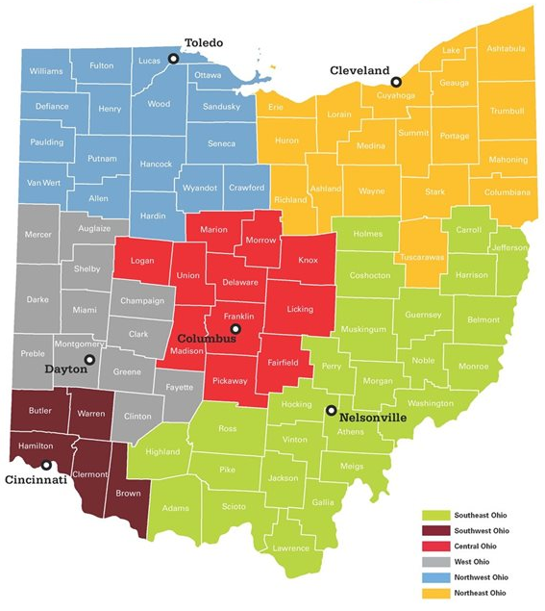
Ohio Tech Prep Regions
Northwest –
Dr. Kathy Siebenaler Wilson
Northeast – Naima Lusane
Central – Carrie Scheiderer
West – Pam Hunt
Southwest – Rita Graf
Southeast – Katie Good

Slide 4

Ohio Tech Prep Goals:
Build and foster relationships between education, business and community partners in the region.
Assist education partners in the region in developing high-quality career technical education pathways and programs of study.
Provide technical assistance and professional development opportunities to education partners on the implementation of high-quality work-based learning experiences.

Slide 5
Ohio Department of Education
Brenna Bartlett
Assistant Director, CTE
Cadie Allen
Program Administrator, CTE
Travis Taylor
Program Administrator,
Graduate Success

Slide 6
Today’s Agenda
Accountability & Reporting
Learning Agreements
Business Partner Incentives
Graduation Requirements
Questions

Slide 7
Why Work-Based Learning?
Business & Industry Need
Governor’s Office of Workforce Transformation
Ohio Excels
Labor Market Data
Policy & Legislation
Each Child Our Future; Graduation Requirements
Perkins V & CTE
Implementation
Minor Labor Laws; SB 166; State Supported Internships

Slide 8
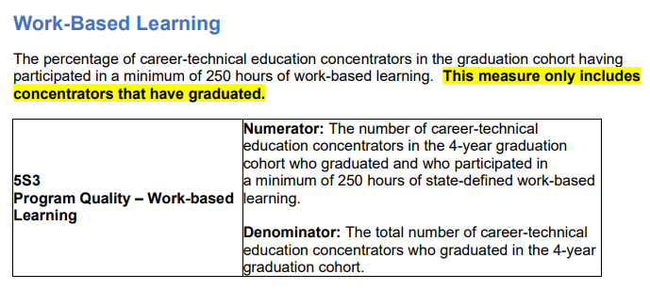

Federal Accountability
Work-based learning is a Program Quality Indicator of Performance under the Ohio Perkins V Plan.
This accountability measure is limited to students in career-technical education programs; It is calculated at the Career-Technical Planning District level.

Slide 9
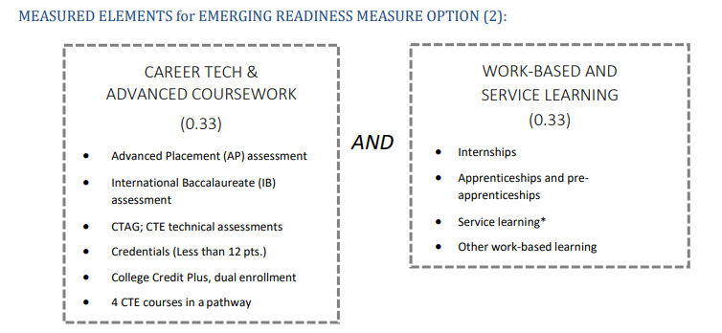
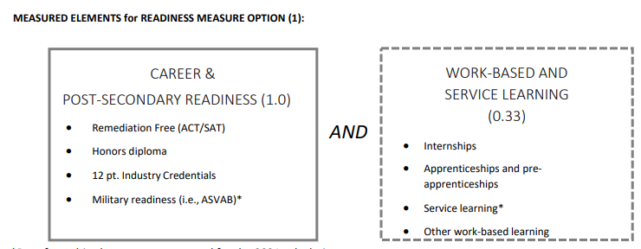
State Accountability
Work-based learning is a part of the Ohio School Report Cards.
On the Career-Technical Planning District Report Card, work-based learning is part of the Career and Postsecondary Readiness Component.

Slide 10
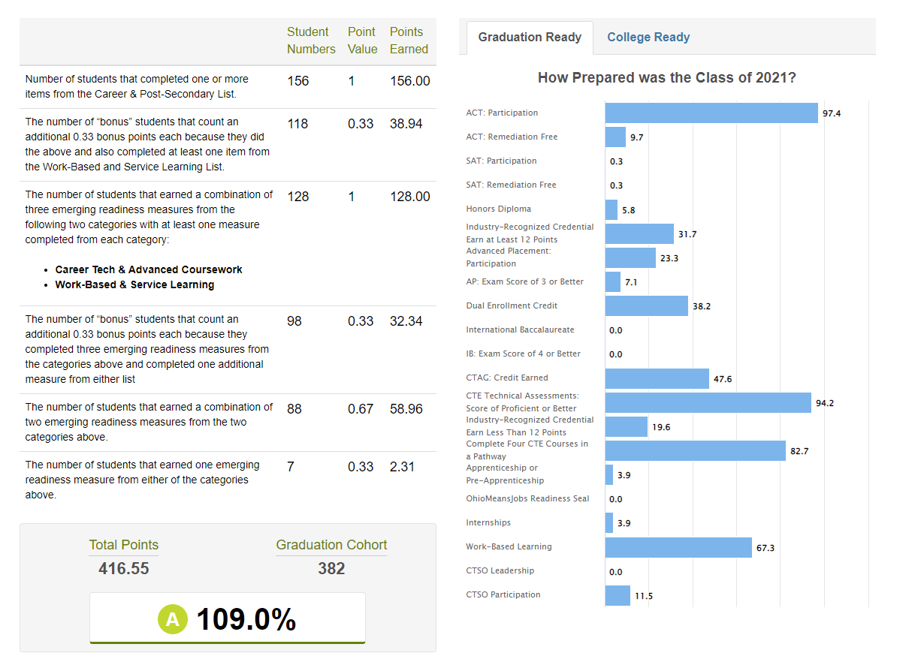
State Accountability
This measure is limited to CTE students; There are no minimum hours for this accountability measure.
The measure is calculated at the Career-Technical Planning District level.

Slide 11
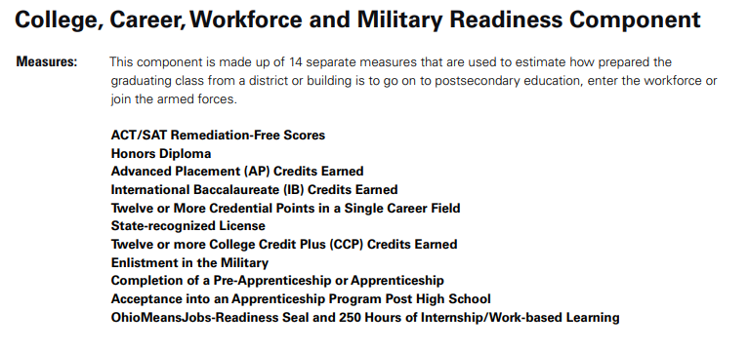
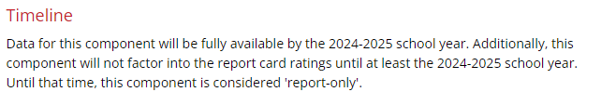
State Accountability
Work-based learning is a part of the Ohio School Report Cards.
On the Traditional School and District Report Cards, work-based learning is part of the NEW College, Career, Workforce and Military Readiness Component.

Slide 12
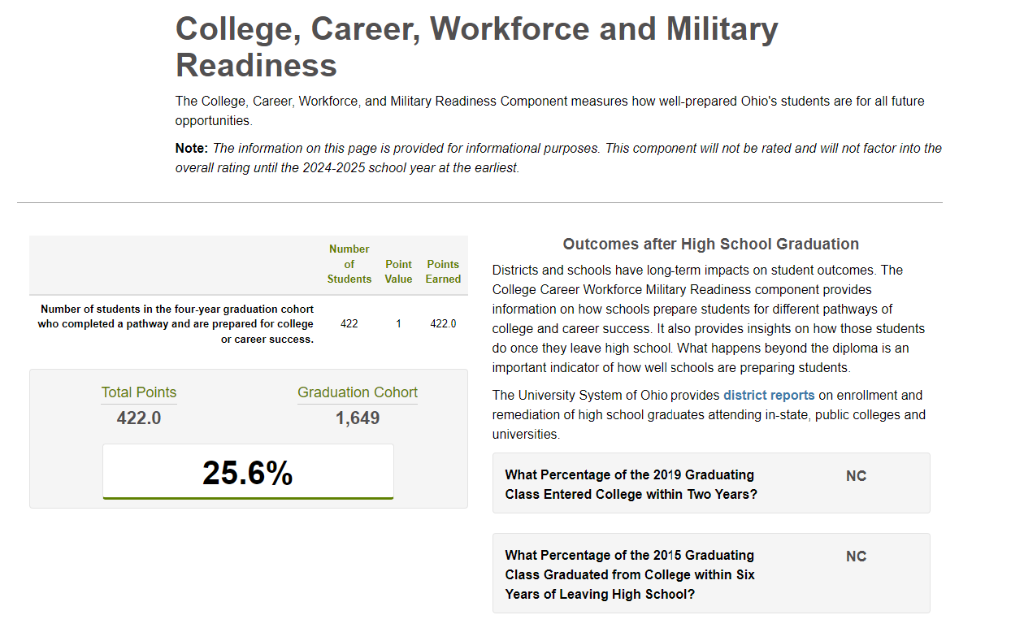
State Accountability
This measure includes all students; the measure is calculated at the district level.

Slide 13
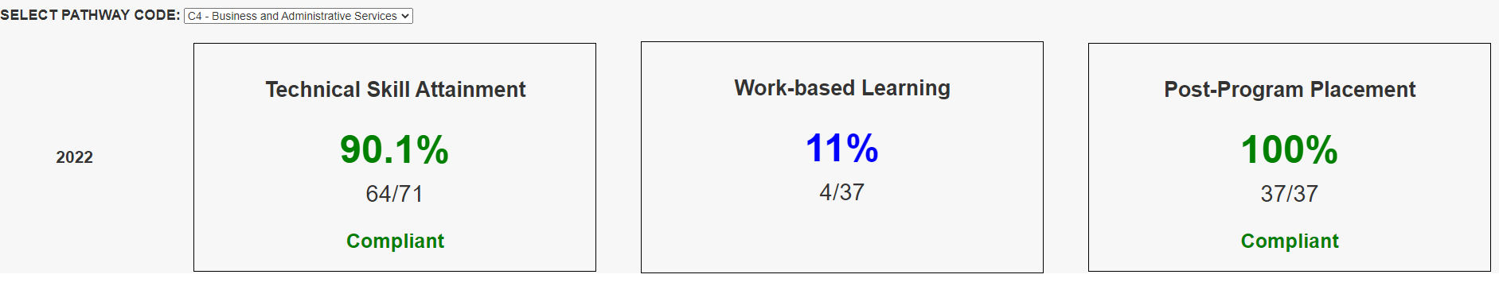
Local Accountability
Work-based learning is a Quality Program Measure under the CTE Quality Program Review.
This accountability measure is limited to students in career-technical education programs. It is calculated at the pathway level.

Slide 14
Local Accountability
Work-based learning is also a possible pathway to graduation for all students.
More on that later…

Slide 15

“Start with Why”
What is your motivation for expanding and implementing high-quality work-based learning?

Slide 16
Work-Based Learning Reporting
Work-Based Learning Reporting Element | Program Codes | How is it used? | When can I report?
Experience Program Codes | 305012: Internship Completion 305014: Apprenticeship/Pre-Apprenticeship 305016: Apprenticeship Acceptance 305018: Apprenticeship Completion 305099: Other Work-Based Learning | Used to calculate performance on the CTPD & Traditional District Report Cards. | Can be reported in the Student (S) collection or the Graduate (G) collection.
Hours Program Codes | Work-Based Learning Hours Ranges: 310040: >0 and <40 hours 310099: 40-99 hours 310249: 100-249 hours 310499: 250-499 hours 310500: 500+ hours | Used to calculate performance for the CTE Quality Program Review and Perkins V accountability systems; calculations occur at the building pathway and CTPD level, respectively. Used to determine graduation progress in ODDEX. | Can be reported in the Student (S) collection or the Graduate (G) collection; should always represent the cumulative total of hours, across grades 9-12.

Slide 17
Helpful Tips
Please refer to the EMIS Manual for more information and definitions for each program code and/or reporting element.
There are no minimum hours required to report the Experience Program Codes; hours should be reported as specified above for the Hours Program Codes.
Completion of a minimum of 250 hours of work-based learning experience (reported using the Work-Based Learning Program Codes) can also be used as a demonstration of competency in meeting the Graduation Requirements for the Class of 2023 and Beyond.
For Joint Vocational School Districts – If you do not report in the Student (S) collection, coordinate with your member schools to ensure this information is accurately reported in the Graduate (G) collection.
All Reporting Elements should be reported, as applicable, for all students.
If you have additional questions about reporting work-based learning experiences, please first reach out to your ITC.

Slide 18
Learning Agreements

Slide 19
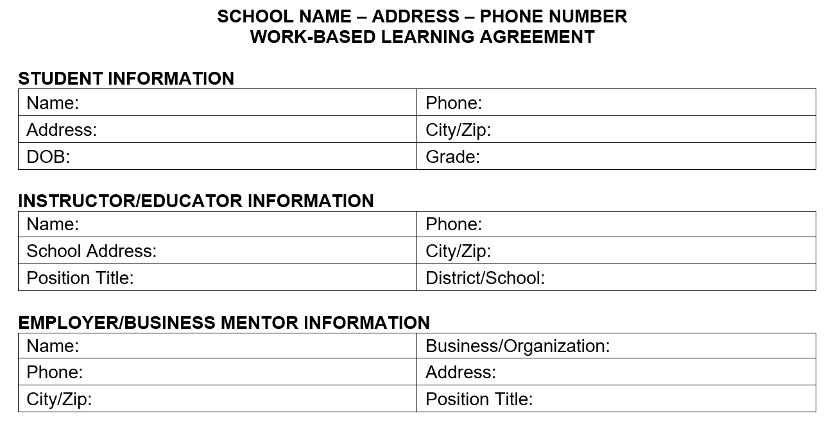
Learning Agreements

Slide 20
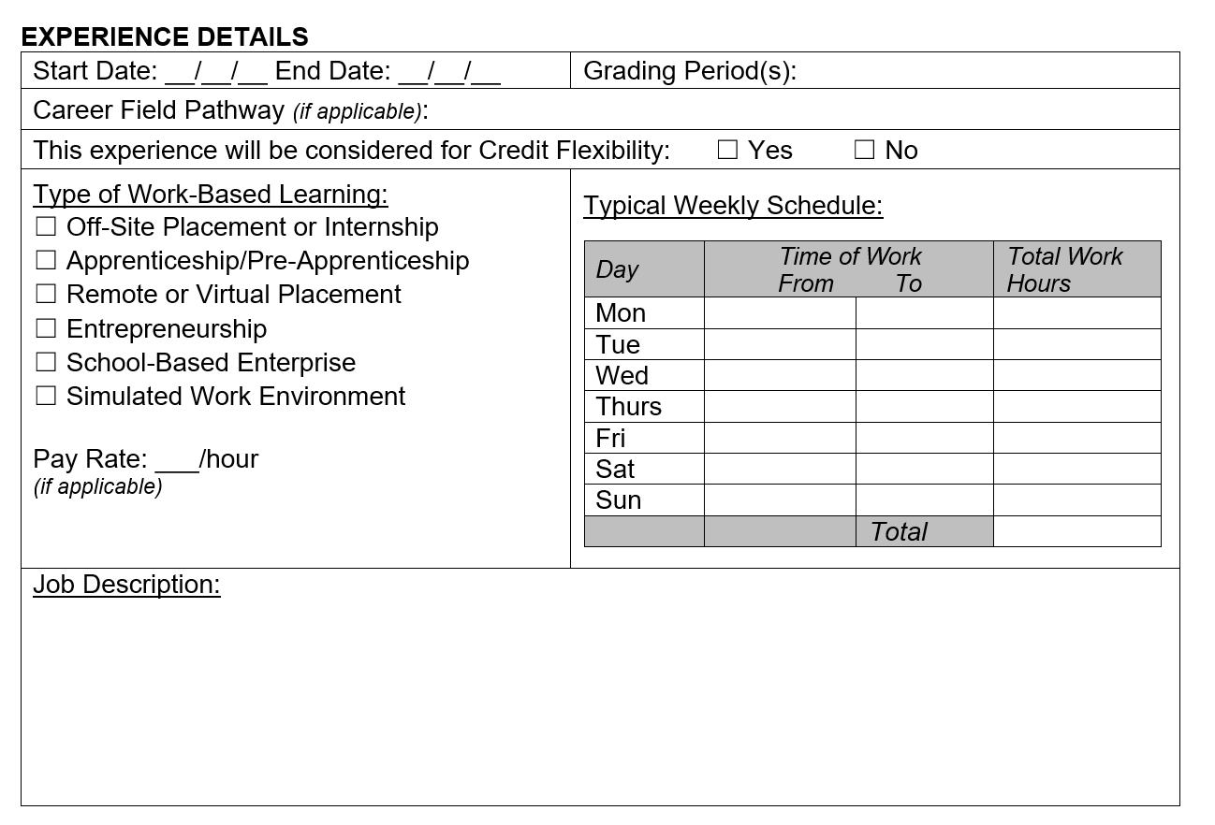
Learning Agreements

Slide 21
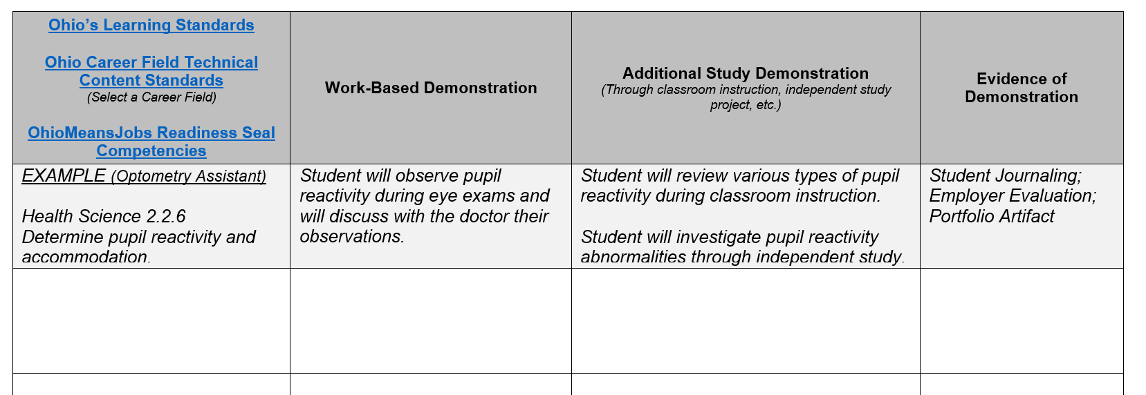
Learning Outcomes

Slide 22
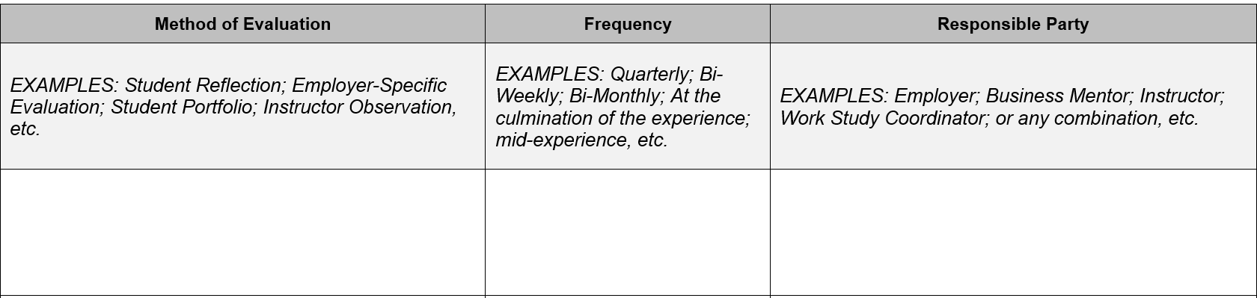
Evidence of Positive Evaluations

Slide 23
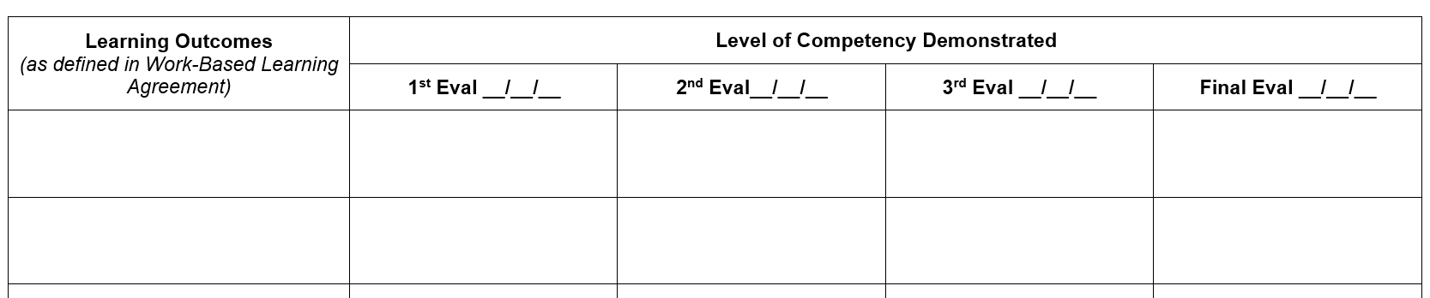
Evidence of Positive Evaluations

Slide 24
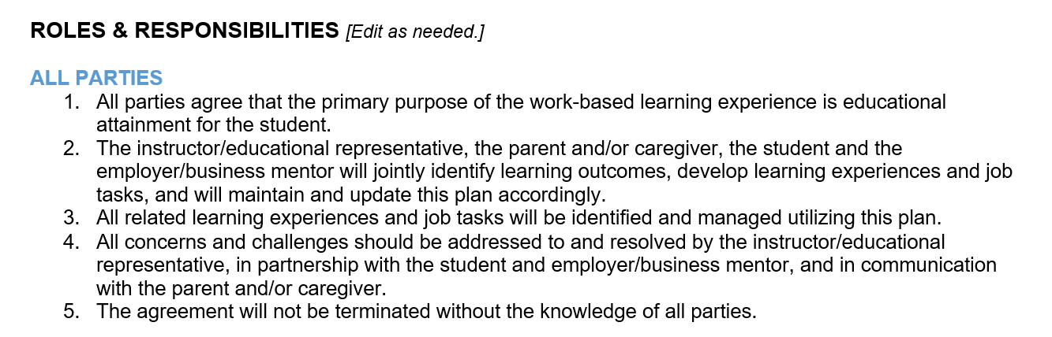
Roles & Responsibilities

Slide 25
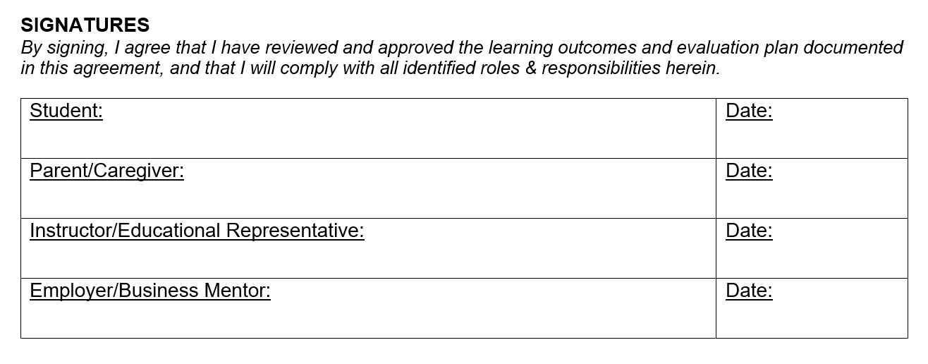
Roles & Responsibilities

Slide 26
Business Partner Incentives

Slide 27
Tax Credit Certificate for Work-Based Learning Experiences
Passed in Senate Bill 166, ORC 5747.057
Opportunity to expand WBL experiences
Credit is allowed against a taxpayer’s aggregate tax liability

Slide 28
What Businesses are Eligible?
Must be a taxpayer or pass-through entity (ex. LLC)
Must employ an eligible student employee in fulfillment of a work-based learning (WBL) experience associated with an approved CTE pathway in which the student employee is enrolled
Does not need to be a new WBL experience

Slide 29
Important Definitions
Eligible Employee: an employee who is nineteen years of age or younger and enrolled in an approved career-technical education (CTE) pathway.
To be considered enrolled in a CTE pathway, a student must be enrolled in at least one CTE course within the approved pathway. Students enrolled in CBI and FCS Programs are eligible.
Eligible compensation: compensation paid on and after the effective date of March 23, 2022, from which the employer is required to deduct and withhold income tax.

Slide 30
Tax Credit and Funding Limits
May receive the lesser of $5,000 per eligible employee or 15% of wages paid to an eligible employee
Tax Credit Certificate is submitted with employer’s Ohio income tax return and provides a credit against aggregate tax liability
Total amount of funding is not to exceed $5 million within state fiscal biennium (2-year period; March 23,2022-June 30, 2023)

Slide 31
Required Information
  1. Name and Date of Birth of employee/student
  2. Employee/student Social Security Number (SSN) (Last Four Digits Only)
  3. Employer Name and Address
  4. Employer Person of Contact/Phone/Email
  5. Type of Employment (Registered Apprenticeship/Registered Pre-Apprenticeship/Other)
  6. Work Start and End Date
  7. Total compensation paid to employee during the preceding calendar year
  8. Name of CTE program in which the employee is enrolled
  9. Amount of tax credit received in any prior year for the employee
  10. Description of employee’s duties as part of WBL experience

Slide 32
Student Information
Schools will be able to provide a form with necessary student information to businesses using ODDEX
Additional roles will be allowed for this use
  Verifier- ODDEX WBL
Each document is assigned a unique 10-digit Document ID
  Used to identify the documentation along with student name
  No SSIDs included
  Unique document ID is sent to ODE
Program of concentration/pathways list
  Only those CTE-26 approved
  Includes FERPA information and Parent/Guardian Signature

Slide 33
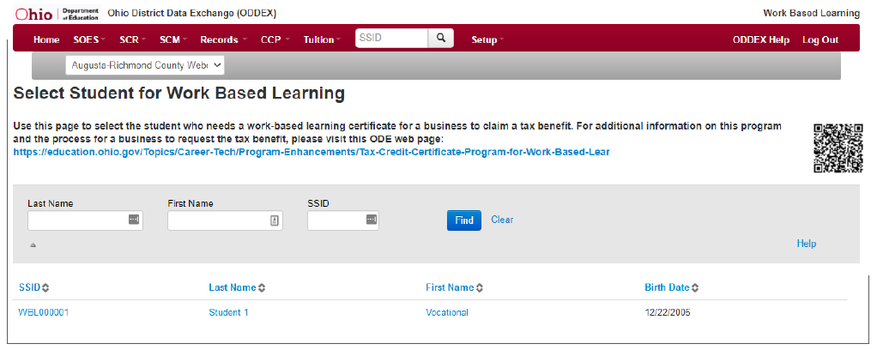
Accessing Document

Slide 34
Creating Document
All courses listed
User Interface Input
  Select Pathway
  Enter Local Program Name
  Expected to continue?
  Expected to graduate?
  Generate PDF

Slide 35
Example ODDEX Form

Slide 36
Application Process
Meet with CTE Partner to outline goals, POC and review application
School gives ODDEX form to student to give to business
Employer creates an OHID account and SAFE account
Employer completes Tax Credit Certificate Application (Upload ODDEX and WBL docs)
ODE Reviews Application
If approved, certificate is available to download within 60 days
Employer submits certificate with income tax return
Notes:
Employer completes Tax Credit Certificate Application (Upload ODDEX and WBL docs)
ODE Reviews Application
If approved, certificate is available to download within 60 days
Employer submits certificate with income tax return

Slide 37
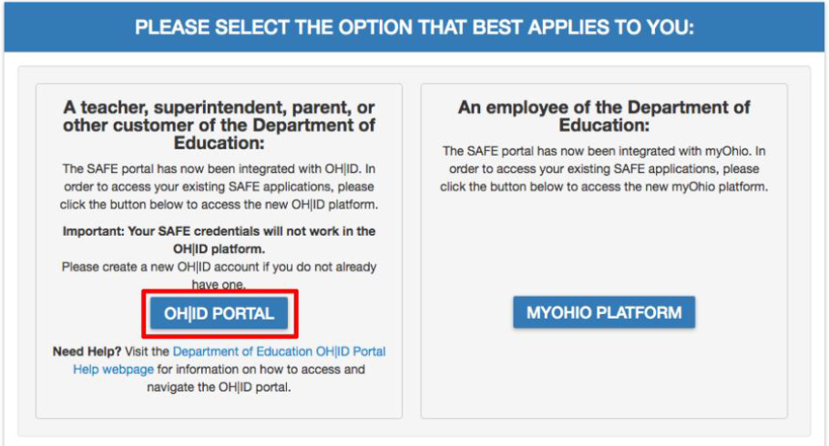
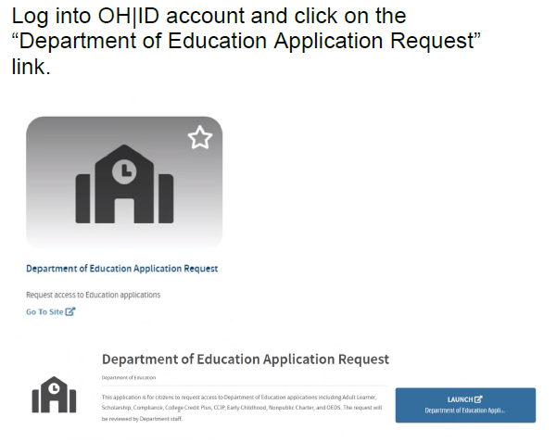
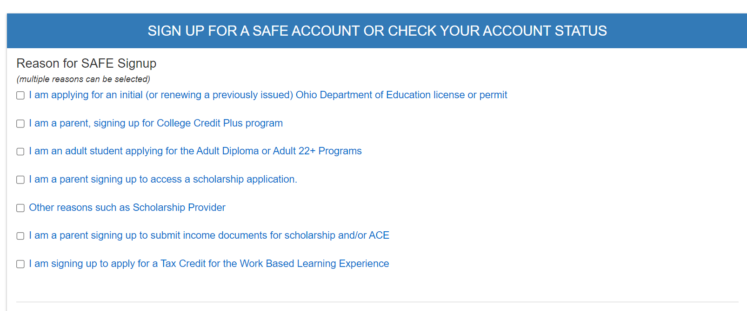
OHID and SAFE Account

Slide 38

For more information, visit the Department website.

Slide 39
Senate Bill 166: Workers Compensation
Senate Bill 166 expressly prohibits the Ohio Bureau of Workers Compensation from charging any amount against an employer’s experience rating for workers’ compensation claims made as part of a bona fide work-based learning program.

Slide 40

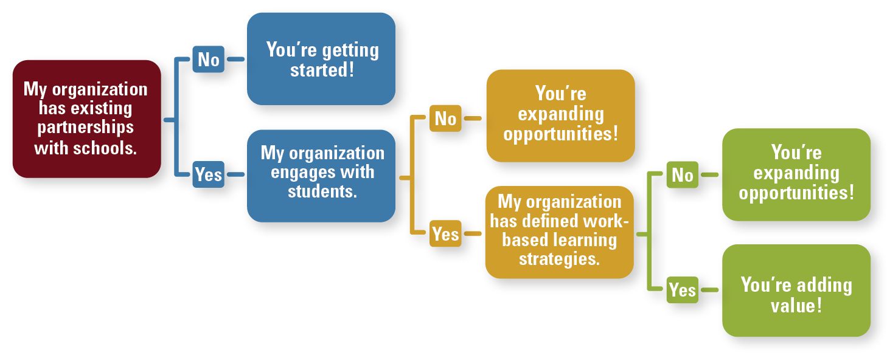
IT’S HERE!
Ohio’s Employer Guide to Work-Based Learning

Slide 41
Graduation Requirements

Slide 42




Ohio’s Long-Term Graduation Requirements
Students must meet requirements in all three areas
1. Course Requirements
2. Demonstration of Competency
3. Demonstration of Readiness

Slide 43
Graduation Requirements: Credits
Students can earn credit by participating in Work-Based Learning.
General Course Requirements ​ | State Minimum ​
English language arts ​ | 4 units ​
Health ​ | ½ unit ​
Mathematics ​ | 4 units ​
Physical education ​ | ½ unit ​
Science ​ | 3 units ​
Social studies ​ | 3 units ​
Electives ​ | 5 units ​
Districts may require more than the minimum 20 credits as a local decision.​ ​ Students must receive instruction in economics and financial literacy (in high school) and complete at least two semesters of fine arts* (during grades 7-12). ​ ​

Slide 44
2. Demonstration of Competency
Competency on ​Ohio’s State Tests:
Algebra I (or Integrated Math I) - 684
English Language Arts II - 684
Competency on ​Ohio’s AASCD:
Mathematics – Basic (489)
English language arts – Basic (485)
Competency Alternatives
Military
Enlistment
Career Readiness
ACT or SAT
Remediation Free Score
College Credit Plus
Notes:
​

Slide 45


Competency Alternative: Career Readiness
Students can show competency through Work-Based Learning.
Foundational Demonstration
Supporting Demonstration
Cumulative score of proficient or higher on 3 or more WebXams in single career pathway
Earn a 12-pt. approved industry-recognized credential or group of credentials totaling 12 pt. in one career field
Earn a State issued license in a vocation that requires an examination
Pre-apprenticeship or apprenticeship program
  Registered with Ohio State Apprenticeship Council
Complete 250-hours Work-based Learning
Earn workforce readiness score on WorkKeys
Earn the OhioMeansJobs Readiness Seal

Slide 46









Demonstration of Readiness:
Basic font sizes
Students can demonstrate readiness through Work-Based Learning.

Slide 47
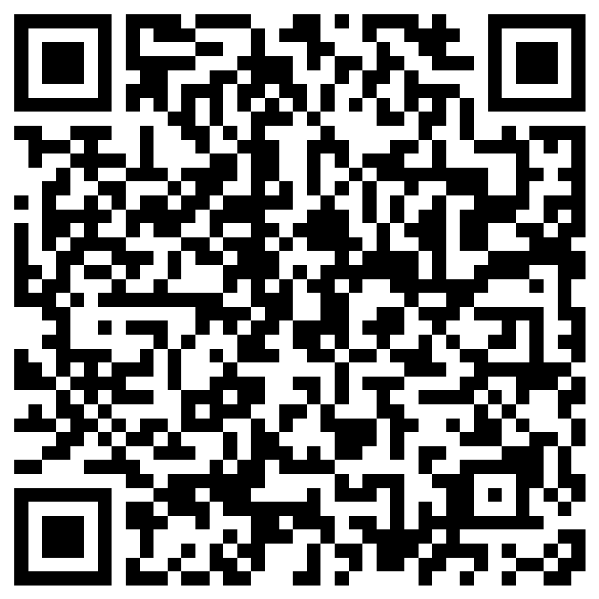
Graduation Requirements Contact & Support
Graduation Requirements Office Hours: Biweekly from August - May on Wednesday’s from 3:30-4:30pm and Friday’s from 9:30-10:30am we’ll host open office hours. Register for Graduation Requirements Office Hours.
Graduation Requirements Inbox: gradrequirements@education.ohio.gov
New Graduation Requirements Webpage: Ohio’s Long-term Graduation Requirements

Slide 48

Questions?

Slide 49

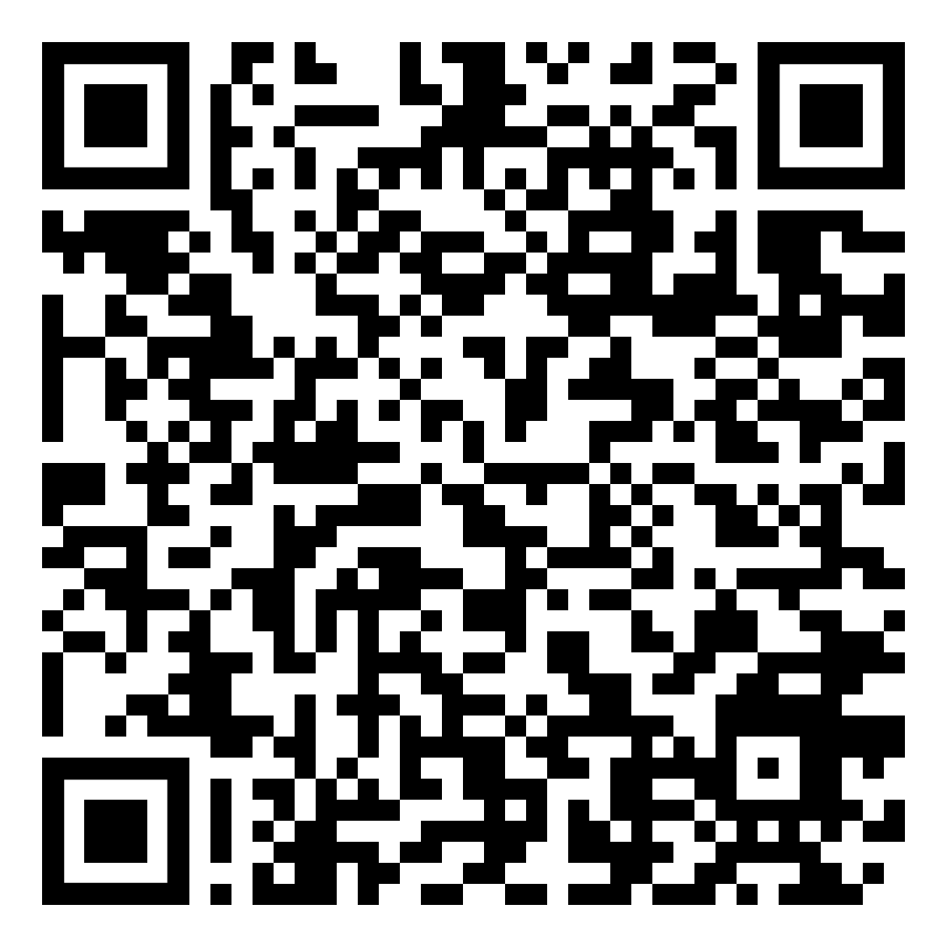



Slide 50


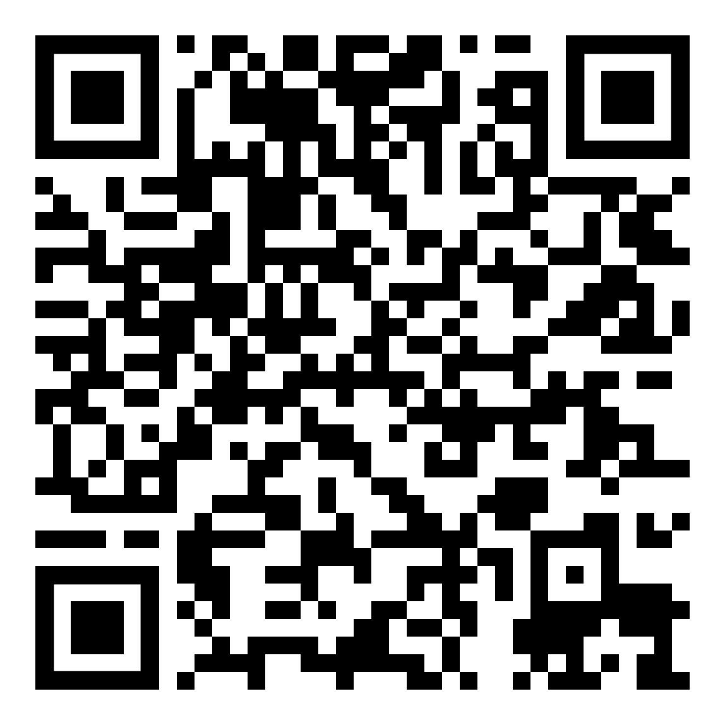
Thank you for joining us!
Please take a moment to fill out our brief survey
Feedback Survey Link: https://www.surveymonkey.com/r/V965FVK
For more information about Ohio Tech Prep:
Ohio Tech Prep Regional Centers
https://education.ohio.gov/Topics/Career-Tech/College-Tech-Prep

Slide 51
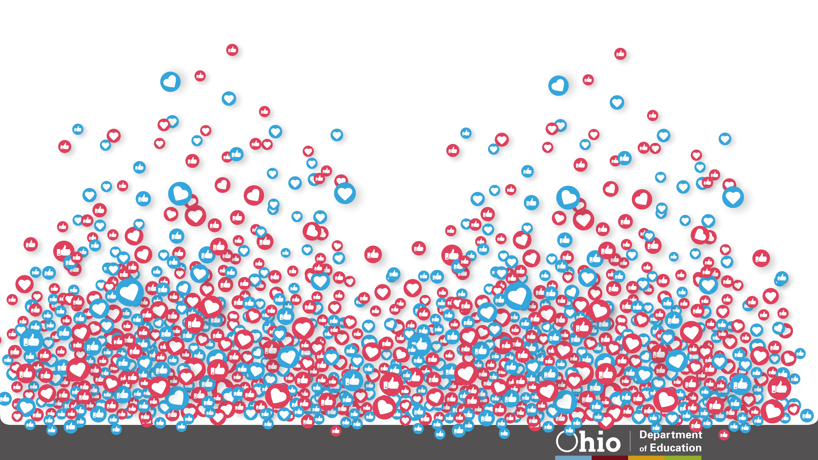





@OHEducation

Slide 52

Share your learning community with us!
#MyOhioClassroom
Celebrate educators!
#OhioLovesTeachers

