Slide 1



Ohio College Tech Prep West Regional Center
Pre-Apprenticeship Learning Series
Session One: Pre-Apprenticeship Overview
September 21, 2022

Slide 2
Agenda
Time | Information
9:00 | Introductions: Pam Hunt, West Region, Chief Administrator
9:05 | ApprenticeOhio: Matthew Longfellow, Apprenticeship Service Provider
9:50 | Sinclair Office of Work-based Learning: Todd Schilling, Pre-Apprenticeship Coordinator
10:20 | Q&A: Pam Hunt

Slide 3

Welcome
Pam Hunt
Ohio Tech Prep
Chief Administrator
West Regional Center
Sinclair College
pamela.hunt@sinclair.edu
C: 513.708.3726

Slide 4
Pre-Apprenticeship: Growing Local Talent

Slide 5

Introductions
Todd Schilling – Pre-Apprenticeship Coordinator: Sinclair

Slide 6
Overview
Sinclair’s Role
Successes and Areas of Growth
Building a Successful Program
Establishing Business Partners

Slide 7
Sinclair’s Role
Serve as Registered Apprenticeship Sponsor
Assist with design and implementation of Pre-Apprenticeship Program
Assist in Building Industry/Business Partners
Co-Tracking Students
Transitioning Students to Registered Apprenticeship or one of Sinclair’s Programs

Slide 8
Pre-Apprenticeship Successes
Students are getting real world experiences with industry partners
Business Partners are beginning to recognize the importance to working with high school students
Innovative Programs
Students obtaining graduation requirements
Provides students with opportunities outside the traditional pathways
Collaboration

Slide 9

Pre-Apprenticeship Areas of Growth
Building business partners
Establishing a program to fit your students
Student access to resources

Slide 10
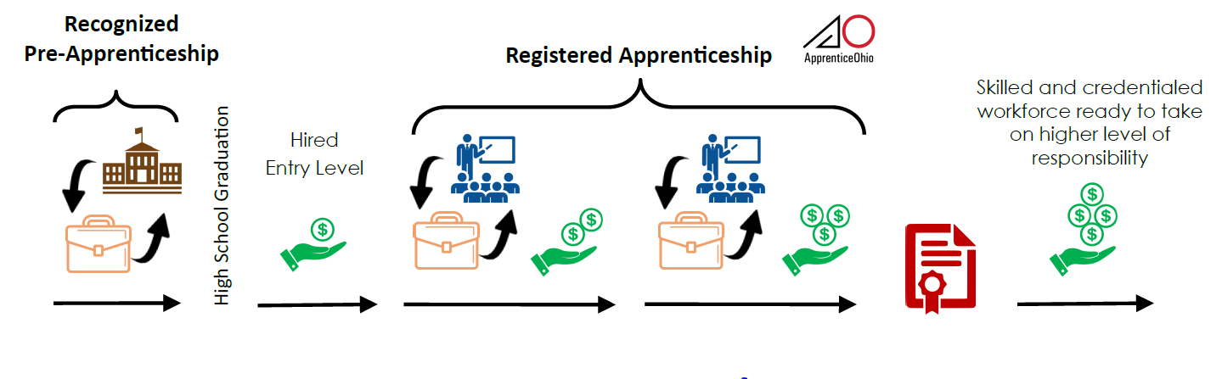
Establishing the Pipeline

Slide 11
Transitioning to Next Steps
Pre-Apprentice
Continue with Current Employer
Exploring Career Options in Different Field
Continue in Career Field – Seeking New Employer

Slide 12
Sinclair’s Office of Work-based Learning
Steps to Getting Started

Slide 13
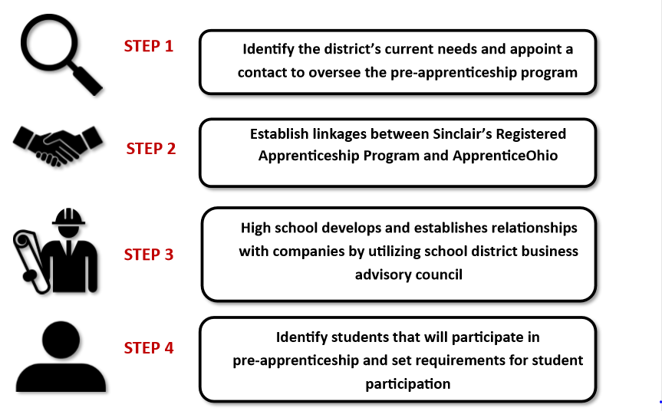
Pre-Apprenticeship

Slide 14

STEP 1: Identify POC
Identify the District’s current need(s) and area(s) of discipline and appoint a primary point of contact to oversee the pre-apprenticeship program.

Slide 15

STEP 2: Establish linkages
Establish linkages between Sinclair’s Registered Apprenticeship Program, other Registered Apprenticeship programs and Apprentice Ohio.

Slide 16

STEP 3: Build Relationships
The high schools begin to build relationships with local companies utilizing their own school district business advisory councils. Can also use companies that are currently partnering with Sinclair.

Slide 17

STEP 4: Identify Students
Identify students that are interested and willing to participate in the pre-apprenticeship. Create requirements and setup expectations for student participation.

Slide 18
Working with Businesses
Establish partnerships with companies
  BAC, Chamber of Commerce, Sponsors
Work with company to design unique opportunities
Understanding minor labor laws
SB 166
Sinclair is here to help!

Slide 19
What is the role of the Employers?
Companies must establish Signatory Employer relationship with Sinclair
Work with high school partners to provide work-based learning opportunities
Design learning experiences for students to learn the career field
Work with the high school contacts to report students progress
Provide students opportunities after graduation

Slide 20
Questions

Slide 21
Contact Information
Todd Schilling
  Email: todd.schilling@Sinclair.edu
  Phone: 937-512-3355

Slide 22


Thank you!

