Slide 2
Work-based learning & graduation requirements
Brenna Bartlett
Emma Waymire
Office of Career-Technical Education

Slide 3
Why work-based learning?
Business & Industry Need
Governor’s Office of Workforce Transformation
Ohio Excels
Labor Market Data
Policy & Legislation
Each Child Our Future; Graduation Requirements
Perkins V & CTE
Implementation
Minor Labor Laws; SB 166; State Supported Internships

Slide 4
Each child, our future

Slide 5
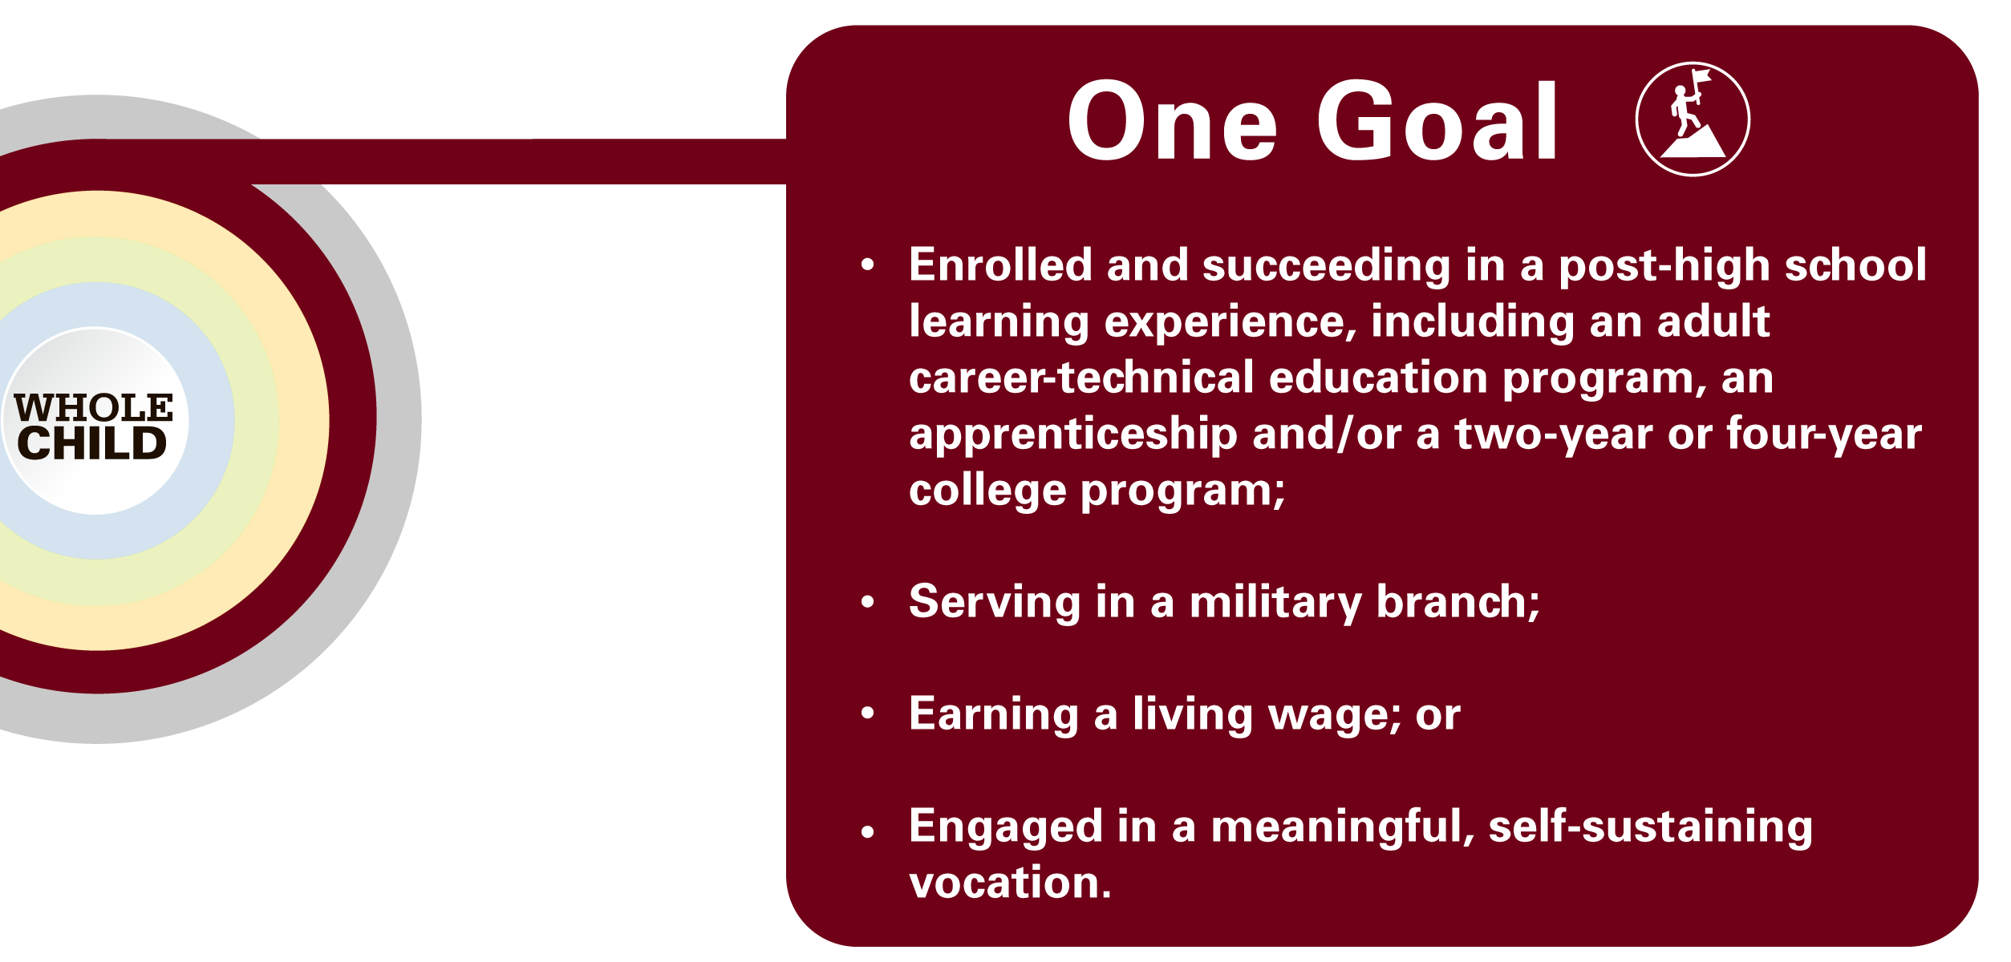
Each child, our future

Slide 6
Ohio graduation requirements
Students can earn credit by participating in Work-Based Learning.

Slide 7
Ohio graduation requirements
Students can show competency through Work-Based Learning.

Slide 8
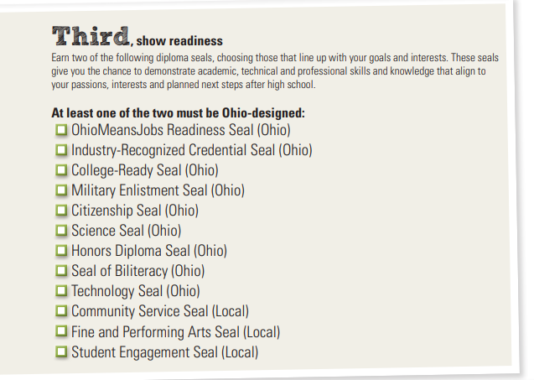
Ohio graduation requirements
Students can demonstrate readiness through Work-Based Learning.

Slide 9
Work-based learning definition
From Perkins V…
Work-based learning is defined as “sustained interactions with industry or community professionals in real workplace settings, to the extent practicable, or simulated environments at an educational institution that fosters in-depth, firsthand engagement with the tasks required in a given career field, that are aligned to curriculum and instruction.”
Work-Based Learning Overview

Slide 10
Work-based learning definition
Aligned to Graduation Requirements for the Class of 2023 and Beyond:
Supporting Demonstration of Competency in Career Experience & Technical Skill
Beginning as early as grade 9, students should accumulate 250 hours of work-based learning aligned to their program of study, or their student success or graduation plans, with evidence of positive evaluation.

Slide 11
Work-based learning definition
Work-based learning experiences must occur at work-based learning sites (Can be virtual or within school facilities).
Work-based learning experiences must be co-supervised and co-evaluated by an instructor or other educational representative and an employer or business mentor.
A learning agreement built on professional, academic and technical competencies aligned to the student’s program of study must be in place.

Slide 12
Types of work-based learning
Template Learning Agreement

Slide 13
Continuum of supervision
Internship/Work Site Placement
Remote/Virtual Placement
Simulated Work Environment
Apprenticeship/Pre-Apprenticeship
Entrepreneurship
School-Based Enterprise
Scaffolding of supervision across types allows students to develop and demonstrate work-readiness – including self-regulation, ability to follow direction, etc.
All parties should be engaged regardless of setting to allow for this development.

Slide 14
Why work-based learning?
Aligned Education
Industry Engagement
Qualified Workforce & Talent Pipeline
“The educational models for the past 40 years have operated with Business as an advisor. In this role, they could only inform learning experiences, with engagement being at the end of the student’s educational journey—hiring based on the level of educational attainment.
Industries and businesses need to shift their focus to engaging in the educational system as a solution partner. The time is now to invest in the supply side of this equation—WBL provides the most effective way to close the skills gap.”

Slide 15
Resources
Employer Guide to Work-Based Learning
Who Can Help
Learning Agreements
Senate Bill 166
Employer Income Tax Credit Certificate
Up to $5,000 credit per student
How To Design

