Slide 1
MAGNIFY INTERNSHIP PROGRAM
DISCOVER. DEVELOP. DREAM.
Businesses that participated in 2023

Slide 2
2023 Internship by the Numbers
Mid-Intern
Post-Intern
100% of students rated their internship experience as excellent
Students enjoyed:
Working with others
Gaining experience
Increasing their skill sets
95% of students rated their internship experience as excellent.
Things students learned during their internship experience:
Adaptation
Project management
Self-management
How to work with a team
Students
Student Mid-term survey results
Student post-intern survey results
95% of employers rated their internship experiences as excellent
100% of employers felt that their intern was well prepared for their internship
90% of Employers stated that they would participate again in 2024
Student Strengths:
Communication
Following directions
Dependable
Dedicated
Prioritizing tasks
Employer Mid-term survey results
Employer post-intern survey results
Employers

Slide 3
‘24 REFRESH
Plan to Recruit Employers and Students for the 2024 Internship Program. Taking the Warm Introduction approach to relationship building.
Employer Immersion
Invite businesses into schools to share Internship and employment opportunities.
Community Awareness
Culminating event for Interns and Employers participating in the Internship Program.
Recruit Students
Share the 2023 Internship results with Businesses and key stakeholders.
Help support local employers prepare to interact and hire Clark Co. students. Well-crafted talking points provided.
Go For the GOLD
Employer Roadshow
Recruit Businesses

Slide 4
Student Immersion Experience: Go For GOLD
Sink or swim session for students to prep for Internships in a real-world environment.
HOMEWORK: Prior to participating, students must complete the following: YouScience, collect transcripts, complete application and submit references.
How to Keep a Job
Communication and Interviews
Communication- how to talk to an employer.
Interviews- best practices, good and bad examples, practice interviews.
How to Manage your Life
Time management, general hygiene, finances
Local Bank to do finance portion of the session.
Money Management game
OPENING
SESSION 1
SESSION 2
SESSION 3
WRAP-UP
Opening Session
Icebreaker game- Olympic scavenger hunt
Based on YouScience
Use this game to find their cohort.
Set expectations for the day.
How to get a Job
Resume, Written Communication (social media), Dress for Success
Fashion show (show different industries)
Closing Session
Survey- QR code
Drawing for winner
Certificate of completion
LUNCH: YouScience Overview and Alumni Intern sharing their success story.
To simulate a professional conference, Vendors will be invited to set up booths at the immersion session. Potential vendors included, but not limited to: ODJFS/OMJ, Clark State, Clothes That Work, Springfield Foundation, Rocking Horse, Park National Bank, Partners In Prevention, Springfield Fire Dept & Police Dept., among other organizations to be invited at a later date.
Notes:
Student Requirements:
Complete YouScience before training day
Transcripts
Application
References
Timeline:
8:00 Arrival
8:10-8:30 Open Session
8:30-9:45 Session 1
15-minute break
10:00-11:15 Session 2
15-minute break
11:30-12:45 Lunch
15-minute break
1:00-2:15 session 3
15-minute break
2:30-3:00 Closing Session
Possible Session Leaders
Session 1: Bank Representation,
Session 2: Clothes the Work, Kara (Imperial Express)
Session 3: Jen, ?
Available to help:
Kaitlyn Tyler
Amy Donahoe
Raphael Allen
Location: Brinkman Building?
Workshop Needs:
Workbook
Community resources added.
Notebook and Pens

Slide 5
There is a better way to bridge education and industry
Notes:
We know that waiting to get in front of talent once they graduate college is way too late.
Don’t you wish you were in front of today’s talent three years ago?
Let’s see how we are working to bridge the gap between education and workforce.

Slide 6
Benefits of Business and Industry Engagement

Slide 7
Benefits for students
BUSINESS & INDUSTRY ENGAGEMENT
Makes learning more enjoyable and interesting
Increases motivation to do well at school
Doing better in exams
Make better career decisions
Increase aspirations
Become more employable, getting access to better opportunities
Going into better paying jobs
Enhances social mobility

Slide 8
Benefits for employers
[PHOTO OR VISUAL]
BUSINESS & INDUSTRY ENGAGEMENT
Employee morale, giving back to the community
Employee development, giving workers at all levels the company opportunities for leadership development
Favorable community relations, brand recognition

Slide 9
Introducing a better path forward with YouScience® Employer Spotlight
Find emerging talent with aptitudes suited to your industry.
Tap into a talent pipeline that is local and prepared.
Create an effective and efficient recruiting ecosystem.
Advance diversity, equity and inclusion in hiring practices.
Utilize industry-recognized skill certifications.
Build relationships with local schools and communities.
Fill internship, apprenticeship, and entry level openings.
Strengthen your local community and economy.
Notes:
YouScience offers multiple avenues to reach your target audience.
Connecting with talent early helps solve a lot of common workforce issues we are seeing in today’s climate.
Finding candidates with aptitudes in your industry is critical.
Identifying candidates who are often underrepresented allows you to target a more diversified talent pool.
Connecting with candidates who have the skills needed for your roles helps you maximize your investment in interns and apprentices.

Slide 10
How to think about YouScience:
What we are:
A proven technology that aligns students with best-fit careers
Earliest connection to students and educators
Distribution channel to reach more than 7,000 schools and millions of students
A strategic talent pipeline development solution
What we are not:
A recruiting firm like Indeed, Monster, or Handshake
Notes:
As we wrap up, let me share what we are and what we’re not.
First, we are not a recruiting company like indeed, monster, handshake, etc. Those companies fill that role well and we are not attempting to enter that space.
What we are is:
A proven technology that aligns students with best-fit careers based on aptitudes and certify industry skills
Earliest connection to students and educators – starting in middle school and through high school and beyond
Distribution channel that helps you reach more than 7,000 schools and millions of students – and growing
A strategic talent pipeline development solution for long-term success

Slide 11
YouScience offers smart solutions to activate talent pipeline development
Use aptitudes to find & engage the right students for you.
Use our platform to build a strong reputation with students and educators.
Reach students and educators when decisions are being made about careers.
Notes:
Our solution helps you build a long-term, sustainable talent pipeline. YouScience Employer Spotlight is a smart solution to activate talent pipeline development in high school college, or trade schools at the key moments that matter.
Our solution is based on three strategic pillars:
YouScience Employer Spotlight uses aptitudes to engage the right students who have the ability be successful in your business or industry.
YouScience Employer Spotlight helps you build a strong reputation with engaged students and educators earlier than any other solution.
YouScience Employer Spotlight enables you to scale your message and opportunities to more students when decisions are being made about careers without additional headcount or resources.
We are a career guidance platform that is being used in schools nationally. High Schools, tech schools, adult education programs and colleges.
Our
platform’s goal is to connect upcoming talent to local employers
How do we do this?
Users go through a series of aptitude assessments to identify their natural skills and talents. Rather than only asking candidates what they like, we help them identify their natural skills and connect those skills to real world opportunities.

Slide 12
Additional benefits
Be the champion of your industry for students and educators
Support students, schools, and disadvantaged communities
Build your social responsibility and development story
Improve long-term brand value and recognition
Notes:
We offer you:
Be the champion of your industry with students and educators.
Improve long-term brand brand association (career titles, college majors, certifications).
Support students, schools, and disadvantaged populations.
Take ownership of social responsibility, economic development, and growth narratives.

Slide 13
Connect with students during
moments that matter
Exploring personalized aptitudes
Exploring personalized career matches
Help students get certified
Introduce students to interested employers
Connect with higher education opportunities
Notes:
At each of these stages we are looking for employers to sponsor these careers, certifications, and opportunities.
The employers who are featured here will have prominent access to millions of students around the country.
You will also be seen by the educators, counselors, and parents who are influencing decisions.

Slide 14
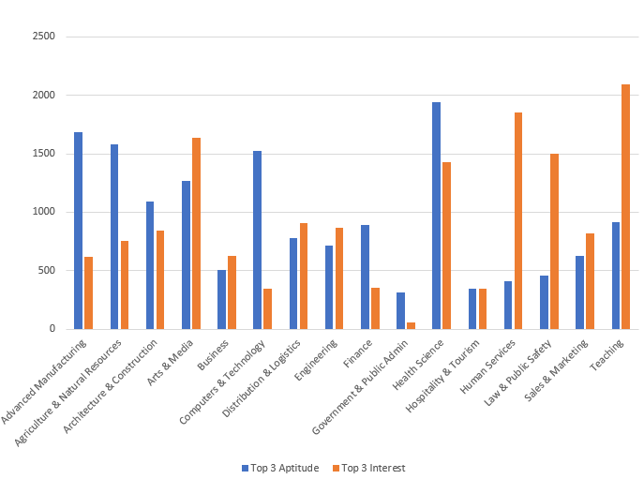
The Problem:
Awareness Gap not a Talent Gap
Notes:
This is a visual of the problem we are helping to solve!
Our goal is to bring awareness to candidates of careers in industries they may not have known they were a fit for or even existed.
For example, when you think of ___(Industry)______________, you may not think of ___(JOB)_________ as a possible career or job. Our system brings awareness to those with the aptitudes, or talents, to all the opportunities ___(Industry)______________ offers.
Does this slide surprise you at all?

Slide 15
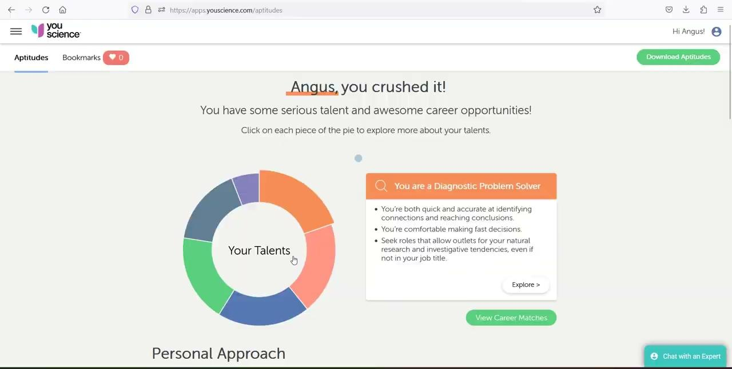
Moment that matters 1.0
Exploring their personalized aptitudes
Notes:
This is what the students see after they take their aptitude and career discovery assessment.
The students can explore the aptitude wheel to see what superpowers they have, how they contribute as a team member, and more.
Lastly, students are directed by their counselors, teachers, or parents to view career matches. These career matches are built on the most recent data available from the U.S. government and suggestions are made to students using Artificial Intelligence built into the system.

Slide 16
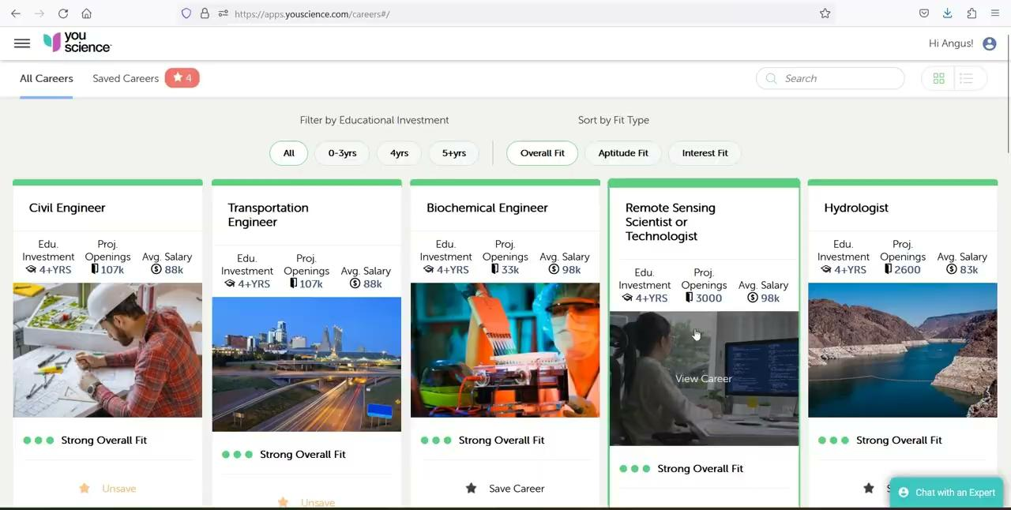
Moment that matters 2.0
Exploring personalized career matches
Notes:
Based on the students’ aptitudes they will see an assortment of career cards that they can explore. Again, these are the careers that best match their aptitudes and therefore are the careers that will come easiest to them.
As students choose a career to explore, they are presented with a variety of information that helps them see and learn about this career.
They see:
A day in the life
Fit for this career for both aptitudes and interests
How they can get this career
What schooling is required
Salary ranges and availability of jobs

Slide 17
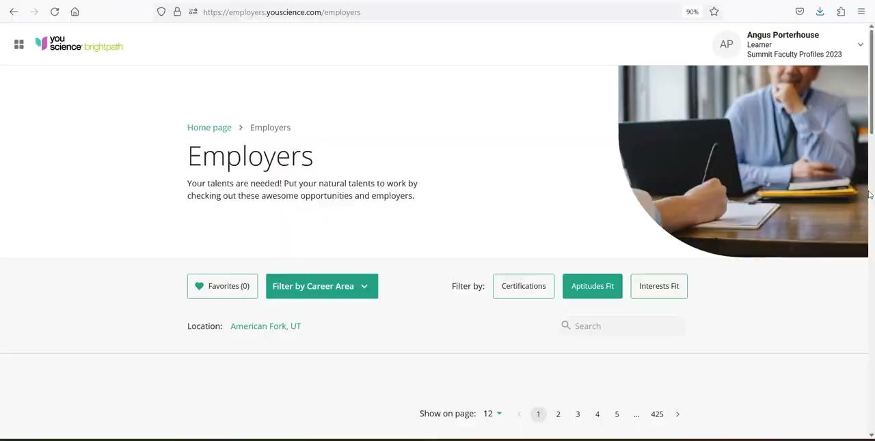
Moment that matters 4.0
Introduce students to interested employers
Notes:
Employers are featured prominently for students.
Employers can populate this information with career areas of interest, jobs, internships, or career information.

Slide 18
For more information…..
https://www.youscience.com/employers/

Slide 19
Thank You!
Kaitlyn Tyler
Talent and Education Coordinator
Greater Springfield Partnership
ktyler@greaterspringfield.com

