Slide 1
Opportunities for Business Partners
Partners in Developing Workforce
Cassie Barlow
cassie.barlow@soche.org
Nov 2023

Slide 2
"The worldwide competition of overall national strength is actually a competition for talents, especially for innovative talent."
China's President - Hu Jintao

Slide 3
SOCHE Overview
Non-profit founded in 1967 SOCHE, focused on engaging with colleges, universities, K-12, and industries to transform the economy through education and employment.
Annually, employs hundreds of interns (High School through Postdoctoral) in businesses of all types to include government agencies.

Slide 4
College and University Partners
Air Force Institute of Technology
Antioch College
Antioch University Midwest
Bowling Green State University
Case Western Reserve University
Cedarville University
Central State University
Cincinnati State Technical and Community College
Clark State Community College
Cleveland State University
Edison State Community College
Franklin University
Kent State University
Kettering College
Kettering Foundation
Miami University
Miami University Regionals
Northeastern Ohio Medical University
Ohio University
Shawnee State University
Sinclair Community College
Southern State Community College
The Ohio State University
University of Akron
Union Institute & University
University of Cincinnati
University of Dayton
University of Toledo
Wilberforce University
Wilmington College
Wittenberg University
Wright State University
Youngstown State University
SOCHE member institutions are in bold.

Slide 5
K-12 and Industry Partners
Dayton Public Schools
Fairborn Public Schools
Beavercreek Public Schools
Springboro Public Schools
Brookville Public Schools
Vandalia Butler Public Schools
Dayton Region STEM School
Centerville Public Schools
Greater Ohio Virtual School
CTC (Greene, Montgomery, etc)
Edison State Community College
Franklin University
Kettering Public Schools
Carroll, CJ, Alter, Lasalle, Moeller
Lebanon Public Schools
Etc….
Technology First
Dayton Region Manufacturers Assoc.
Associated Construction & Builders
Greater Dayton Area Hospital Assoc
Dayton Area Logistics Association
CareSource
Dayton Childrens
Dysinger
Kettering Health
Alluring Glass
Mr. Label Company
APDC Companies (200+)
Etc

Slide 6
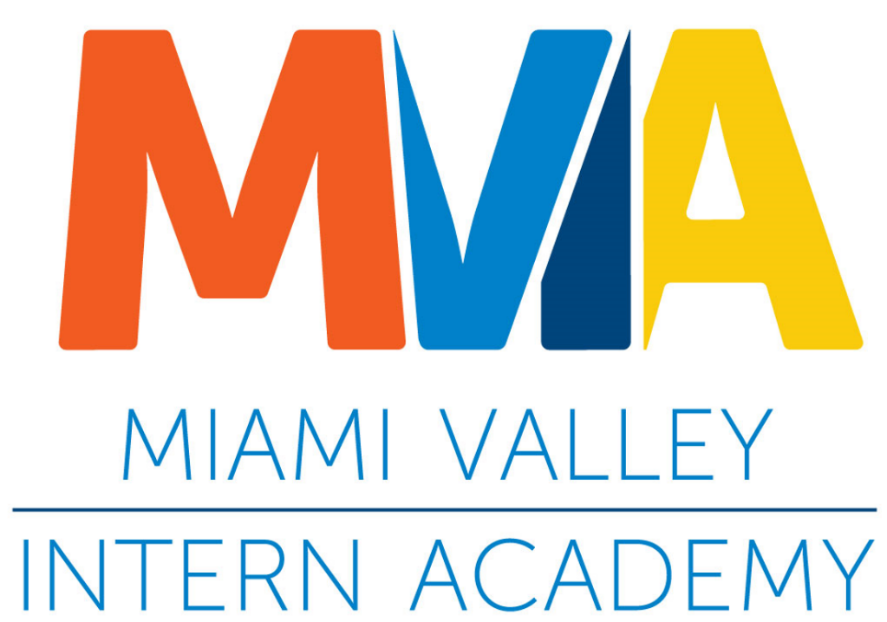
SOCHE Portfolio
Professional Development
Workforce Development
Vision:
An educated, employed, and engaged citizenry
High School
+
College Students
=
Tomorrow’s Workforce
Cross Registration
Councils & Committees

Slide 7
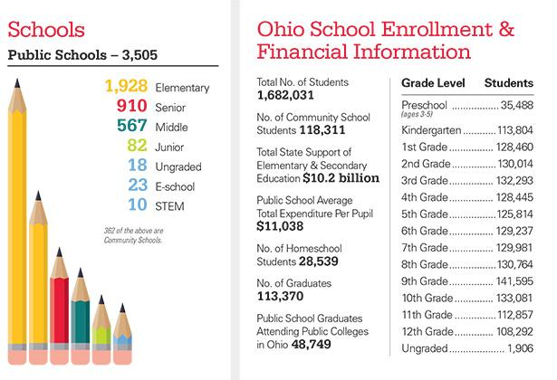
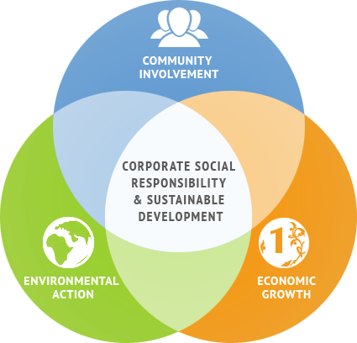
The Pipeline -- The Reality -- The Opportunity
~220,000 Juniors & Seniors in Ohio are in the pipeline every year
~43% elect College path
~57% enter Career path (~65,000 enroll in On-the-Job-Training….)
~400K College students in our State

Slide 8
Why Hire Interns – Practice says….
Reduce Brain Drain
85% of Ohio High School Seniors stay in Ohio for College (US is at 81%)
69% of Ohio’s College Graduates stay in Ohio
Which college grads stay in Ohio?
61% of Engineers
63% of Scientists
71% of Business Professionals
Demand/Competition for Talent
Fuel Ohio’s In-Demand Jobs
Ohio needs world-class talent to attract/retain companies
https://www.ohiohighered.org/sites/default/files/hei/sp18_grads_0.pdf

Slide 9
Why Hire Interns – Research says…..
Cream of the Crop - 67% of college grads are offered full-time positions after their internship.
Find Future Employees - Year-round recruiting tool and ongoing pipeline.
Better Retention - Interns have significantly greater retention rates after five years when compared to outside hires. (52% vs 35%).
Test Drive - The best way to evaluate a potential employee is through an internship.
Inspire Your Best Thinkers - Interns bring fresh ideas and can work with or free time for your best employees to explore new territory.
Source: National Association of Colleges and Employers (NACE)

Slide 12
Example SOCHEIntern Employment Partners
Wright-Patterson Air Force Base (STEM)
Air Force Research Laboratory (AFRL)
Air Force Institute of Technology (AFIT)
Regional Partners (STEM and Non-STEM)
Montgomery County Environmental Services
City of Dayton Water Department
City of Dayton Aviation
Dysinger Inc.
Wright Brothers Institute
CDO Technologies
Pole Zero
CareSource
PQ Systems
Dayton Children's Hospital
State Farm
KBR
Chapel Electric
And many more…………

Slide 13
Partnering with SOCHE is easy
Step 1: (Form Partnership)
SOCHE and Business agree to work together to provide a student with an internship opportunity
Step 2: (Define Internship)
SOCHE works with Business to:
Prepare Business for hosting a high school or college student
Develop job description
Define work conditions
Step 3: (Find Talent)
SOCHE works with School to:
Ensure skill expectations are realistic
Find qualified candidates for Business to interview
Coordinate hired student’s class schedule
Step 4: (Manage Employment Cycle)
SOCHE manages onboarding, orientation, hiring, payroll actions, taxes, and insurance
SOCHE invoices business monthly for the hours the intern works
Business focuses on providing intern meaningful work and guidance
School focuses on developing student through coursework
Student continues internship and employment opportunities through SOCHEIntern and DAGSI programming and no transfer fees to convert to business payroll

Slide 14
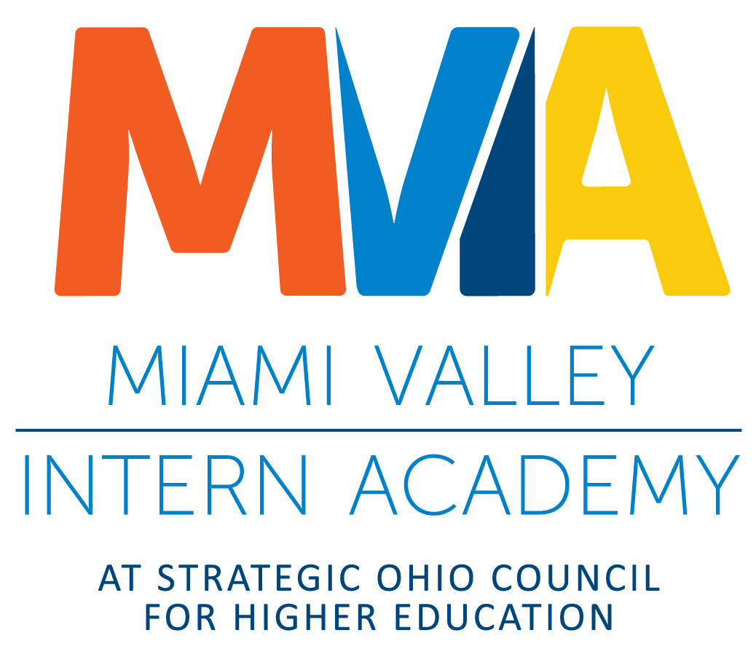
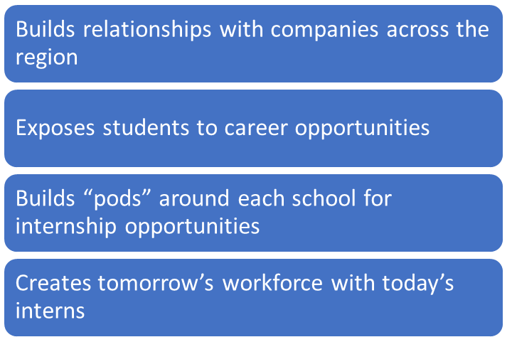
Financial Support for Companies who Hire High School Interns
Supplement’s student’s salary by at least 50% and up to 100%
Grants made possible:
Engineering & Science Foundation of Dayton
Ohio College Tech Prep
ODE
DOE
Notes:
In demand nonservice industries. Great option for your CCP students and they keep internship after graduation while going to college FT

Slide 15
Questions?

